Slide 1
Archives Live: Windrush 75
What can documents reveal about the experiences of people from the Windrush generation?
Notes:
This resource is designed to prepare children to take part in Archives Live: Windrush 75.

Slide 2
What do you think we keep in The National Archives?
Notes:
Teachers notes: Ask students to discuss what is kept in The National Archives.
The National Archives is home to millions of historical documents, stretching back about 1000 years. Students might use language like ‘records’, ‘treasure’, ‘sources’ or ‘evidence.’ A document is anything that contains information from the past.
The National Archives looks after documents for the government of England and Wales.
You could ask students to think/discuss what types of documents may be kept.
Mostly The National Archives has written documents. This includes one of the oldest documents- the iconic Domesday book, a survey of much of England ordered by William the Conqueror. However there are also lots of other types of documents, including photographs, maps and more recently tweets from 10 Downing street! (Next slide shows some different types)

Slide 3
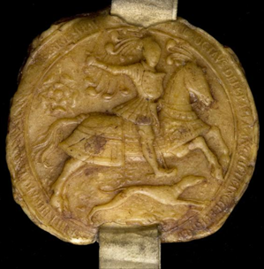
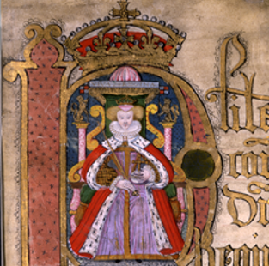
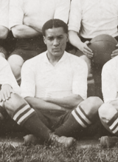
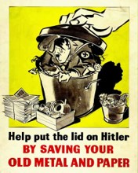
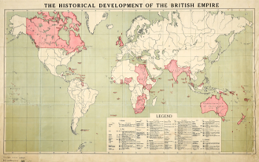
Documents
Letters
Objects
Drawings
Photographs
Posters
Maps
Notes:
To show some of the different types of documents held at The National Archives.

Slide 4
Notes:
You could get children to guess how many boxes of documents there are in The National Archives. Clues are we have 8 repositories or safe rooms to keep the documents in. These rooms can be as big as the size of two football pitches!
There are around 12 million boxes of documents kept at The National Archives.
Documents are kept in fireproof and waterproof boxes.

Slide 5
Mystery document
Discuss
What can you see?
What type of document is it?
When was it made?
Notes:
Mystery Document
Get students to discuss the questions.
Ideas for feedback discussion
Consider clothing the people in the image are wearing. Children might describe the clothing as smart and for cold weather.
There is luggage visible, children can infer that they are going on a journey of some kind.
Children might comment on the expressions on people’s faces. Mostly they seem happy and smiling, although the boy looks uncertain. The girl is the only person looking at the camera.
Although the family are the focus of the image there are many people visible in the background. Many are wearing hats and are dressed quite formally.
Type of document, if children say ‘picture’- you can clarify what type of picture, a photograph. This captures a snapsnot in time. You could discuss the ‘third’ person in the image, the photographer.
Get children to consider when this was taken/made. Their clothing might help give a clue and the fact it is in black and white.
Other questions to ask as follow up- where was this taken?

Slide 6
Mystery document
This is a photograph.
You can see a family, the father is carrying a small child. They have arrived in England from Jamaica, in the Caribbean.
This photograph was taken in about 1950.
Notes:
Description of the image:
A Jamaican family, with the father carrying a small child, on their arrival in England, location unknown, around 1950.

Slide 7
Arrival of Empire Windrush ship
In June 1948, 75 years ago, a ship called ‘Empire Windrush’ arrived at Tilbury dock in Essex, Britain. People disembarked on 22 June 1948.
There were over 1000 people on board and most gave their last address as being in the Caribbean. There were men, women and children on board.
This was not the first time that people from the Caribbean had migrated to Britain. However it has become the most famous ship that sailed from the Caribbean after the Second World War.
Some of the countries in the Caribbean were British colonies at this time, meaning that lots of the people on board had British citizenship.
People who came to settle in Britain from the Caribbean countries between 1948 and 1971 became known as the Windrush generation.
Notes:
You might also want to play this clip which interviews Caribbean arrivals (from 49 seconds):
The SS Empire Windrush - YouTube-
However it is important to state that news clips present the arrival of Empire Windrush in a particular way, usually giving the impression that arrivals were welcomed warmly. You could discuss with students what viewpoints/perspectives might be missing from this news clip.
At The National Archives there are documents (which will be explored in the live event) that show the negative response from some people in government to the arrival of people from the Caribbean. This was in contrast to attitudes towards white migrants from British Colonies. Arrivals from the Caribbean were viewed differently because of the colour of their skin.
Children will be learning more about the story of the Empire Windrush ship and the Windrush generation in the live event. There are more notes about the context of the Windrush story in the ‘teacher notes’ section of the resource pack.

Slide 8
Arrival of Empire Windrush ship
Activity
Match the key terms with their meanings.
Challenge
Find the places on the map that the Empire Windrush ship stopped.
Clue: they are listed on your key terms sheet.
Notes:
Key terms matching activity
Give students the key terms matching activity. They can do this individually or in pairs. This activity is designed to help with understanding key parts of the story of Empire Windrush and the Windrush generation.
Answers: 1D, 2E, 3G, 4A, 5H, 6B, 7F, 8C
Map of the Caribbean and Central America
Hand out the map of the Caribbean and Central America (p. 12). Get children to find the places that the ‘Empire Windrush’ ship stopped at on the map. These places are listed in the key term definition for ‘Empire Windrush’. There are some places listed that it did not stop at.
As an extension, you could ask them to think about how long the journey might have taken in 1948 to Britain. (It took about 22 days.) Also, they could begin to consider what the journey might have been like.

Slide 9
Baroness Floella Benjamin
Floella Benjamin arrived to England in 1960 aged 10 with her brothers and sisters.
Watch this short film to learn more about her story and achievements.
Notes:
Baroness Floella Benjamin
Students watch this short film introducing Baroness Floella Benjamin.
Get children to discuss three interesting things they found out about Floella’s life with another student.

Slide 10
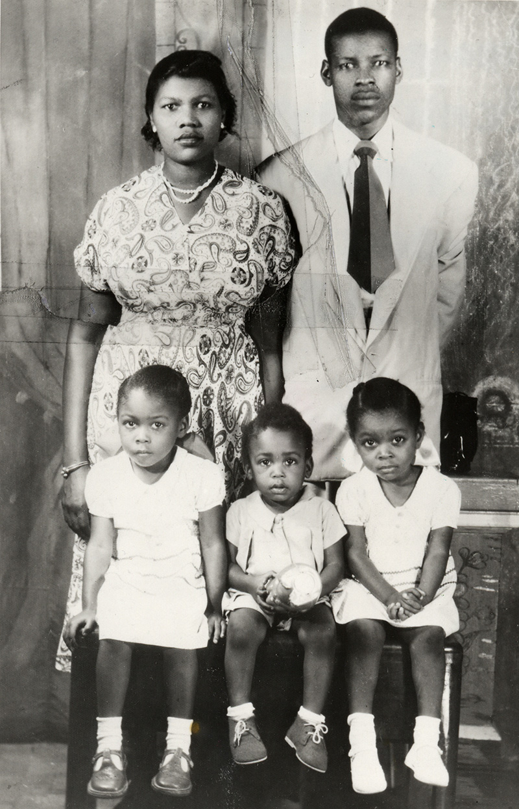
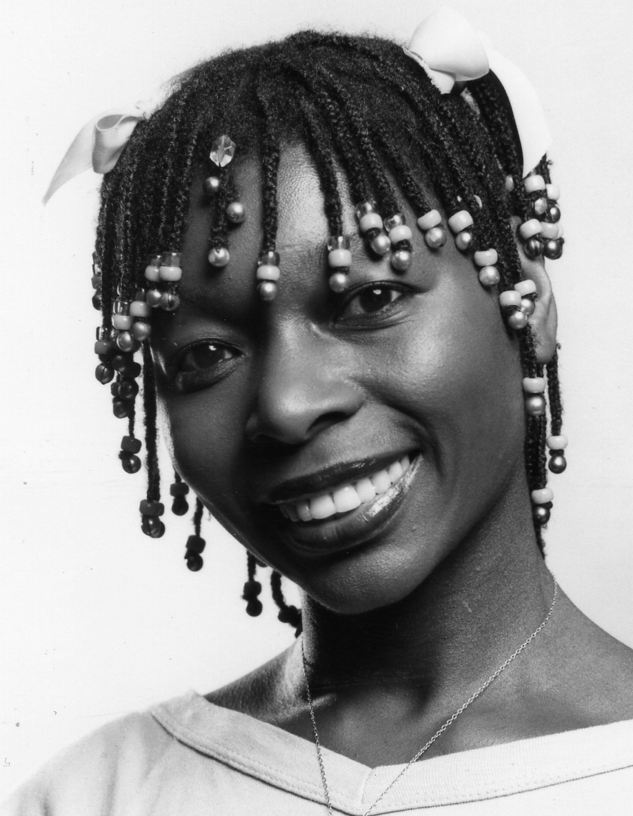
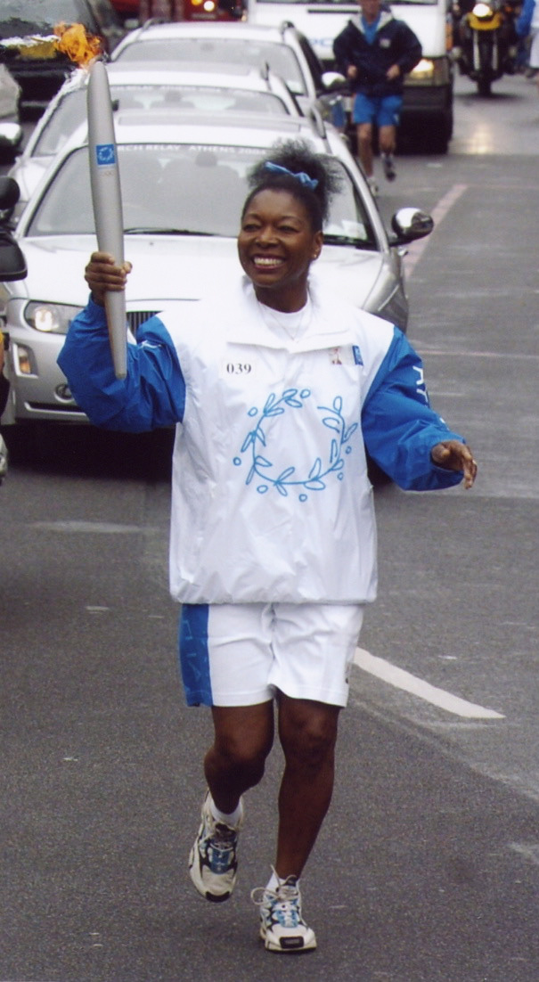
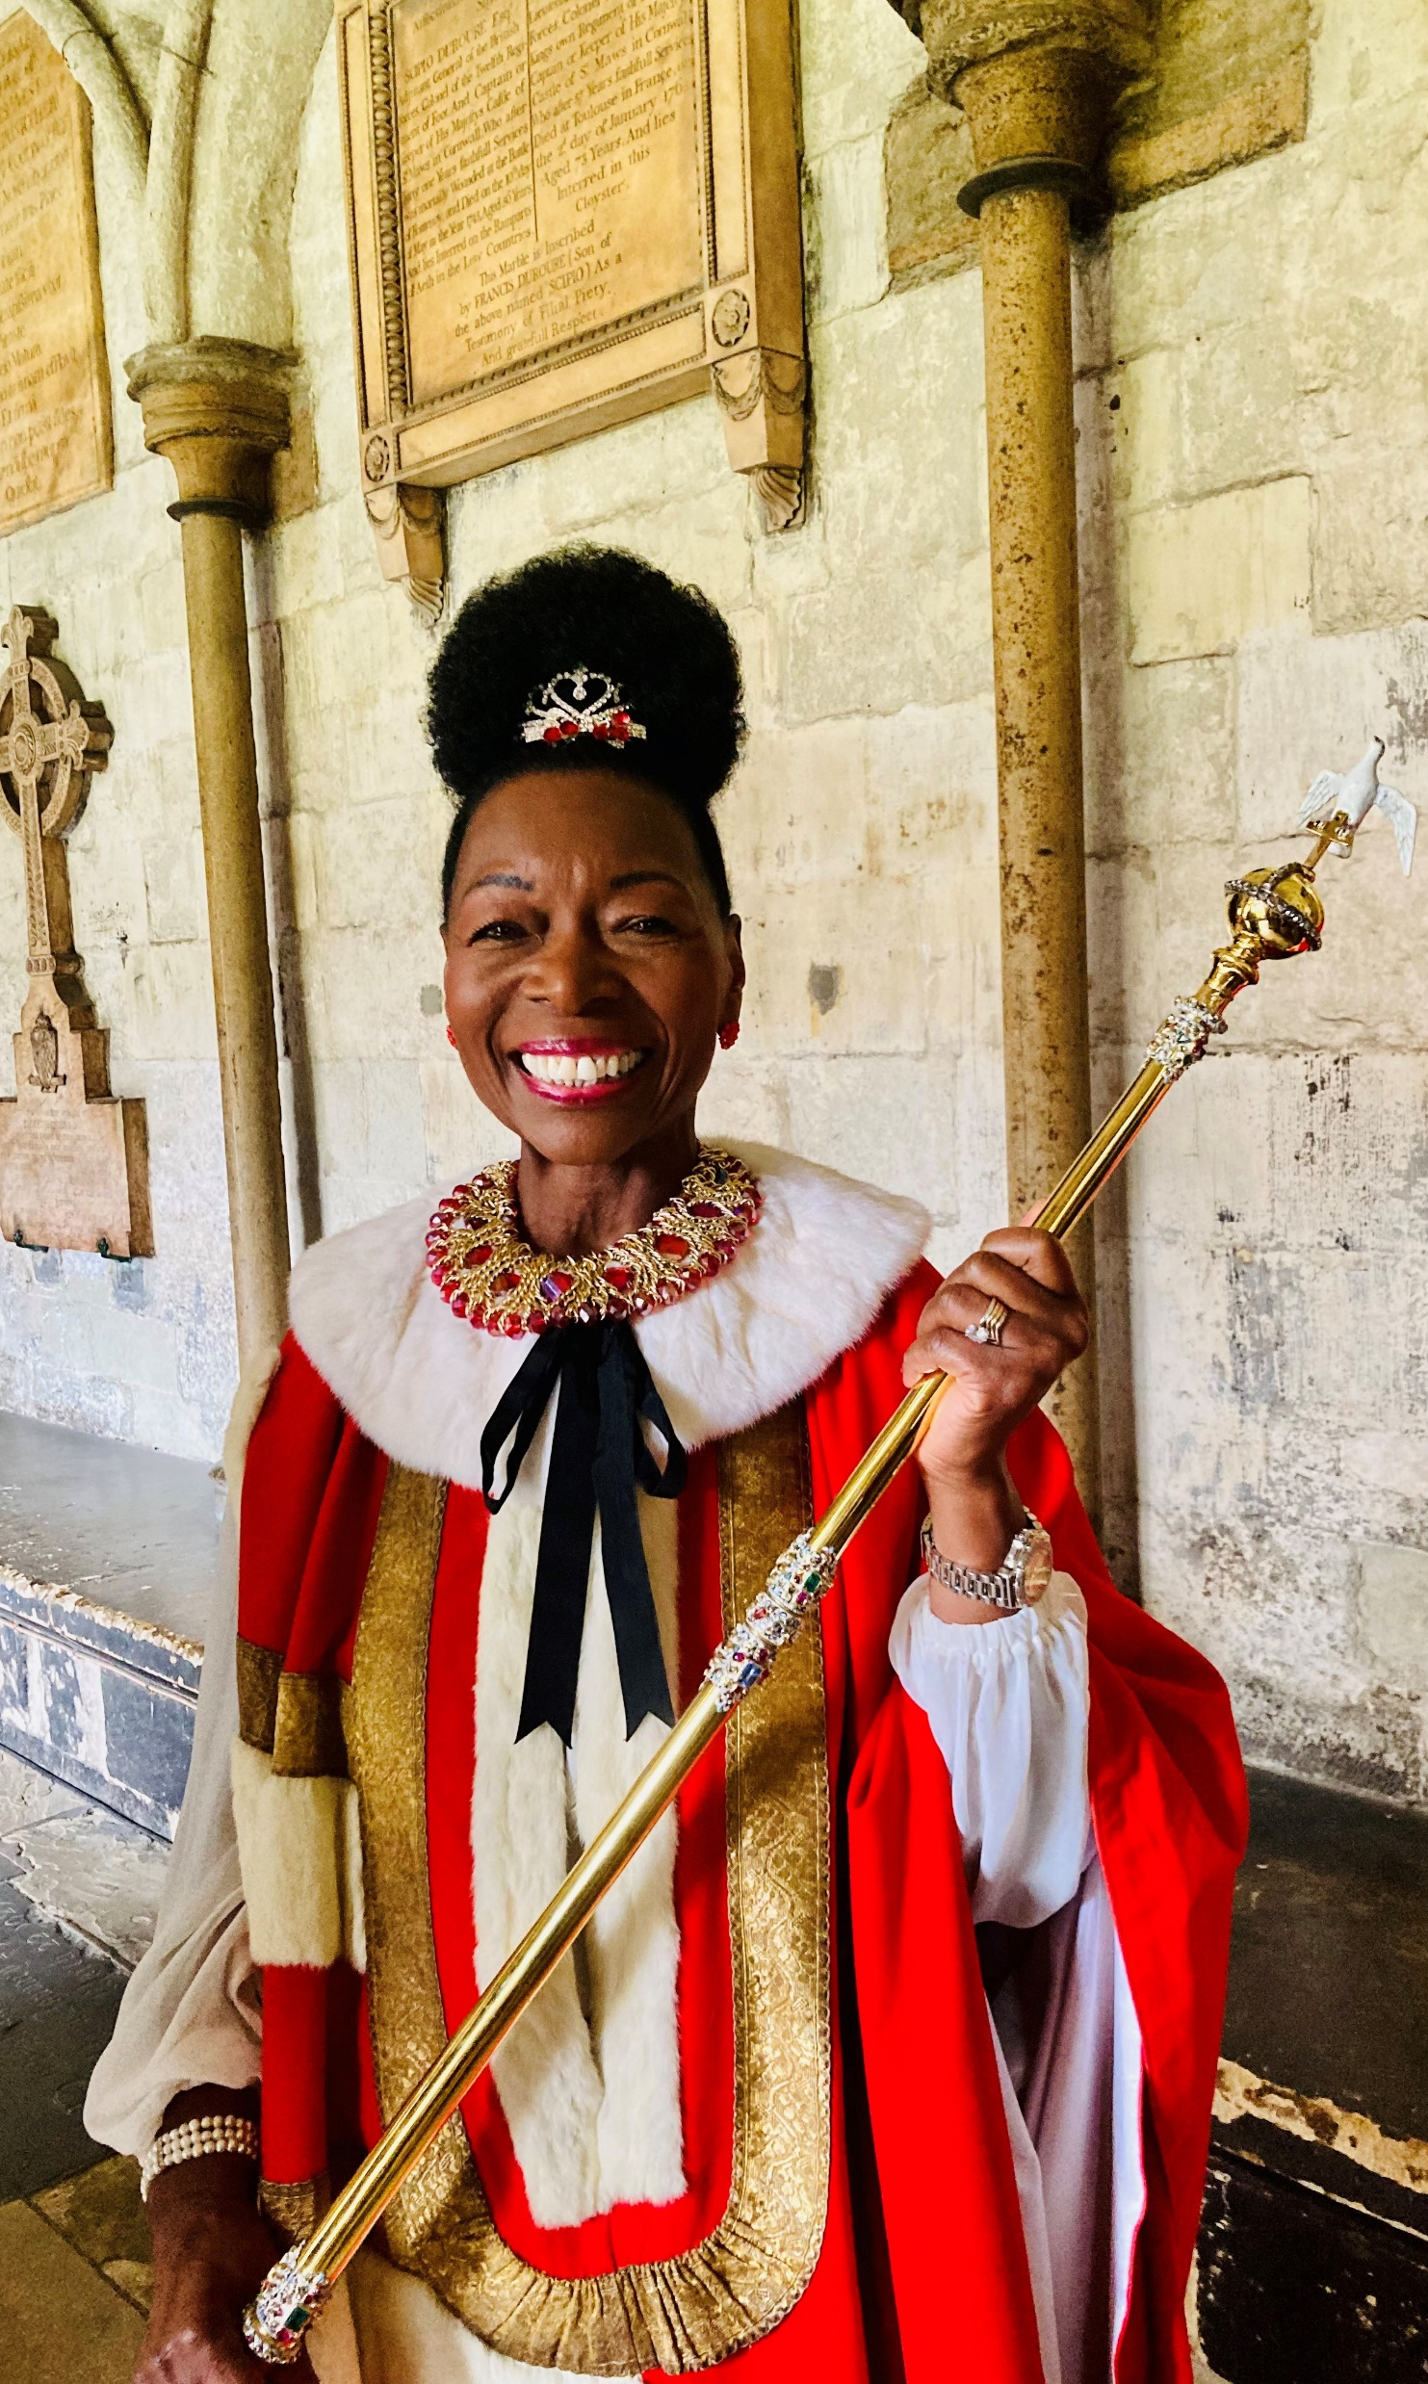
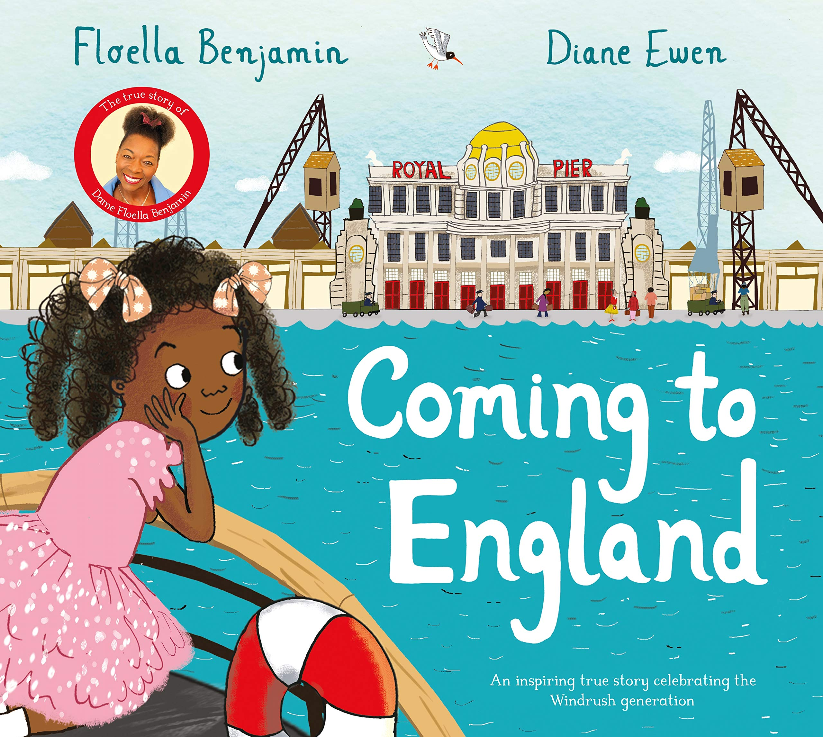
What do these pictures tell you about Floella Benjamin?
1
2
4
5
3
Notes:
Either show on the PPT or hand out the image collage of Floella Benjamin. Each image reveals something different about her life. Get students to discuss what they show about her. They might be able to make links to the video.
Feedback
An image taken of Floella Benjamin as a child. She is sitting on the far right. Pictured are her siblings, mother and father. This was taken before her father left Trinidad for Britain.
Floella Benjamin pictured with her hair in beads during her time as a children’s presenter of the programme ‘Play School.’ She was the first person on television to wear beads in her hair.
Image of the front cover of Floella’s book for children called ‘Coming to England.’ There are different versions for younger and older children. The book tells her story of arriving in England on board a ship with her siblings, who travelled alone.
Photograph of Baroness Floella Benjamin carrying the Olympic torch through Peckham in London in 2004. The Olympics were held in Athens, Greece.
Photograph taken on May 6th, 2023, showing Floella Benjamin carrying the sceptre as part of her special role in the coronation ceremony of King Charles III. Floella Benjamin became a member of the House of Lords in 2010 and is wearing her red robes.

Slide 11
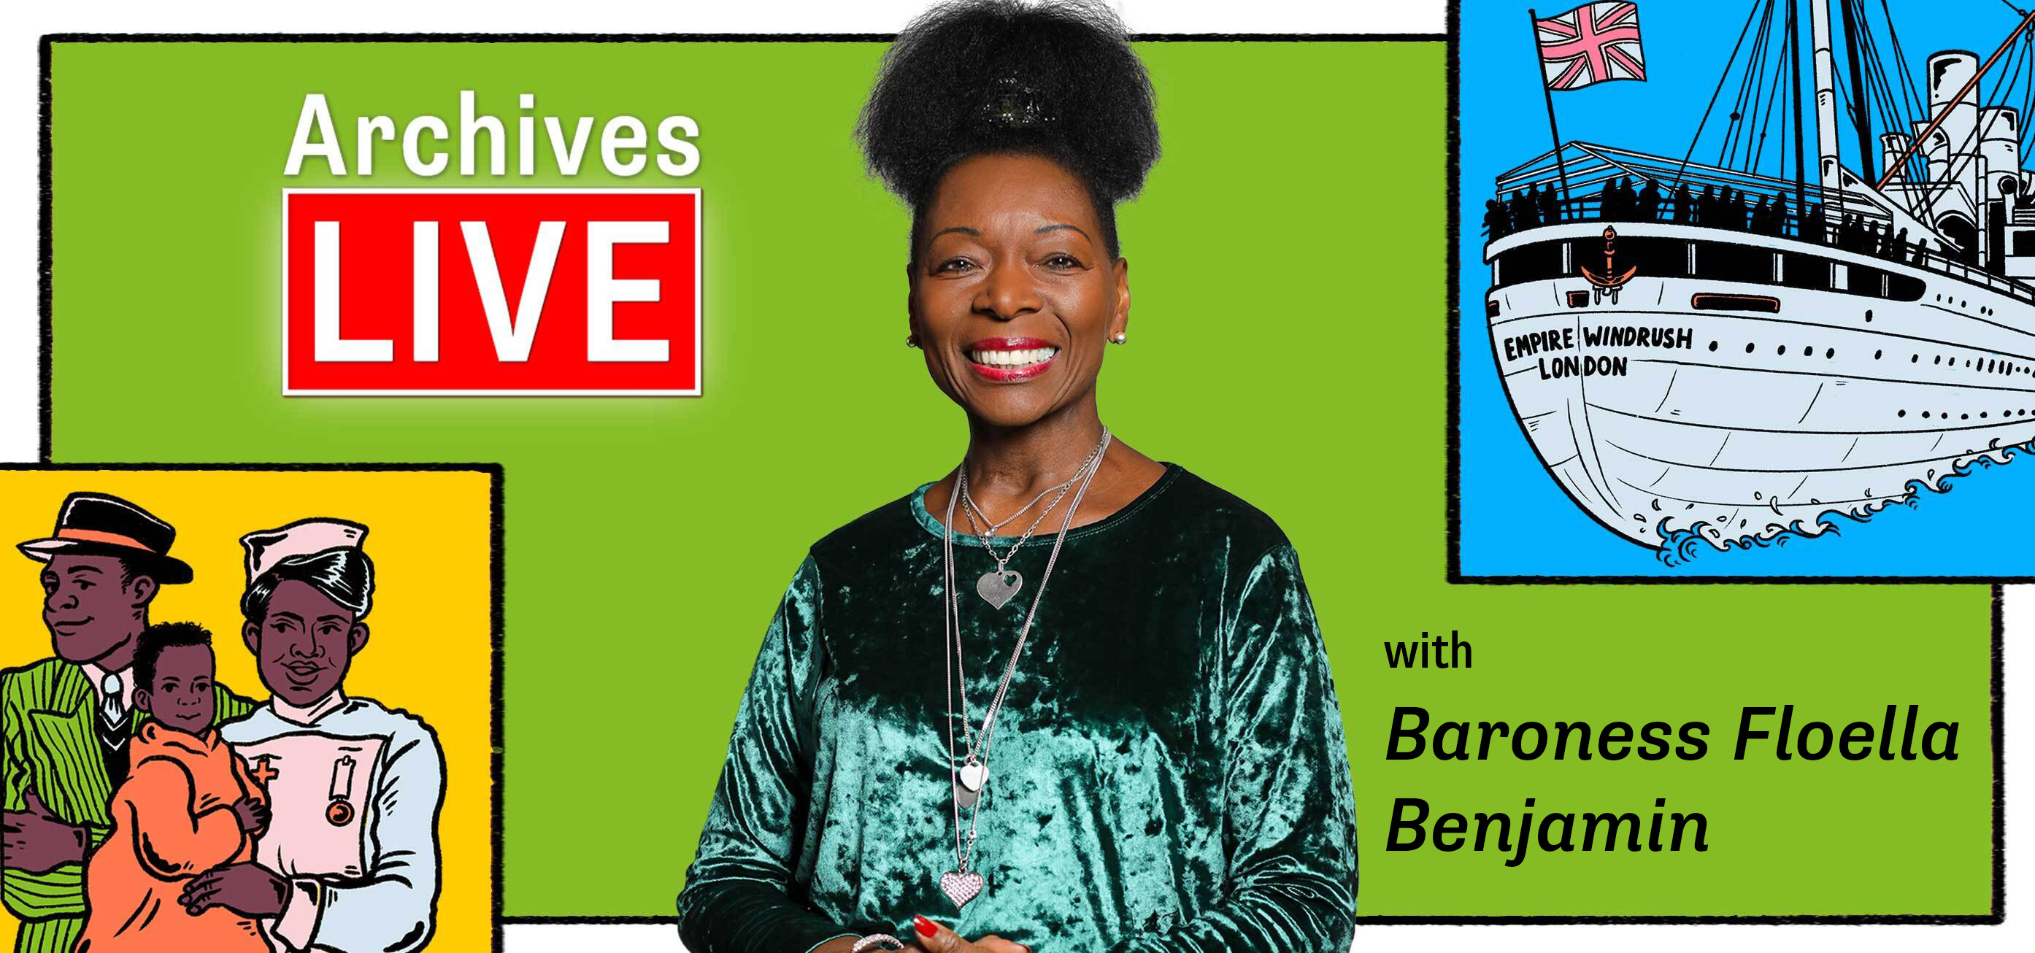
On Monday 19th June Baroness Floella Benjamin is going to be speaking to you live from the archives. You will be learning more about a very important document, which is personal to her.

Slide 12
Preparations for the event
What question would you like to ask Floella Benjamin?
Does your family have a story of migration? How do you know this story?
Why do you think it is important to mark the 75th anniversary of Empire Windrush arriving to Britain?
Notes:
These are discussion points to get children to prepare for the live event.
Preparations for the event
Children should think of questions they would like to ask Baroness Floella Benjamin. You might want to decide on one for the whole class. You will be able to submit questions during the live event.
Ask children whether they have a migration story in their family. You can get them to think about how they know this story. E.g through written documents like passports, or through stories passed down from relatives, or their own experiences.
Ask children why they think it is important to mark the 75th anniversary of Empire Windrush arriving to Britain. We will get schools to share their ideas about this at the end of the event
There is a suggested creative activity for after the event in the preparation pack.

