Slide 1
72 Hours to the Belfast (Good Friday) Agreement

Slide 2
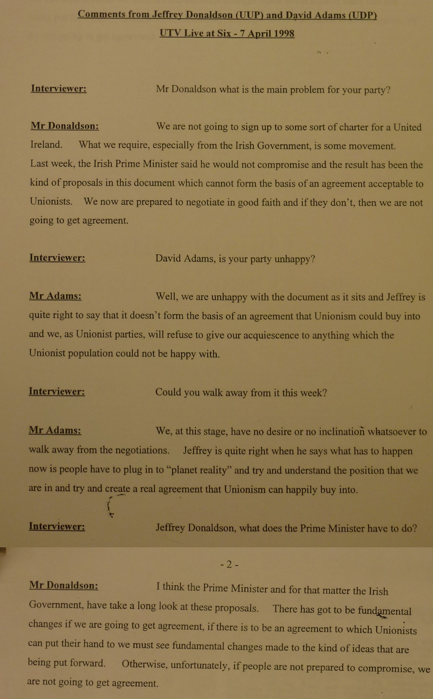
Starter Activity
Mystery date
????
Can you guess the date of this document?
7 June 1996
7 October 1997
7 February 1998
7 April 1998
Notes:
NAI Catalogue Ref: DFA_2021_53_15 p1 and p2
Be careful not to reveal the date – answer on slide 4

Slide 3
Starter Activity
Mystery date
????
Read the document in front of you and answer the following questions (remember that the Belfast (Good Friday) Agreement was signed on 10 April 1998):
What do you think ths document is?
Are Jeffrey Donaldson and David Adams Nationalists or Unionists?
Do they seem satisfied or dissatisfied with the peace talks so far?
From their point of view, does it seem like an agreement is near or far away?
Notes:
NAI Catalogue Ref: DFA_2021_53_15 p1 and p2
Be careful not to reveal the date – answer on slide 4

Slide 4
Starter document description
This document is from the National Archives of Ireland.
It is a transcript of an interview from a TV news programme in Northern Ireland, Live at Six, with two Unionist politicians.
They both express unhappiness with the proposals for an Agreement, with Donaldson describing them as ‘some sort of charter for a United Ireland’.
The document’s date is 7 April 1998, just three days before the Agreement was actually signed.
What might this suggest about the final days of negotiation leading up to the Agreement?
Notes:
NAI Catalogue Ref: DFA_2021_53_15 p1 and p2

Slide 5
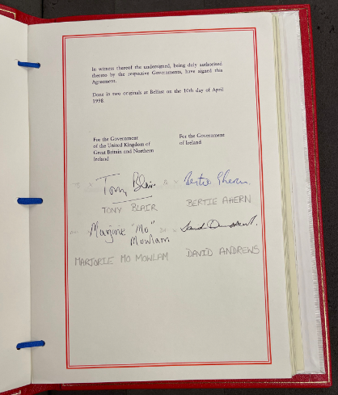
The Road to Peace
How was peace achieved in the final 72 hours of negotiations?
Notes:
TNA Catalogue Ref: FO 93/171/33

Slide 6
By the end of the session, you will:
know what barriers still stood in the way of an agreement, 7–10 April 1998
understand how the Belfast (Good Friday) Agreement was finally achieved
be able to use contemporary documents to deepen your understanding
Notes:
TNA Catalogue Ref: FO 93/171/33

Slide 7
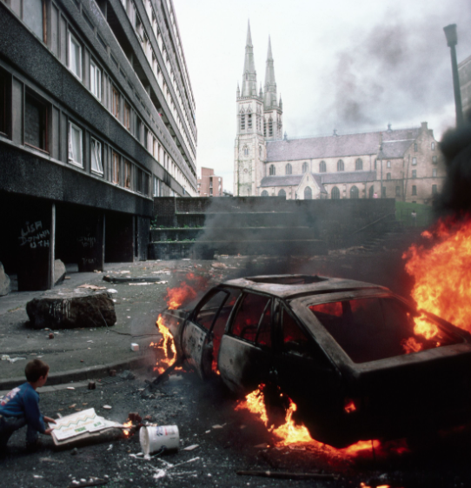
In your lessons on 1996 and 1997, you learned about the key barriers to peace, such as:
violent actions by paramilitary groups
the absence of political parties from the negotiating table as a result
historical mistrust
the strong personalities and deep convictions of the people involved
mistrust by both unionists and nationalists of each other and of the UK and Irish governments
Notes:
Getty Images – 635240049

Slide 8
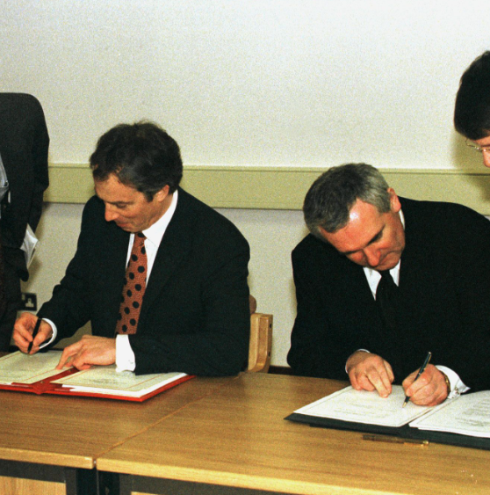
In today’s session
However, as the Starter Activity demonstrated, there were still doubts about whether an agreement would be reached just days before it was finally signed by all parties.
In today’s session, you will examine the final 72 hours of negotiations to find out how and when the Belfast (Good Friday) Agreement was finally reached.
Notes:
Reuters Images- RTRD2XQ

Slide 9
Some key events, October 1997 – April 1998
7 Oct 97
New round of talks opened in Stormont, Belfast. The DUP were not present.
6 Nov 97
Some Republicans, unhappy with Sinn Féin’s involvement in the peace process, set up splinter groups, the Continuity IRA and the Real IRA.
3 Jan 98
Crisis hit when prisoners from Loyalist paramilitaries being held in the Maze prison voted to withdraw their support for the peace process.
Jan – March 98
Series of bombings and shootings by Loyalist and Republican splinter groups who rejected the peace process.
26 Jan 98
UDP expelled from peace talks after the UFF (who were associated with the UDP) were found to have been involved in the killing of three Catholics.
25 March 98
After almost two years of talks, Senator George Mitchell (Chairman), set a deadline of 9 April for an agreement to be reached.
Oct 1997 | Nov 1997 | Dec 1997 | Jan 1998 | Feb 1998 | March 1998 | April 1998
20 Oct 97
The UUP walked out of the talks at the refusal of the Irish government to change Articles 2 & 3 of the Irish Constitution, which extended a claim to Northern Ireland.
11 Dec 97
First talks between a UK PM and leaders of Sinn Féin in 76 years.
9 Jan 98
Mo Mowlam went into the Maze Prison to meet with the Loyalist paramilitary prisoners. Her visit was harshly criticised. However, the prisoners’ support for the peace process was regained.
20 Feb 98
SF excluded from peace talks for 17 days because of allegations that the IRA were involved in two killings in Belfast.
6 April 98
Late in the evening, Chairman George Mitchell, presented a draft settlement paper to the parties involved …
Oct – Dec 97
6 murders by paramilitary groups in this period.
Jan – April 98
18 murders by paramilitary groups in this period.
Notes:
All information from CAIN
There are numerous terms on this timeline (e.g. people and acronyms) which will require explanation (see useful list in teachers’ notes document.)

Slide 10
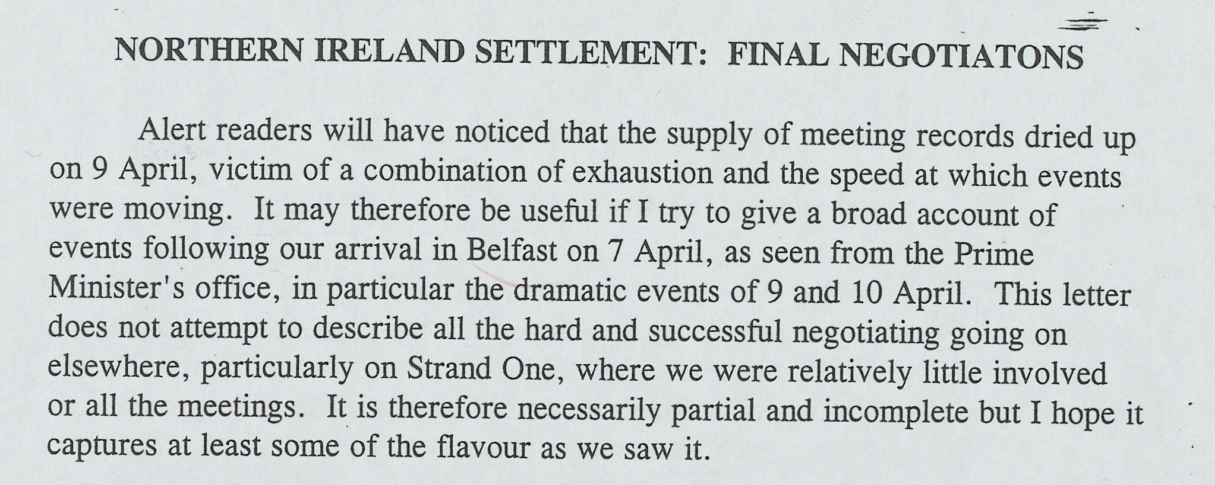
Main activity:
How was the Belfast (Good Friday) Agreement reached in April 1998?
You are going to use a number of extracts from a report written by a senior official to the UK Prime Minister, Tony Blair.
The report, written on 13 April, lays out his account of the final days of negotiation before the Agreement was signed on 10 April.
Notes:
TNA Catalogue Ref: PREM 49/412

Slide 11
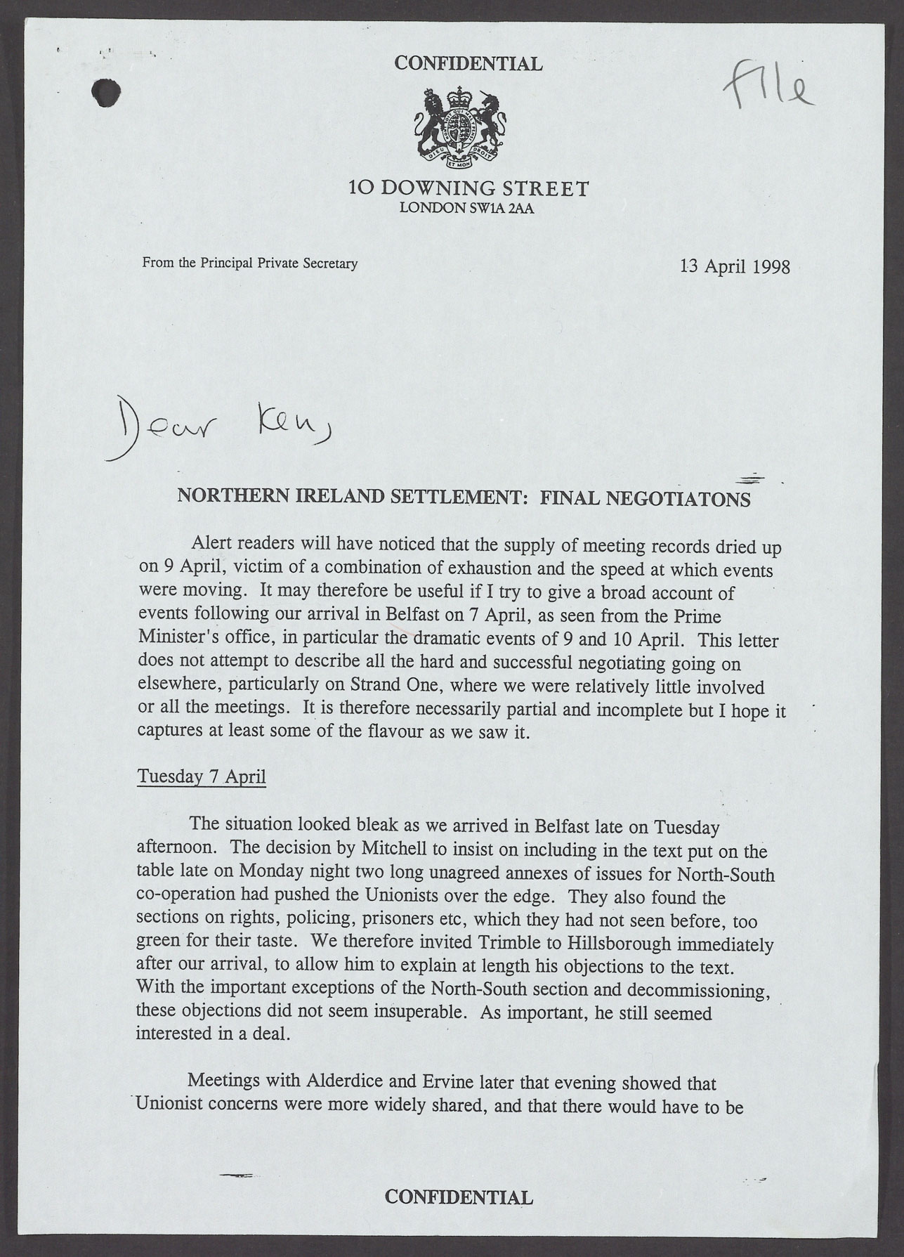
Task instructions
For each extract you examine, you need to:
Find any evidence that the talks are going well or that agreement is close
Find any evidence that there are still challenges or that agreement seems far away
Plot the extract on your graph to show how far away you think agreement was at that point
Use the notes at the bottom of each document extract to help you make sense of the extract.
Notes:
TNA Catalogue Ref: PREM 49/412

Slide 12
Graph
Agreement achieved
Agreement seems unlikely
1 | 2 | 3 | 4 | 5 | 6 | 7 | 8 | 9 | 10 | 11 | 12 | 13 | 14 | 15 | 16 | 17 | 18 | 19 | 20
Tues 7th | Weds 8th April | Thurs 9th April | Fri 10th April

Slide 13
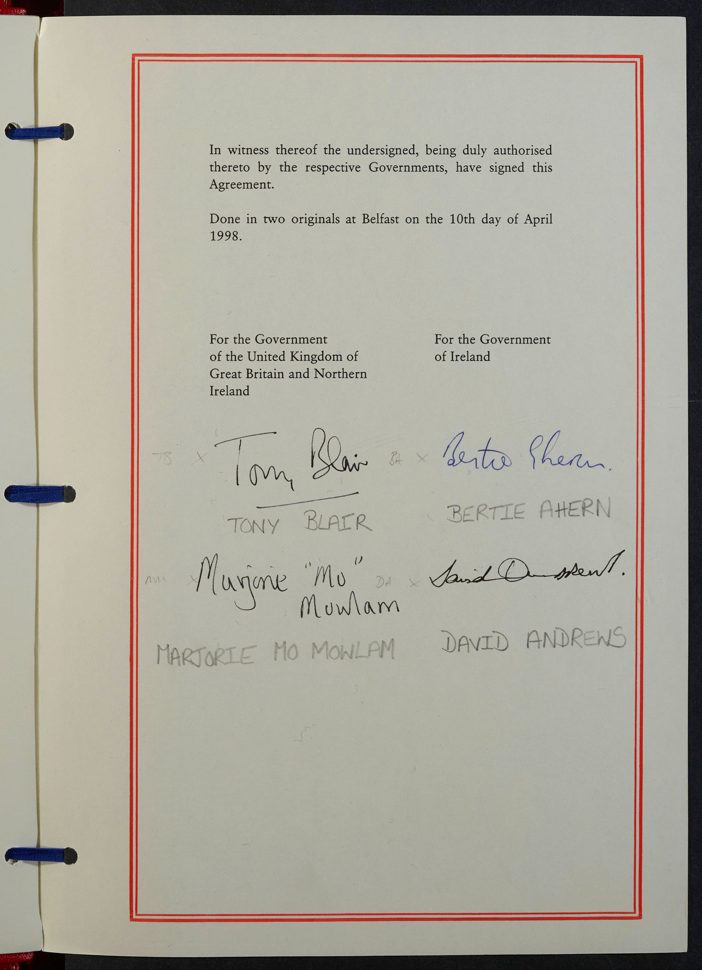
Review 1 - How was the Belfast (Good Friday) Agreement reached in April 1998?
Look back over your graph. How would you describe the final 72 hours of negotiation? Choose from the following or write your own:
‘A roller-coaster of a nightmare’ (as John Holmes described it in the final extract)
Tidying up loose ends and making minor, last-minute adjustments
Tough negotiation on important points but reaching an Agreement was never in danger.
Be ready to support your decision.
Notes:
TNA Catalogue Ref: FO 93/171/33

Slide 14
Review 2 - How was the Belfast (Good Friday) Agreement reached in April 1998?
List what you consider to be three important reasons why agreement was finally reached on 10 April.
You may want to consider the following:
The role played by individual politicians (British, Irish, Northern Irish, American)
Personal relationships and meetings
The willingness to compromise and make concessions
The pressure of a tight deadline
The peace which was at stake
Notes:
TNA Catalogue Ref: FO 93/171/33

