Slide 1
Archives Live: D-Day
What can documents reveal about the experiences of people who participated in D-Day?
Notes:
This resource is designed to prepare children to take part in Archives Live: D-Day.

Slide 2
What do you think we keep in The National Archives?
Notes:
Teacher’s notes:
Ask students to discuss what is kept in The National Archives.
The National Archives is home to millions of historical documents, stretching back about 1000 years. Students might use language like ‘records’, ‘treasure’, ‘sources’ or ‘evidence.’ A document is anything that contains information from the past. The National Archives looks after documents for the government of England and Wales.
You could ask students to think/discuss what types of documents may be kept at the archives?
Mostly, The National Archives has written documents. This includes one of the oldest documents- the iconic Domesday book, a survey of much of England ordered by William the Conqueror. However there are also lots of other types of documents, including photographs, maps and more recently tweets from 10 Downing street! (Next slide shows some different types)

Slide 3
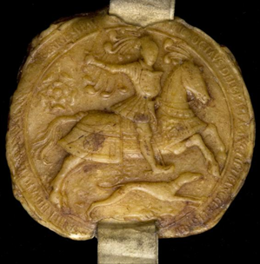
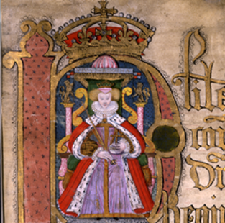
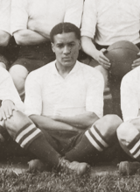
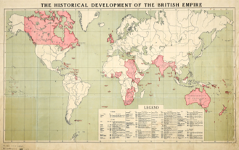
Documents
Objects
Drawings
Letters
Photographs
Posters
Maps
Notes:
To show some of the different types of documents held at The National Archives.

Slide 4
Notes:
You could get children to guess how many boxes of documents there are in The National Archives. Clues: we have 8 repositories (or safe rooms) to keep the documents in. These rooms can be as big as the size of two football pitches!
There are around 12 million boxes of documents kept at The National Archives.
Documents are kept in fireproof and waterproof boxes.

Slide 5
Mystery Document
Discuss:
What can you see?
What type of document is it?
When was it made?
Notes:
Mystery Document - Get students to discuss the questions.
Ideas for feedback and discussion:
Consider the scene, where the people might be. It looks like they are on a beach, either on the sand or in the sea.
The weather looks sunny and bright because sunhats are being worn, indicating it might be summertime or somewhere warm.
Students might comment on the activities the people are doing, such as playing in the sand or sitting and relaxing. Mostly they seem happy.
There are many people visible in the background, as well as buildings and beach huts.
Type of document: if children say ‘picture’- you can clarify what type of picture, a photograph. This captures a snapshot in time. You could discuss the ‘third’ person in the image, the photographer.
Get children to consider when this was taken/made. Their clothing/beachwear might help give a clue and the fact it is in black and white.
Other question to ask as follow up: what do you think this document has got to do with D-Day?

Slide 6
Mystery Document
This is a photograph.
You can see people on beaches in Normandy, France. Families and friends are together, enjoying the sand and sea.
As early as 1942, the BBC launched an appeal for the general public to submit their holiday photographs.
Millions of photos ended up being sent in. It was a way of gathering intelligence on the best landing beaches for D-Day.
The beach ‘Luc-sur-Mer’ would go on to be codenamed ‘Sword’ beach on D-Day.
Notes:
Description of the image:
Families on a beach in Normandy, France, c. 1930s-1940s. The beach ‘Luc-sur-Mer’ would go on to be codenamed ‘Sword’ Beach on D-Day.
Millions of photos ended up being sent to the War Office and, with the help of the French Resistance and air reconnaissance, military bosses were able to target the best landing spots for D-Day.

Slide 7
Sword Beach
Notes:
This slide can be used to show that the beach in the photograph (Luc-sur-Mer) was to become the location of codenamed ‘Sword’ Beach, used as one of the five beaches for D-Day landings.

Slide 8
Location
Notes:
Location of D-Day: Map of the south of England and the north coast of France
Hand out the map showing the south coast of England and the north coast of France. Ask students to find the five beaches where the Normandy landings took place. These places are listed as part of the key term matching activity.
As an extension, you could ask students to think about how long the journey might have taken from the coast of England to the coast of France, and the different ways in which the troops may have travelled there (by boat but there were also airborne divisions). Also, they could begin to consider what the journey might have been like.

Slide 9
D-Day: Context
D-Day was the largest seaborne invasion ever assembled.
On 6th June 1944, 156,000 Allied troops landed by sea and air on five beachheads in Normandy, France.
Their focus was on five beaches, codenamed Gold, Juno, Omaha, Sword and Utah.
It was the start of Allied operations which would ultimately liberate Western Europe, defeat Nazi Germany and end the Second World War in Europe.
The ‘D’ in D-Day does not stand for anything. It comes from the word ‘Day’, and ‘D-Day’ means the day on which a military operation begins. The term ‘D-Day’ has been used for many operations, but it is most well-known for the Allied landings in Normandy, France on 6th June 1944.
Notes:
By 1944 Germany occupied large parts of Europe. The Russians had been doing most of the fighting against Germany in the East and wanted the USA and Great Britain to launch an invasion in the West, to ease the pressure on them. Opening a second front would mean that Germany would have to divide their army, making for fewer troops in each place. The USA and Great Britain agreed this was necessary and in 1943 they came up with a complicated plan called Operation Overlord.
This involved landing thousands of soldiers on five beaches in Normandy, in northwestern France. From there they hoped that their forces could push into France and drive out the German army.
It was the largest seaborne invasion ever assembled. Soldiers from all over the world participated. The countries included, USA, Britain, Canada, Belgium, Norway, Poland, Luxembourg, Greece, Czechoslovakia, New Zealand, Australia and 177 French commandos.
On 6th June 1944, 156,115 Allied troops landed by sea and air on five beachheads in Normandy, France. The five beaches were codenamed Gold, Juno, Omaha, Sword and Utah. It was the start of Allied operations which would ultimately liberate Western Europe, defeat Nazi Germany and end the Second World War in Europe.

Slide 10
Discussion Questions
During the live event, we will examine the involvement of three individuals in different parts of Operation Overlord/D-Day.
Discuss the following questions with your partner/group:
1. What do you think the Allies did in preparation for Operation Overlord?
2. How do you think the Allies ensured the location of the invasion was kept a secret?
3. What difficulties do you think the Allies faced on D-Day?
If you are unsure on the answers, use the next few slides to find out more.
Notes:
Ideas for feedback and discussion:
1. Finding a suitable location/recruitment and training of soldiers/paratroopers. Planning which weapons to use and where. Checking the level of mines/barricades used on each beach.
2. Using spies/fake information spreading.
3. There were different roles during the invasion and the difficulties faced included treatment of injuries and facing strong defences on the beaches.
Could then read through the information slides on each section. More information is in the teacher resource pack.

Slide 11
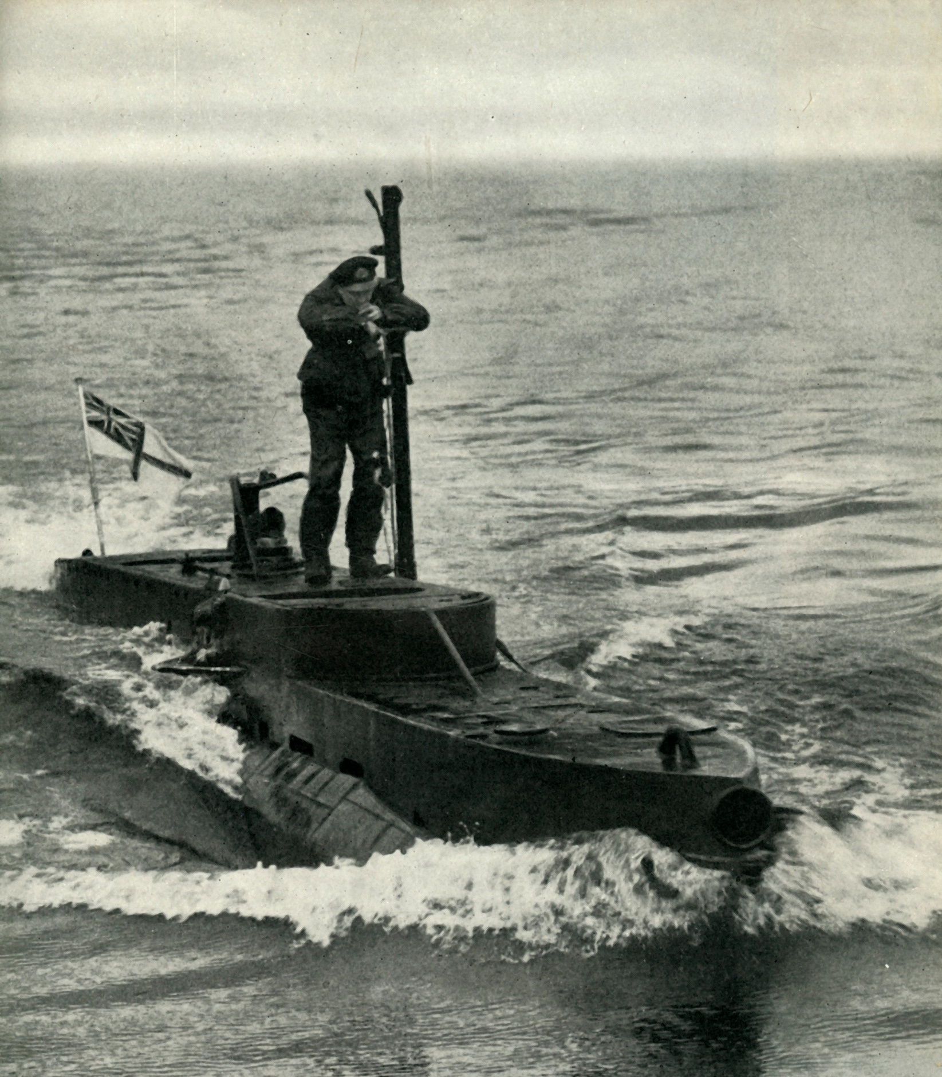
Planning Operation Overlord
The careful planning for D-Day involved reconnaissance of the French coast using tiny submarines known as X-Craft.
Soldiers secretly swam ashore tasked with taking samples of the sand on the proposed landing beaches.
This was to ensure the beaches were suitable for landing craft.
Notes:
Planning had to be meticulous and needed to avoid the same mistakes as previous attempted invasions, such as the disastrous failed assault on Dieppe in 1942.
The careful planning involved reconnaissance of the French coast and included using mini submarines known as X-Craft. Soldiers also secretly swam ashore tasked with taking samples of the sand on the proposed landing beaches. This was to make sure the beaches could handle the weight of the tanks, trucks and other vehicles that would take part in the invasion.

Slide 12
Deception
The Allies used various tactics to trick the Germans into thinking the landings would happen elsewhere.
They used their vast spy network in Occupied France. Many of these individuals acted as Double Agents.
They helped divert the German army’s attention by spreading false information about possible invasion points.
Notes:
The Germans knew that the Allies would plan an attack, but they believed it would concentrate on Calais, France. Calais was the closest French port to England. The Allies used various tactics to trick the Germans into thinking the landings would happen at Calais. They utilised their vast spy network in Occupied France. Many of these individuals acted as double agents. They helped divert the German army’s attention by spreading false information about possible invasion points.

Slide 13
Invasion
On 5th June, a huge fleet of landing craft, ships, and naval vessels headed for France. That night, thousands of men were dropped by parachute into the landing zones.
Early on the morning of 6th June the fleet of ships arrived at the Normandy coast and the first soldiers landed. The Americans faced strong defences on one of their beaches and took longer than they had planned to move off the beach.
By the end of the day, though, all five beaches were in the hands of the Allies.
Notes:
On 5th June a fleet of 3,000 landing craft, 2,500 other ships, and 500 naval vessels began to leave ports in England headed for France. That night thousands of men were dropped by parachute into the landing zone. Their task was to capture important towns, roads, and bridges in Normandy so that the soldiers from the beaches could make their way inland.
On the morning of 6th June the fleet of ships arrived at the Normandy coast. The landing craft were boats that could carry soldiers and tanks. These ships could land on the beaches, drop off their soldiers and tanks, and then return to the larger ships to bring back more men.
The five beaches chosen as the sites of the landings were spread along a 30 mile (48km) stretch of coastline. British soldiers landed on Gold and Sword Beach, Canadian soldiers landed on Juno and the American soldiers landed on Omaha and Utah beaches.
Before the first soldiers landed on the beaches, Allied ships and planes fired at German forts. They hoped to destroy them, but some of the forts were so well built that the Germans were protected and were able to attack the Allies.
On the British beaches the soldiers made good progress, they pushed inland. The Americans faced strong defences on one of their beaches and took longer than they had planned to move off the beach. However, by the end of the day all five beaches were in the hands of the Allies.

Slide 14
Aftermath
The D-Day landings came at a high cost. More than 200,000 Allied soldiers had been killed or wounded by the end of Operation Overlord.
There were insufficient numbers of medical staff to deal with the level of casualties. Those who were present, witnessed terrible scenes and tried desperately to save as many of the injured as they could.
The war continued for another year, but D-Day was the beginning of the end for Nazi Germany. It is considered one of the most successful operations in military history.
Notes:
The D-Day landings came at a high cost. More than 200,000 Allied soldiers had been killed or wounded by the end of Operation Overlord. The Germans suffered a similar number of casualties. There were insufficient numbers of medical staff to deal with the level of casualties. Those who were present, witnessed terrible scenes and tried desperately to save as many of the injured as they could.
As the battle raged on and the Allies moved inland towards Paris, many French civilians were also killed during bombing raids and battles. Although the war would continue for another year, D-Day was the beginning of the end for Nazi Germany. It is considered one of the most successful operations in military history.

Slide 15
Key terms matching activity
Activity
Match the key terms with their meanings.
Challenge
Can you link any of the key terms together? How are they linked?
Notes:
Key terms matching activity:
Give students the key terms matching activity. They can do this individually or in pairs. This activity is designed to help with understanding key terms relating to D-Day operations.
Answers: 1F, 2E, 3B, 4G, 5H, 6C, 7A, 8D

Slide 16
Major Logan Scott-Boden
Major Logan Scott-Boden was part of the heroic effort to plan Operation Overlord.
Before D-Day, Logan secretly swam ashore to the French coast from mini submarines called X-craft to collect samples of sand.
His job was to make sure the beaches could handle the weight of the tanks, trucks and other vehicles that would take part in the invasion.
Notes:
Students read this brief information about Major Logan Scott-Boden.
Students can discuss the interesting things they found out about Logan’s involvement in D-Day with another student and begin to consider questions they might want to ask his son – who will be present for the event – relating to his father’s involvement in D-Day.

Slide 17
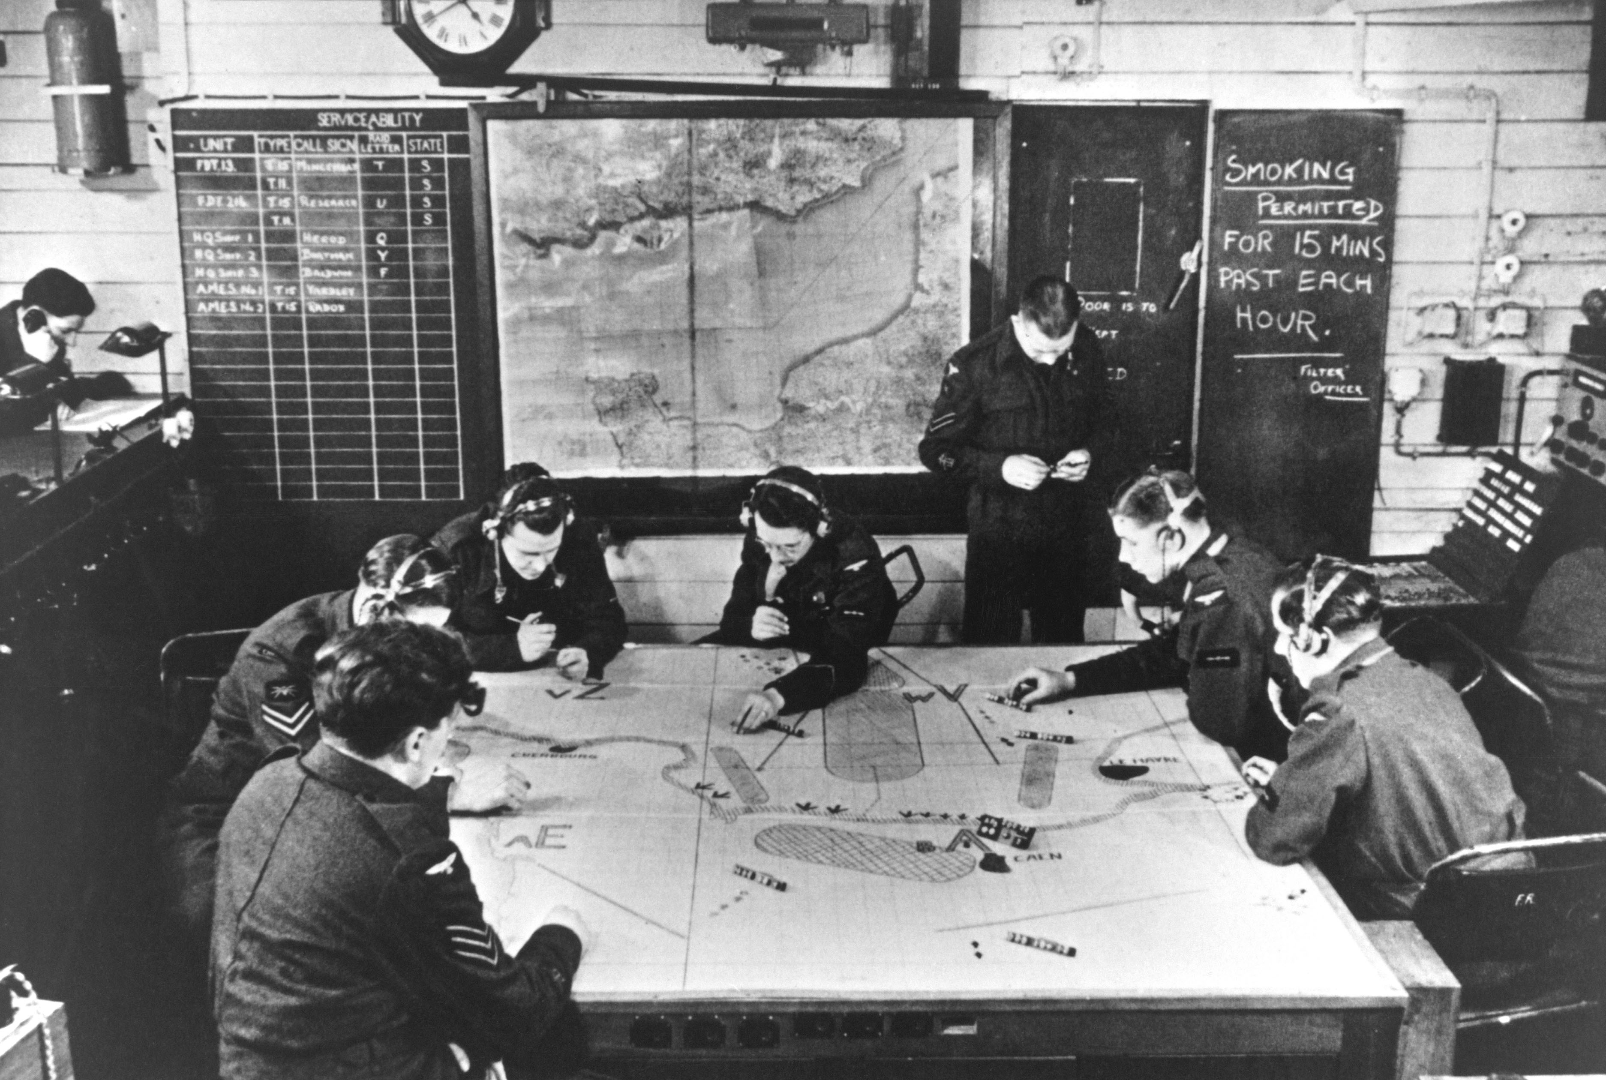
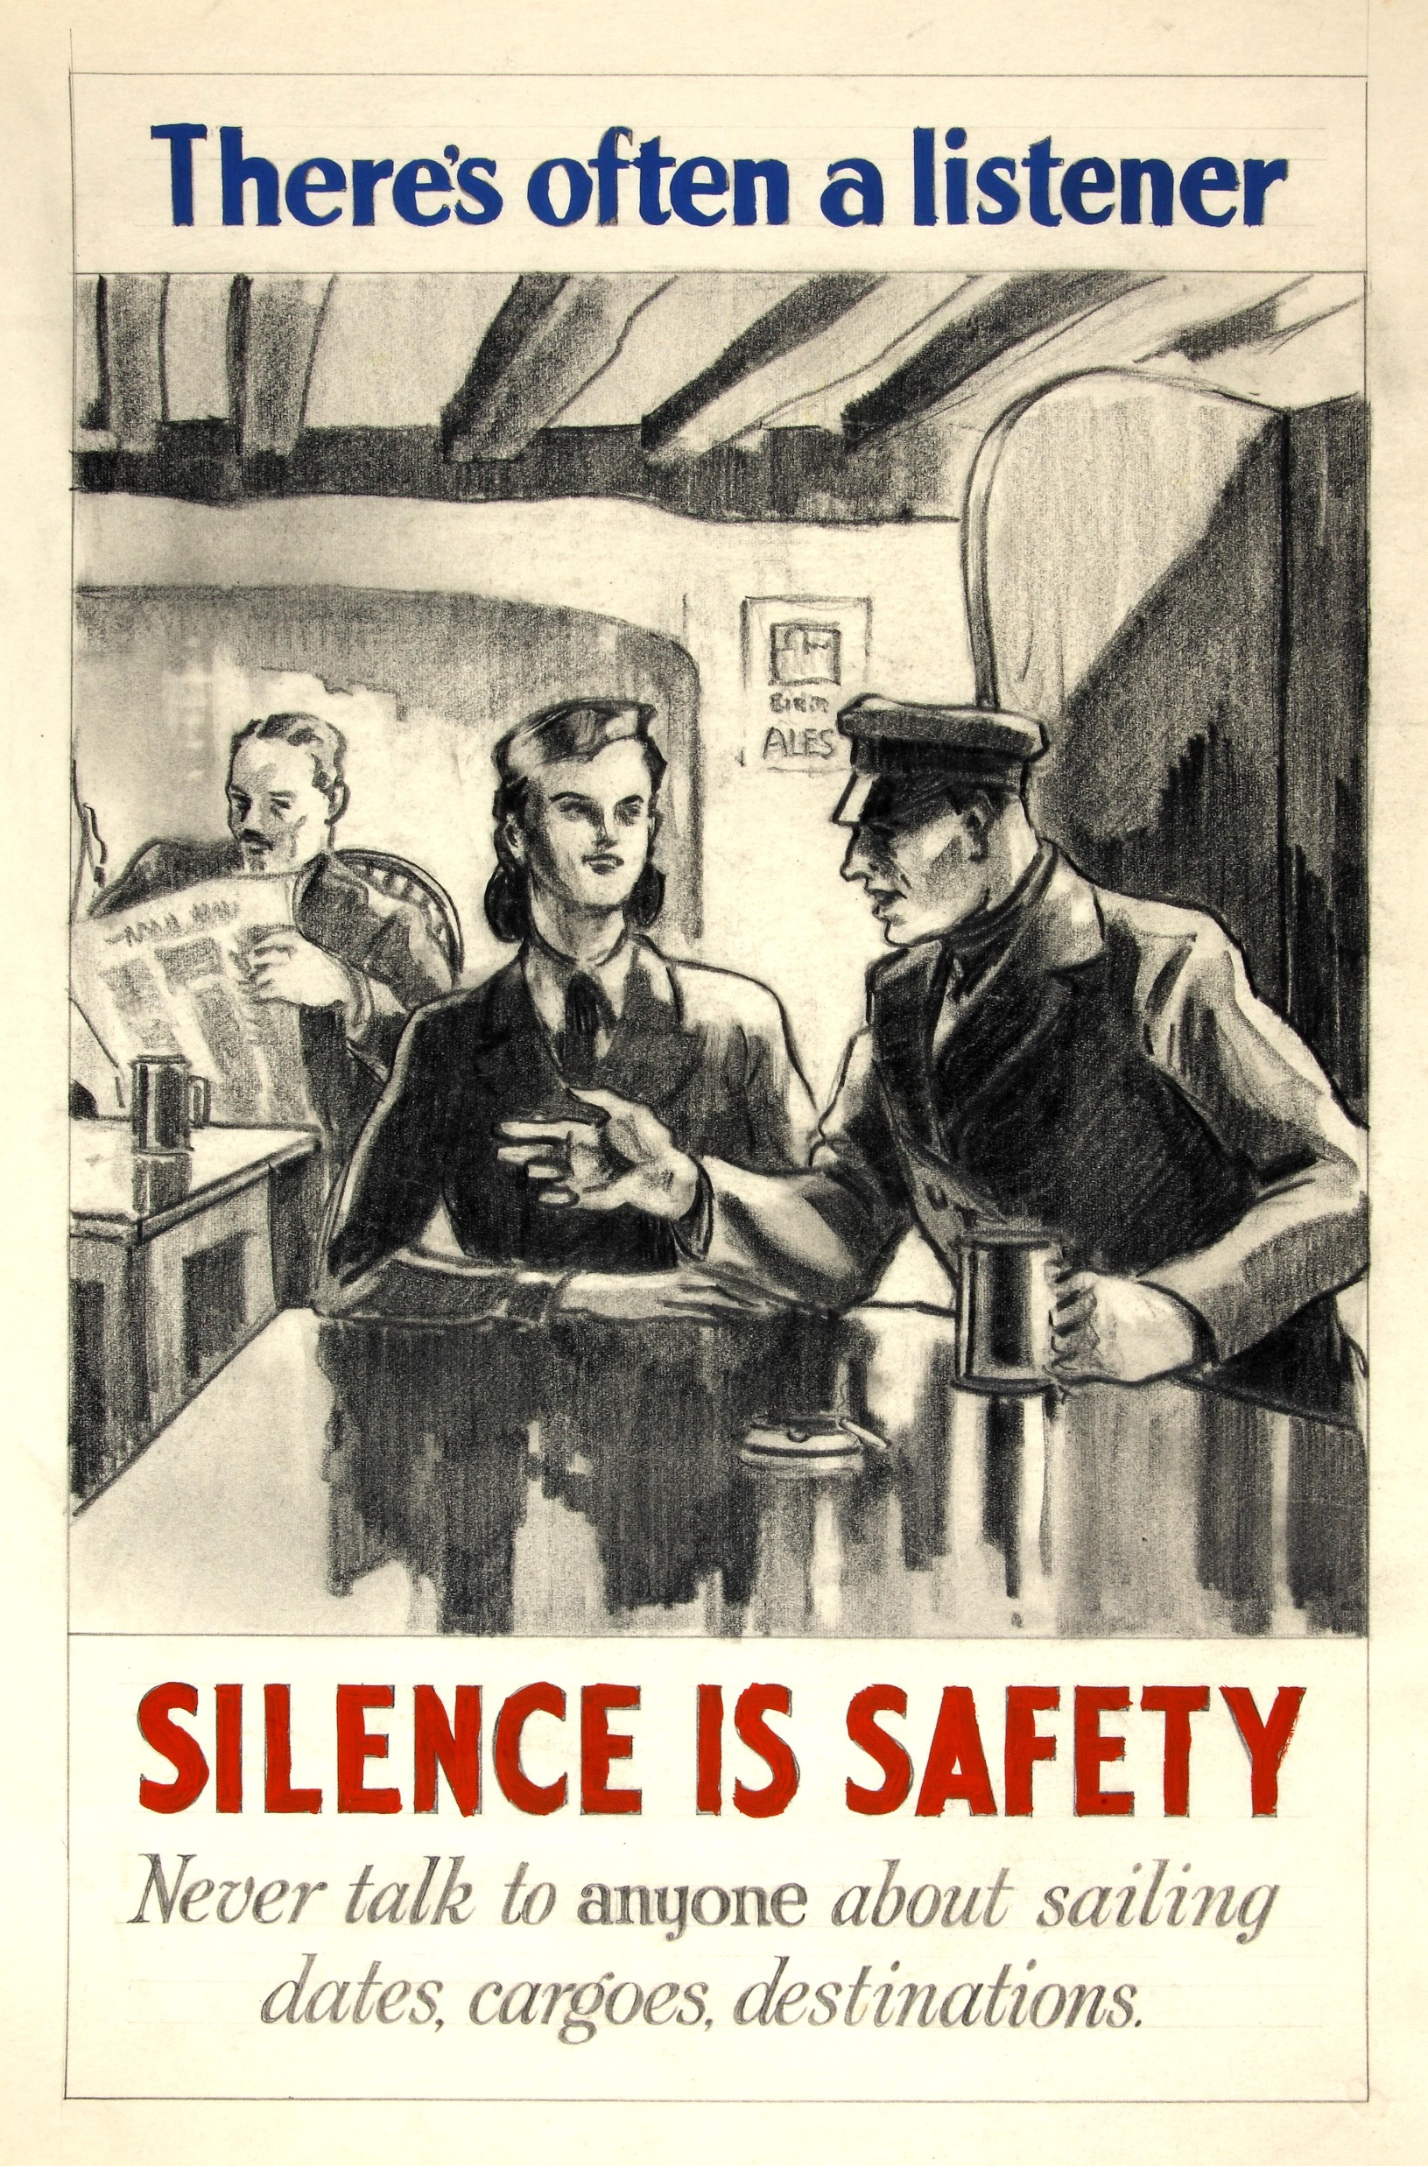
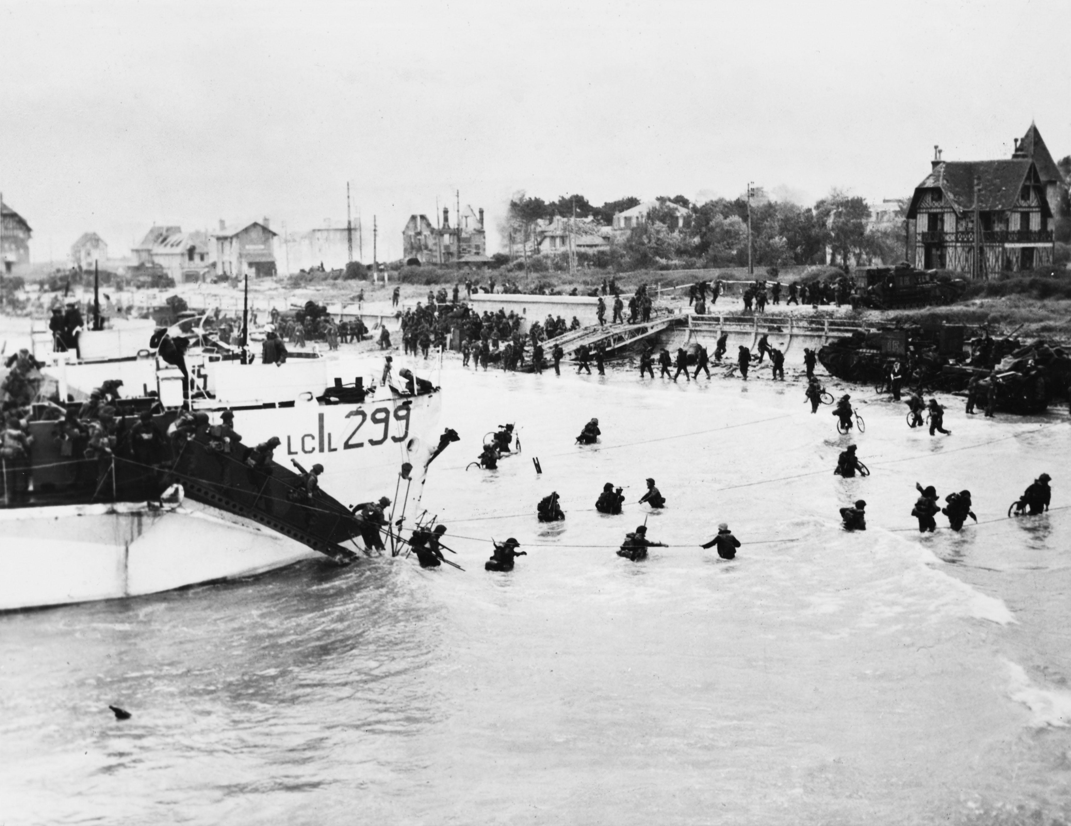
What do these images tell you about the experiences of people who participated in D-Day?
1
2
3
Notes:
Either show on the PowerPoint slide or hand out these images. Each image reveals something different about the experiences of people involved in D-Day. Get students to discuss what they show about D-Day and the people involved.

Slide 18
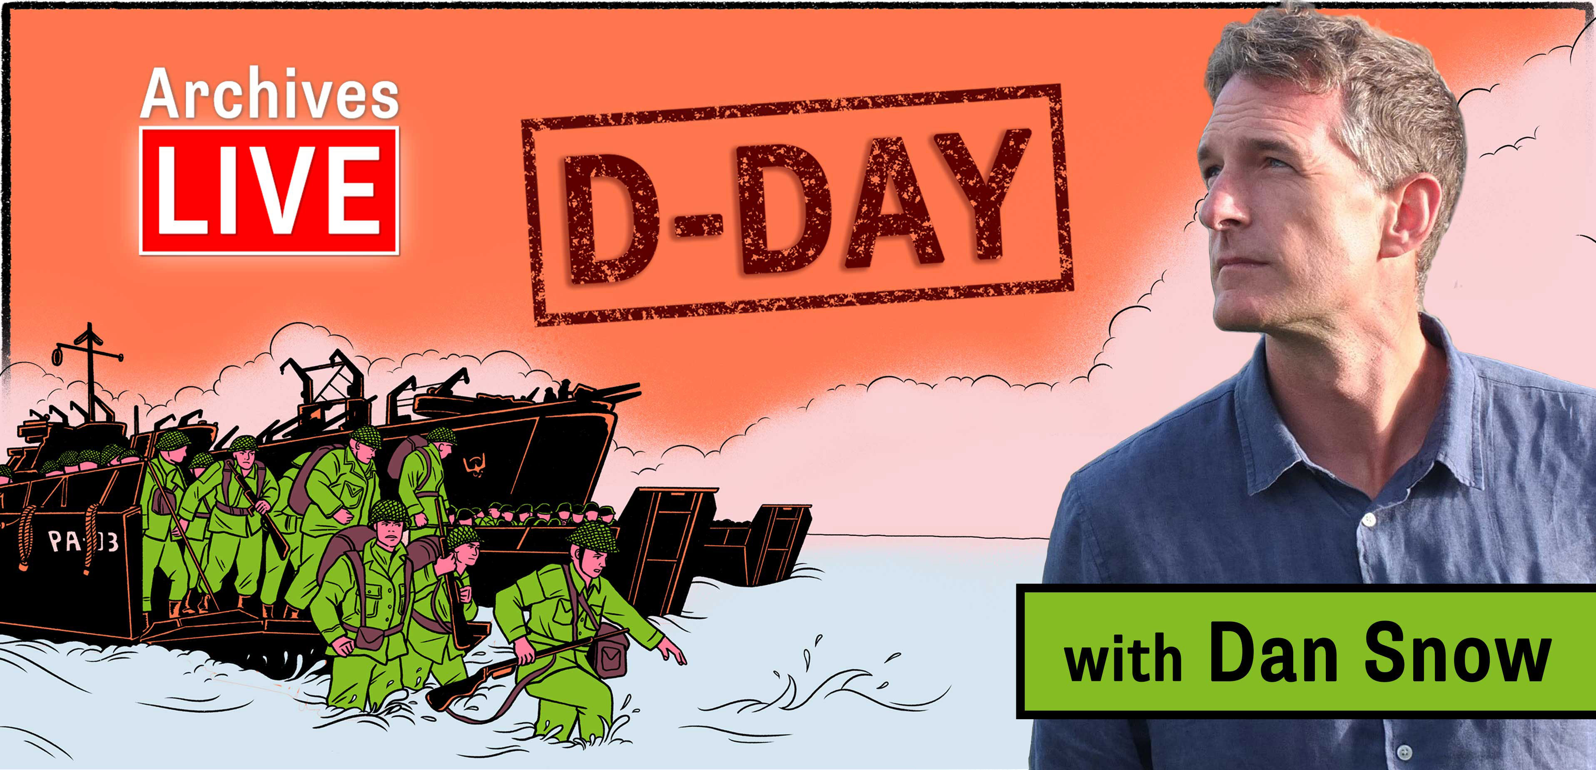
On Monday 3rd June, Dan Snow is going to be speaking to you live from the archives. You will be learning more about some very interesting documents, relating to D-Day.
Notes:
On Monday 3rd June, Dan Snow is going to be speaking to you live from the archives. You will be learning more about some very interesting documents, relating to D-Day.

Slide 19
Preparations for the event
What question would you like to ask Brigadier R L Scott-Bowden MBE, whose father was Major Logan Scott-Boden?
Do you have a family member who was involved in D-Day? How do you know this story?
Why do you think it is important to mark the 80th anniversary of D-Day?
Notes:
These are discussion points to get children to prepare for the live event.
Preparations for the event
Children should think of questions they would like to ask Brigadier R L Scott-Bowden MBE whose father was Major Logan Scott-Boden. You might want to decide on one for the whole class. You will be able to submit questions prior to the live event.
Ask children whether they know of a family member who was involved in D-Day. You can get them to think about how they know this story. E.g through written documents like diaries, or through spoken stories passed down from relatives.
Ask children why they think it is important to mark the 80th anniversary of D-Day.

