Slide 1
What was the significance of the Downing Street Declaration 1993?
A Twin Track Approach

Slide 2
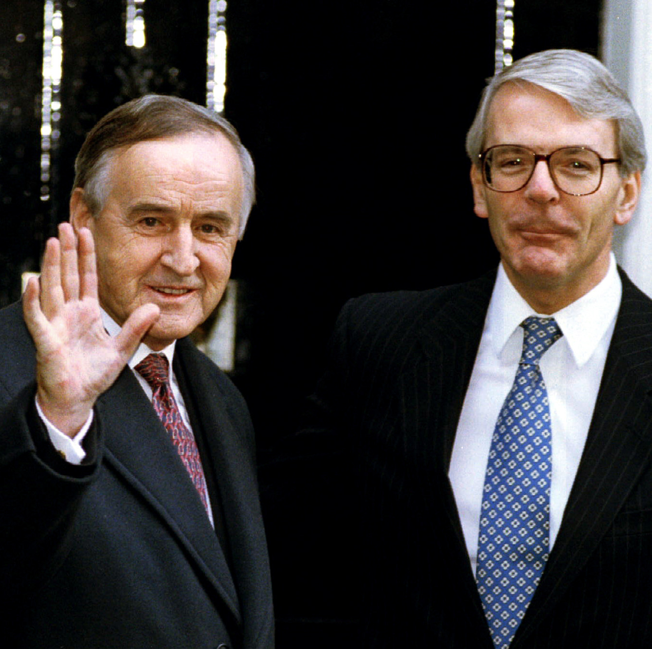
Track 1: The Downing Street Declaration
In December 1993, UK Prime Minister John Major and Irish Taoiseach Albert Reynolds announced an agreement known as the Downing Street Declaration.
Notes:
Reuters images – RTR438XD

Slide 3
The Downing Street Declaration - context
Building on the Anglo-Irish Agreement of 1985
Escalating violence by Republican and Loyalist paramilitaries
Increasing support for peace initiatives within Northern Ireland (eg increased vote for SDLP, massive attendance at peace rallies)
New Irish President, Mary Robinson, who was generally seen as sympathetic towards Unionists
Secret talks between SDLP leader John Hume and Sinn Féin leader Gerry Adams
Secret talks between IRA leaders and the UK government
New US President, Bill Clinton, who was very interested in Northern Ireland and had been critical of UK rule during his election campaign

Slide 4
The Downing Street Declaration – key terms
Continued the co-operation between the UK and Irish governments begun in 1985
Talks to decide a new form of government for Northern Ireland
Only parties which rejected violence would be included in the talks
A joint, public commitment to the principle of consent:
UK Government reaffirmed it would uphold the democratic wish of the people of Northern Ireland if they expressed that they wanted to leave the UK and unite with Ireland
Irish Government agreed it would be wrong to undemocratically impose a united Ireland and confirmed it would propose changes to the claim to NI in the Irish constitution
Notes:
Reuters images – RTR438XD

Slide 5
Track 2: What can we learn from the documents about the Declaration?
We are now going to study a selection of documents from the time to explore this question.
The documents are all from the National Archives and the Public Records Office of Northern Ireland. There is a selection of letters, newspaper clippings, messages between officials and records of meetings.

Slide 6
What can we learn from the documents about the Declaration?
Historians find these sources extremely useful. They use them as evidence to support claims about …
Reasons why the Declaration came about, why key groups or individuals were involved, why progress was difficult
Impact of particular events, actions, individuals
Changes taking place at the time
How the process worked which eventually led to the Declaration e.g. meetings, discussions, documents
Attitudes of the various groups and individuals involved

Slide 7
Why the sources are useful
Historians find these sources extremely useful, in a number of ways …
Factual information (e.g. contents of agreements like the Downing Street Declaration)
Making inferences from the content of the sources (e.g. inferring that X was concerned about Y because of the language they were using about Y; inferring that taking a particular action was difficult for X).
Making inferences from the context of the creation of the sources (e.g. why it is useful to know that X said Z about Y at a particular time, in a particular way, to a particular audience, using a particular medium – official letter, TV interview, particular newspaper etc)
KEY POINT – All sources are useful
Historians can always use sources as evidence about something
When X says something critical of Y it might be unreliable about Y, but it is probably a very reliable source about the attitudes of X

Slide 8
A worked example
Notes:
TNA Catalogue Ref: FCO 87/3596

Slide 9
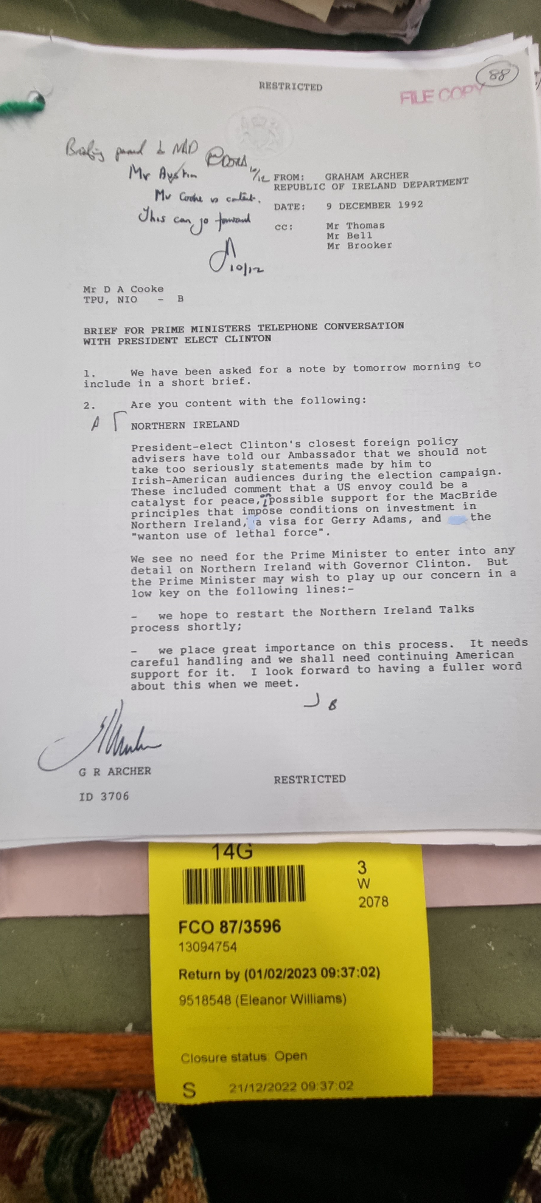
Worked example - headings
Content of source
Context of source
Attitudes
Attitudes
How things work
Notes:
TNA Catalogue Ref: FCO 87/3596

Slide 10
Worked example – suggested answers
Content of source:
UK government officials have been asked to brief the Prime Minister before speaking to the newly elected US President Bill Clinton.
Context of source
New US President Clinton won election (will take office in January 1994). Useful as it tells us that during his election campaign he criticised UK rule in Northern Ireland, proposed a US peace envoy and a US visa for Gerry Adams to travel to USA.
Attitudes
Useful as it shows the UK government is concerned about comments made by Clinton about Northern Ireland during election.
Also useful as it shows that Clinton believed that criticising the UK government is popular with some Irish Americans.
Attitudes
Useful as evidence that the UK think US involvement was important. The UK was not happy about Clinton’s comments but also anxious to keep US support for talks.
How things work
Useful as we learn that UK government have raised concerns with Clinton’s advisers and they have reassured the UK government that Clinton was trying to appeal to Irish Americans.
Notes:
McBride Principles were a set of guidelines for US investment in businesses in Northern Ireland. Essentially US investors had to make sure that they did not invest or work with companies which discriminated against particular groups, most obviously Protestants or Catholics.
TNA Catalogue Ref: FCO 87/3596

Slide 11
Study the documents and complete the table to help you decide what they provide evidence for.
Source | Date | What is the source? | Reasons why the Declaration came about, why groups or individuals were involved, and why progress was difficult | Impact of particular events, actions, individuals | Changes taking place at the time | How the process worked e.g. meetings, discussions, documents. | Attitudes of the various groups and individuals involved.
1
2
3
4
5
6

Slide 12
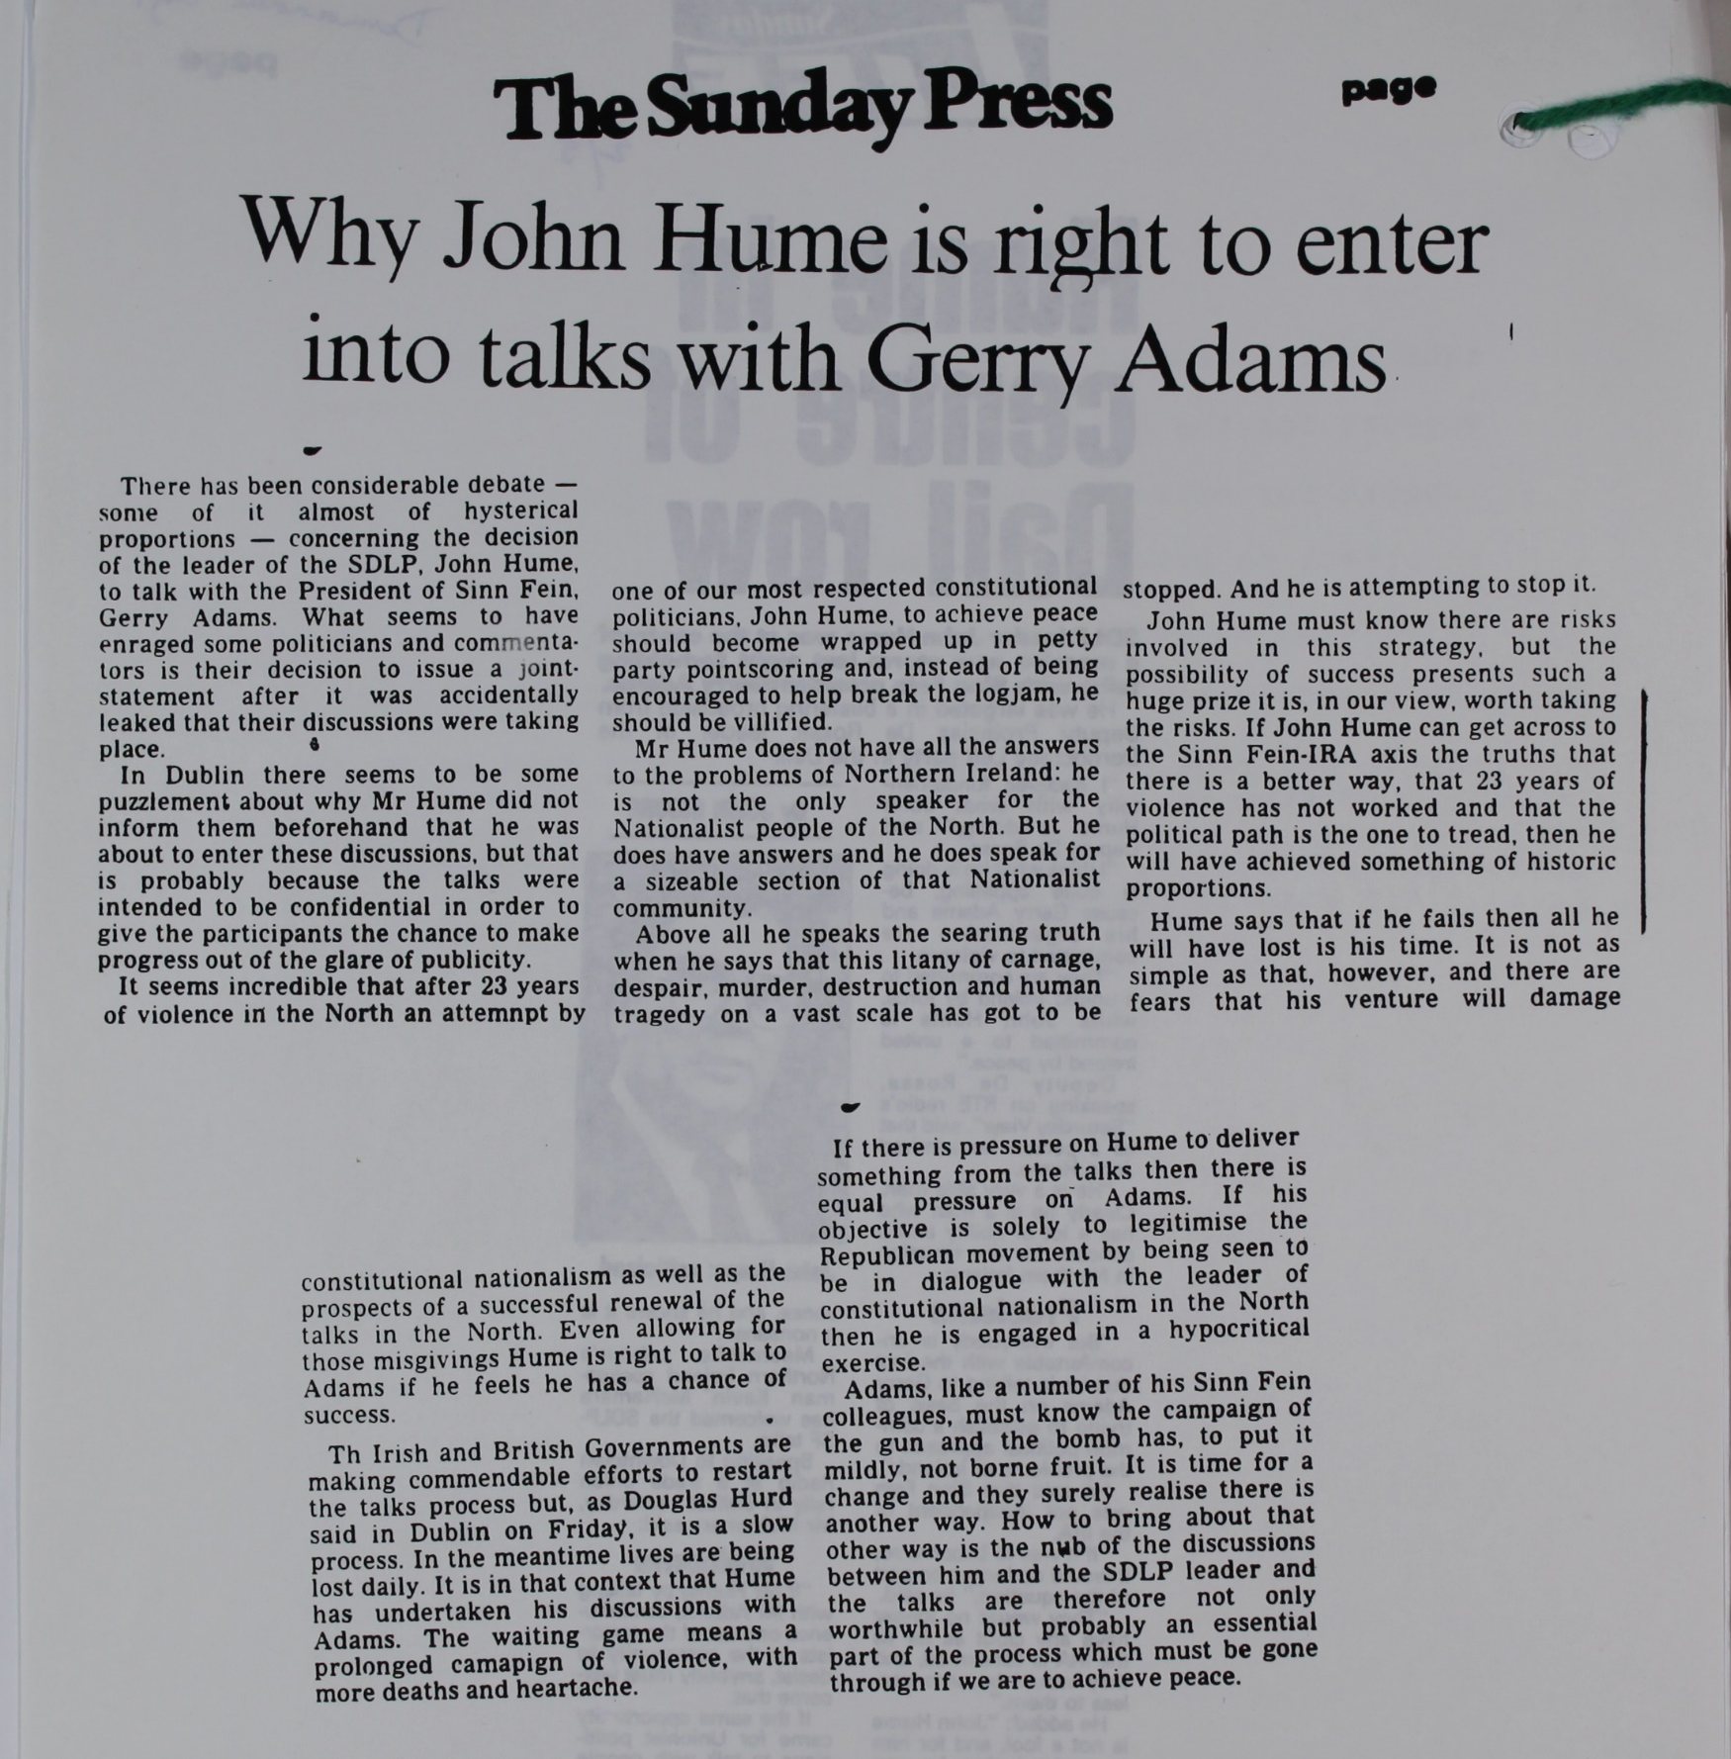
Source 1
A newspaper cutting contained in a UK government file. The article was published in May 1993 in The Sunday News, a newspaper in Ireland.
Notes:
TNA Catalogue Ref: CJ4/11527
Context notes
John Hume was the leader of the Social Democratic Labour Party (SDLP), the largest Nationalist party in Northern Ireland at the time. Gerry Adams was the leader of Sinn Féin, which was generally seen as the political wing of the IRA although Gerry Adams always officially denied that there was a link between the two organisations. They began a series of meetings in 1992 to discuss the conditions which would be necessary to end the conflict in Northern Ireland. In April 1994 these ‘secret’ talks were discovered and widely reported in the newspapers and as a result Hume and Adams made a public statement about their talks in April 1993. They then continued to meet and made further public statements in September and November 1993, setting out their views on how government and politics in Northern Ireland should develop.
Questions
Content
What have Hume and Adams been doing?
What is the view of the author of the article about these actions?
Is there any evidence that there have been reactions from other groups?
Inferences from the content
What can historians infer about public opinion and politicians in Ireland at this time?
What can historians infer about the impact of the Hume Adams talks?
Inferences from the context
Is it significant that a copy of this article was made and was kept in a UK government file?

Slide 13
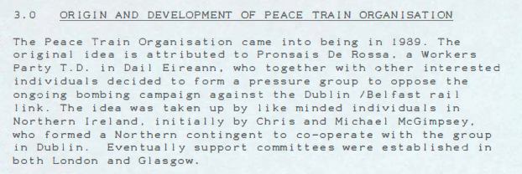
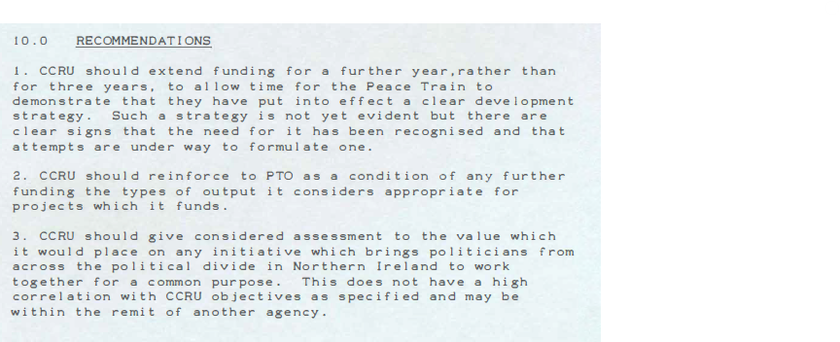
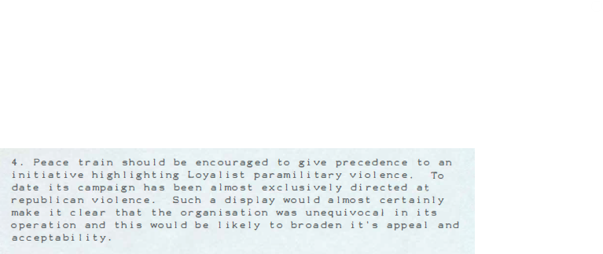
Source 2
A report on the Peace Train Organisation (PTO) produced in May 1993. The report was commissioned by the Central Community Relations Unit, part of the Northern Ireland civil service.
Notes:
PRONI Catalogue Ref: CENT-1-20-33A_1993-nd
Context notes
This report was commissioned by the Central Community Relations Unit (CCRU). The Central Community Relations Unit was established in 1987 to advise the Secretary of State on all aspects of the relationship between the different parts of the Northern Ireland community. The Unit, is part of the Northern Ireland Civil Service. The Unit’s role is to make policies on issues of equality and improve community relations. The purpose of this report was to decide whether the Northern Ireland civil service should continue to provide financial support to the Peace Train Organisation.
Questions
Content
When was the Peace Train Organisation created?
Who belonged to the group?
What were its aims?
What recommendations did the CCRU make?
Inferences from the content
What can historians infer about the impact of the PTO?
What can historians infer about the views and attitudes of the members of the PTO?
Inferences from the context
Is it significant that government officials were providing financial support to the PTO?
What can historians infer about attitudes within Ireland and Northern Ireland towards the conflict at this time?

Slide 14
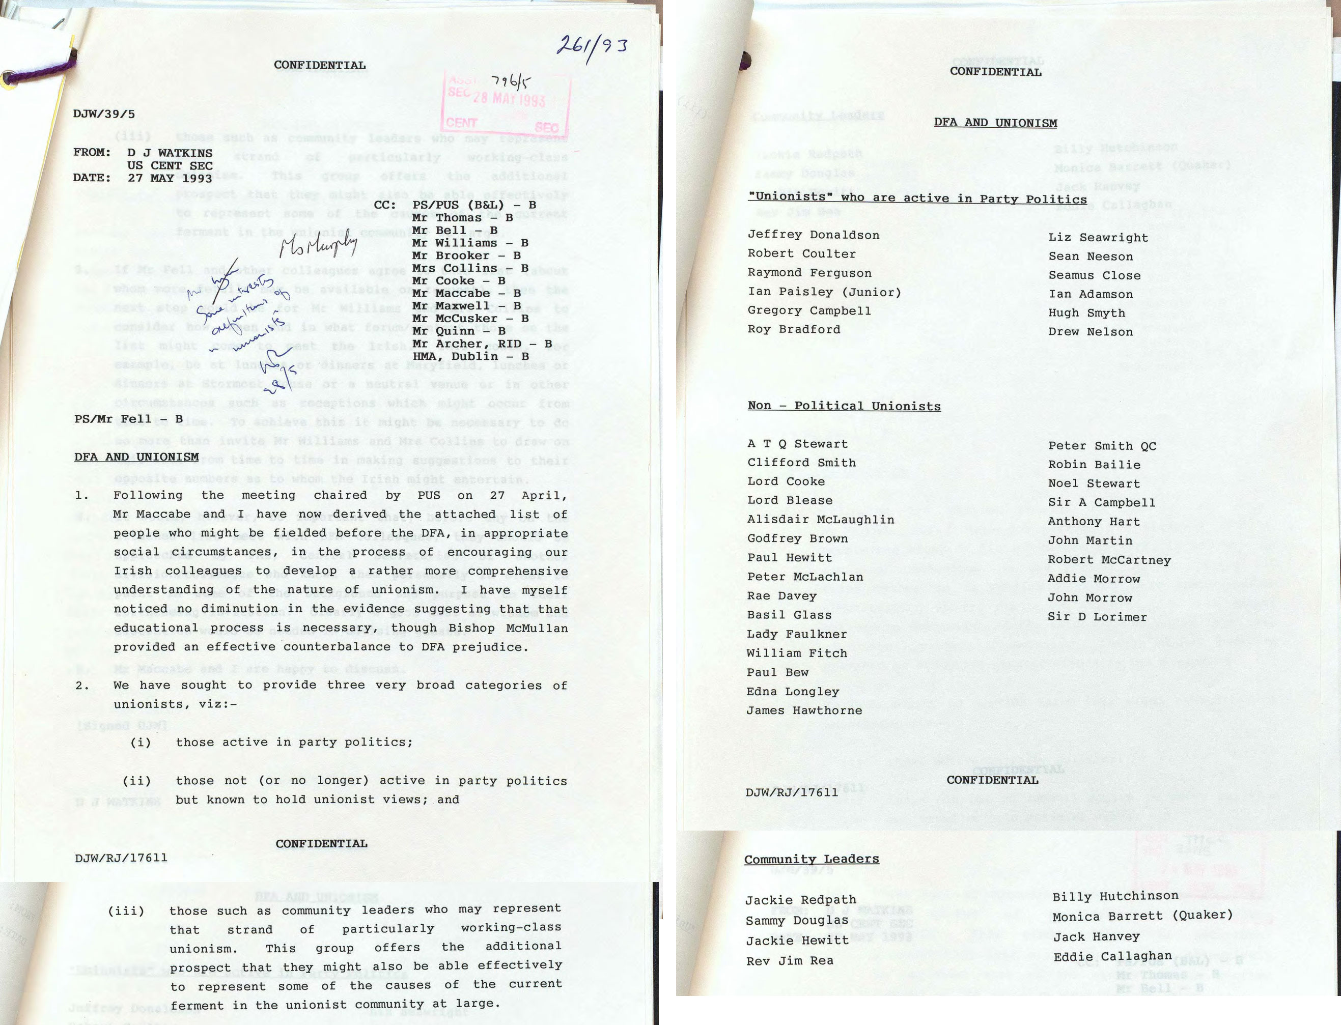
Source 3
An internal memorandum produced by an official in the Northern Ireland Civil Service in May 1993. It is reporting on a plan to arrange a meeting between representatives of Unionism in Northern Ireland and the Irish Government’s Department of Foreign Affairs (DFA)
Notes:
PRONI Catalogue Ref: CENT-1-22-30A_1993-05-27
Context notes
When Northern Ireland was created in 1921 there was a great deal of hostility and bitterness in the rest of Ireland. Many Irish politicians and officials felt that Ireland should be united, and that Northern Ireland should not exist. By the 1990s this hostility towards Northern Ireland was greatly reduced. However, there was a problem that many in the Irish Government were unsympathetic towards Northern Ireland’s Unionist community. It was felt that many in Irish public life and its institutions regarded Unionists with suspicion, and thought they were simply pawns of the UK government.
Questions
Content
What event is this document trying to organise?
What types of people do the officials plan to invite?
Inferences from the content
Is this source more useful as evidence about the Irish DFA officials or about the UK official writing it?
What can historians infer about the relationship between the Northern Ireland Civil Service and the Irish DFA?
Inferences from the context
Explain why it is significant that this meeting was being organised.
Explain why it is useful to see who got a copy of this document.

Slide 15
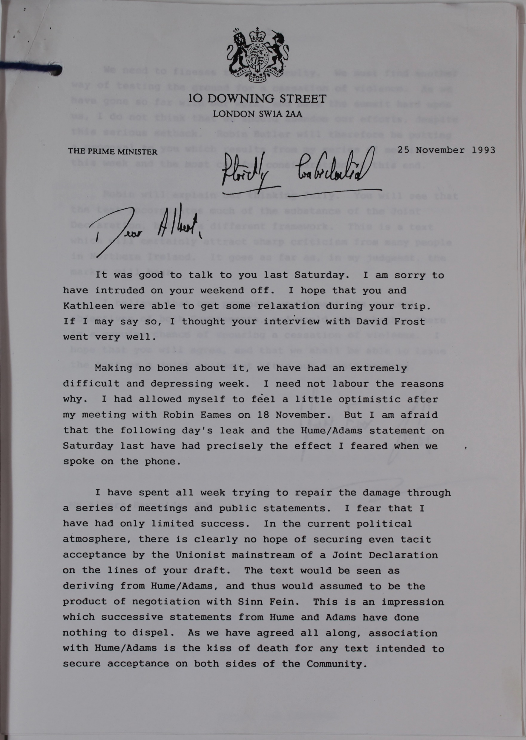
Source 4
A letter from the UK Prime Minister to the Taoiseach November 1993
Notes:
TNA Catalogue Ref: CJ4/10560
Context notes
Throughout 1993 the UK and Irish governments were talking regularly about Northern Ireland. The governments were also talking to political parties, both Unionist and Nationalist, in Northern Ireland. The UK were also talking to representatives of the Provisional Irish Republican Army (PIRA). In the week before this letter a number of events caused problems for Prime Minister John Major. He had spoken to Robin Eames, the most senior figure in the Church of Ireland. That was a positive step, but from this point on things went very wrong. On 15 November a Northern Ireland newspaper reported that the UK had been holding talks with the PIRA. On 19 November a newspaper in the Republic published a document drawn up by the Republic’s Department of Foreign Affairs setting out plans for the future of Northern Ireland. On 20 November John Hume and Gerry Adams issued a third joint statement. On 24 November UK police intercepted a large shipment of arms which was meant for the Loyalist paramilitary group the Ulster Volunteer Force (UVF).
Questions
Content
What events have worried the Prime Minister?
What has the Prime Minister tried to do and how successful has he been?
Which group is the Prime Minister most concerned about?
Inferences from the content
How would you describe the Prime Minister’s attitude towards Hume and Adams?
What can a historian infer from this document about attitudes in Northern Ireland at this time?
Inferences from the context
What can a historian infer from this letter about the relationship between Major and Albert Reynolds?

Slide 16
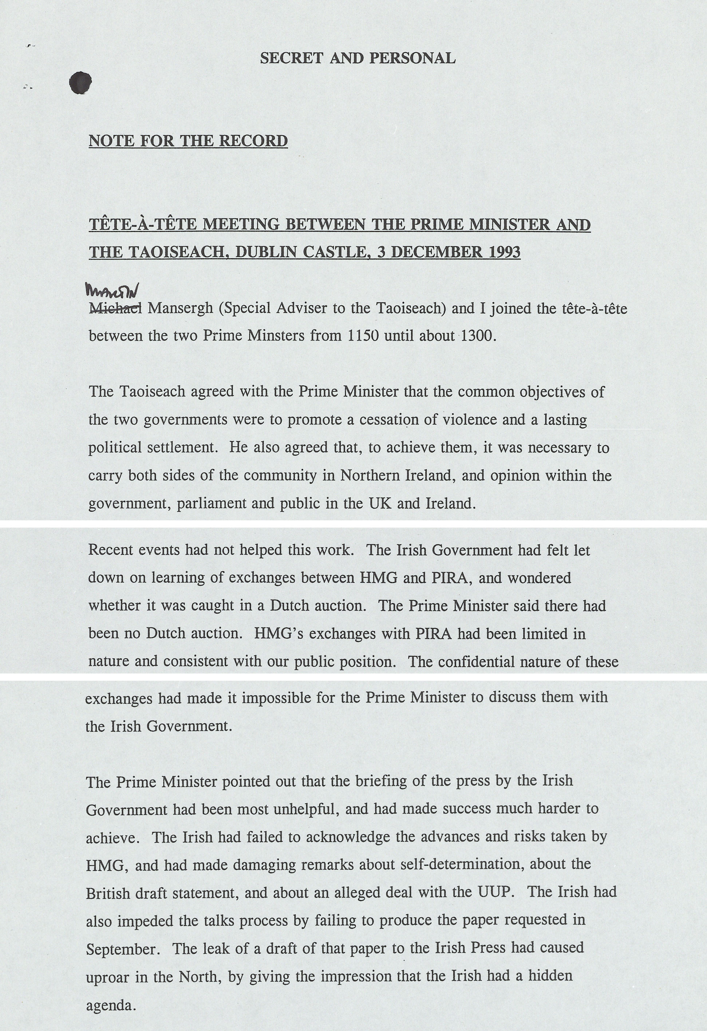
Source 5
Record of a meeting between the UK Prime Minister and the Irish Taoiseach December 1993
Notes:
TNA Catalogue Ref: CJ4/10560
Context notes
This meeting took place a short time before the Downing Street Declaration was issued. There was constant dialogue between Her Majesty’s Government (HMG – i.e. the UK government) and the Irish Government. Sometimes, as in this case, they were tense. In this instance the Irish government discovered that HMG had been holding talks with the leaders of the PIRA. This had been carried out using go-betweens such as Catholic priests, Northern Ireland business-people and also some UK Intelligence officers.
Questions
Content
What did the two sides agree was a priority?
What did they agree was necessary to achieve their aims?
Inferences from the content
What can a historian infer from this document about relations between the UK and Irish governments at this time?
What can a historian infer about the differing concerns of the two governments?
Inferences from the context
Is it significant that the two leaders met face to face (tête-à-tête)?

Slide 17
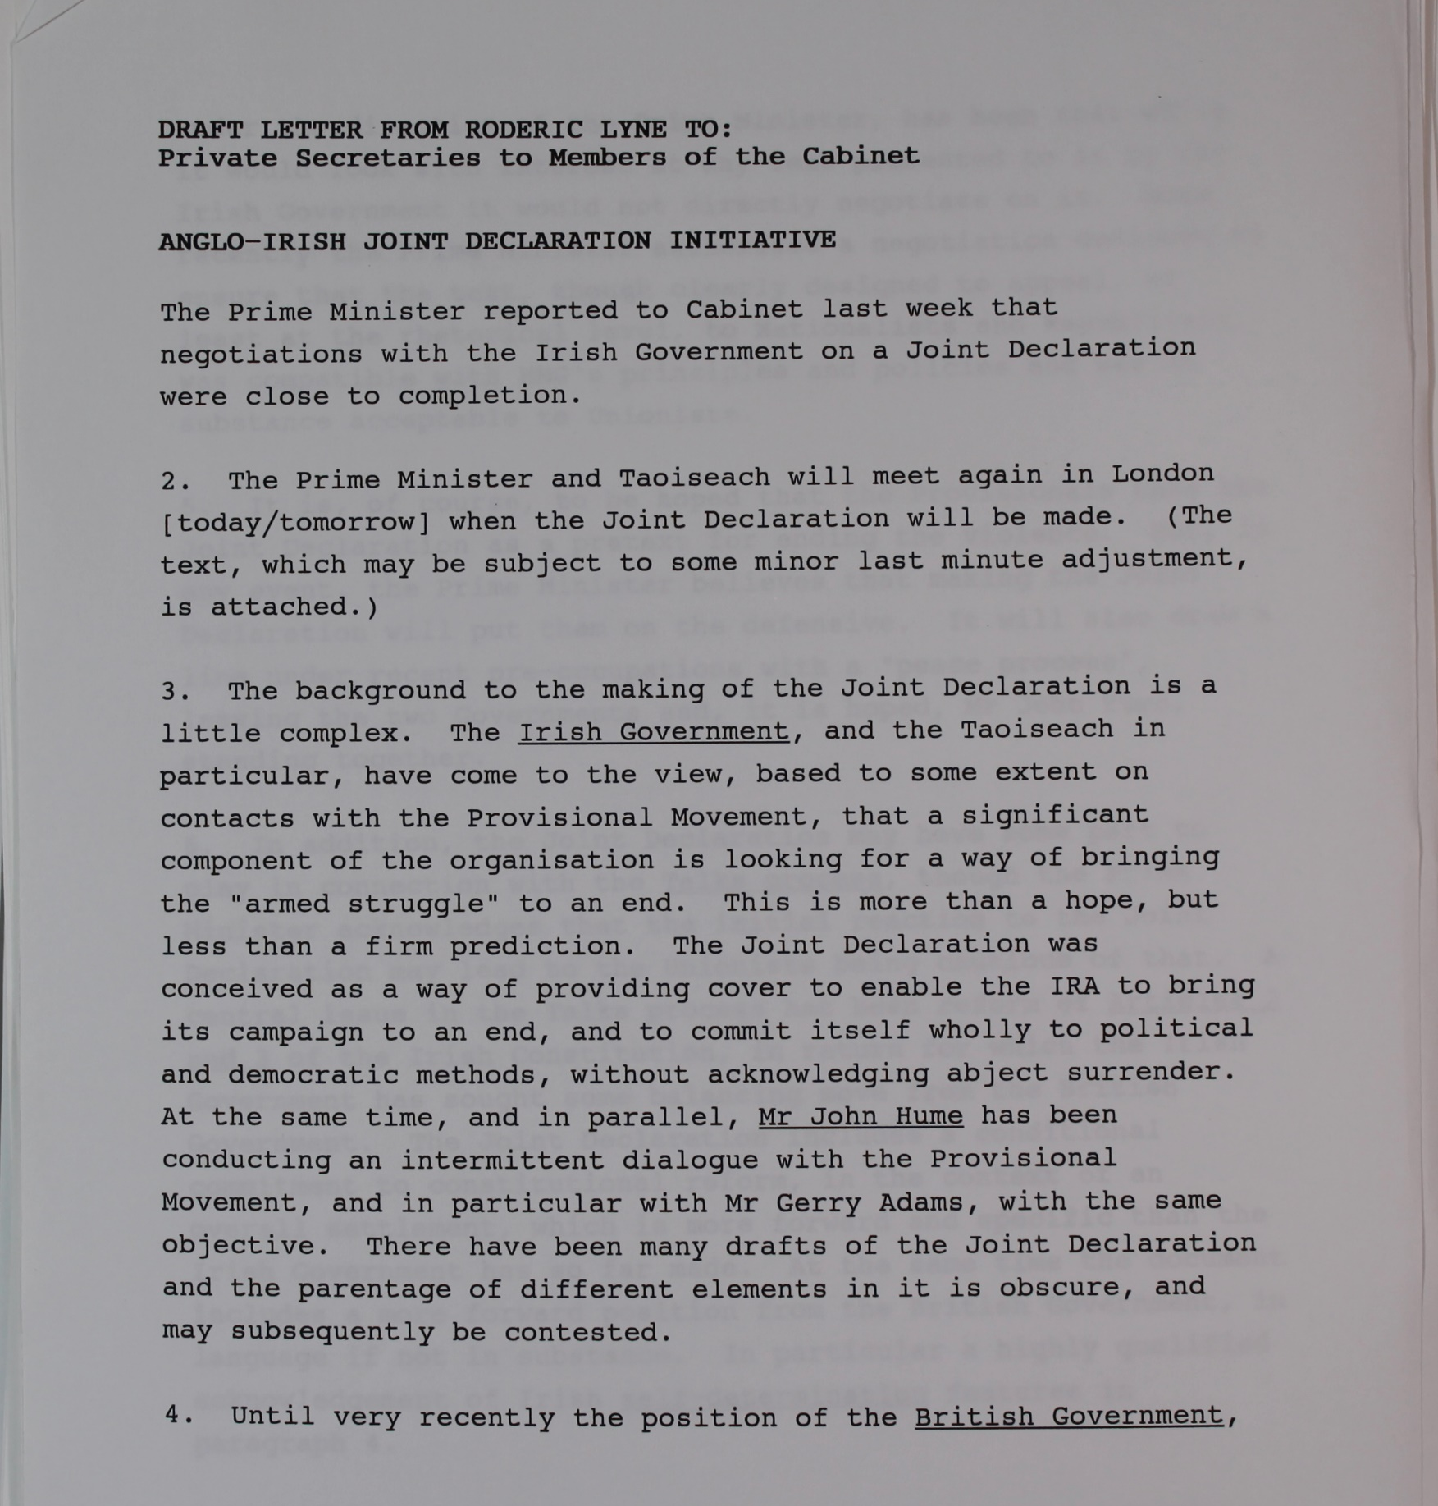
Source 6
Briefing notes sent to senior civil servants explaining the proposed Downing Street Declaration December 1993
Notes:
TNA Catalogue Ref: CJ4/10562
Context notes
This document was written by a senior adviser to the Prime Minister. The document was sent to the Private Secretaries of the members of the Cabinet. Private Secretaries are senior civil servants in government departments and work closely with ministers. The document was designed to alert these officials that the Prime Minister and the Taoiseach would be announcing the Downing Street Declaration and to provide officials and minsters with some important background information and advice on possible questions from the media.
Questions
Content
What event is being announced and who is being informed about it?
What is the view of the Irish government about the PIRA?
What is the intention of the UK and Irish Governments behind the Declaration?
Inferences from the content
Would a historian find this document useful as evidence about the Republican movement at this time?
What can a historian infer about the approach taken by the UK and Irish governments towards the PIRA?
Is this source useful as evidence about the Hume – Adams talks?
Inferences from the context
Is it significant that this document is being sent to all members of the UK Cabinet?

Slide 18
What was the significance of the Downing Street Declaration?
Complete the table before discussing what evidence each source provides about the Downing Street Declaration.
Can you explain the following:
Why the Declaration came about?
Who was involved?
Why progress was difficult?
The impact of particular events, actions and idividuals?
What changes were occurring at the time?
How the process worked that brought about the Declaration?
What attitudes different groups and individuals had?

Slide 19
What was the significance of the Downing Street Declaration?
Once you have gathered evidence from the sources, you will write an extended paragraph in response to the question:
“What was the significance of the Downing Street Declaration?”
Your answer should explain what challenges had to be overcome and how, and explain what the Declaration achieved.
These sentence starters may help…
The Downing Street Declaration agreement was significant because…
This is supported by evidence in Source ___, which shows that …
This is further supported by Source ___, which shows that …
In conclusion the Downing Street Declaration should be seen as…

