Slide 1

Welcome to
The National Archives
Come and have a look inside…

Slide 2
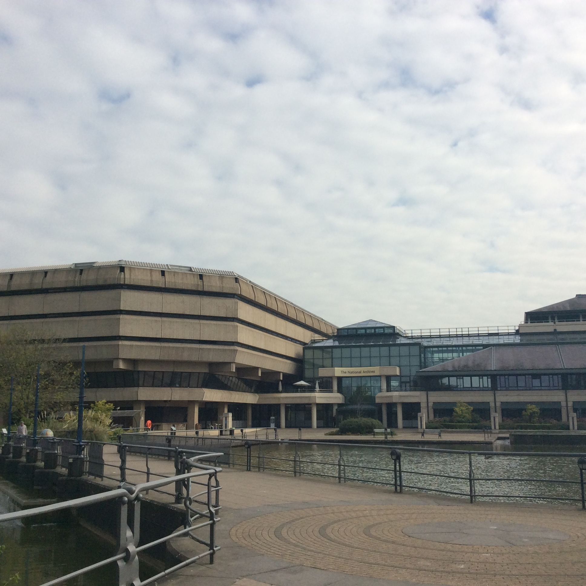
This is The National Archives.
It is a large modern building with ponds outside.

Slide 3
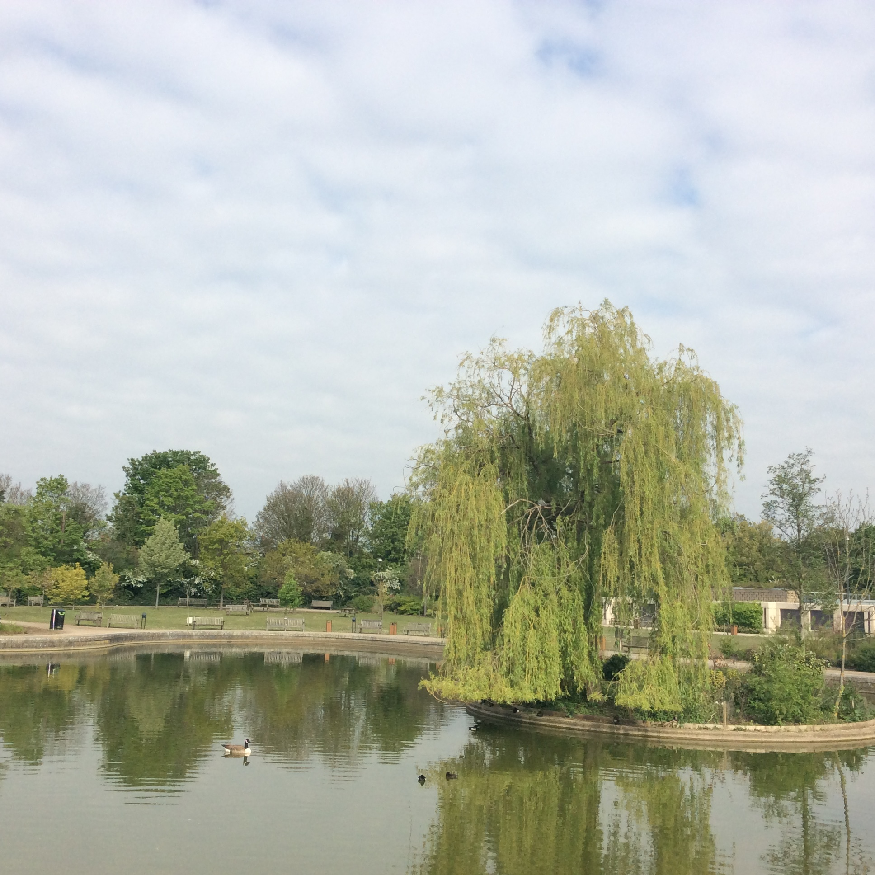
There is a park outside.
Geese and other birds live in the park.

Slide 4
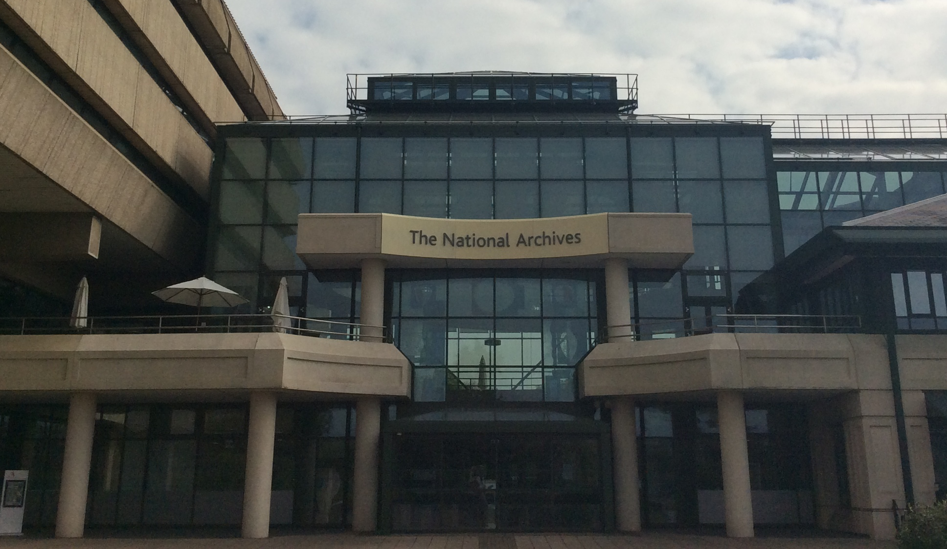
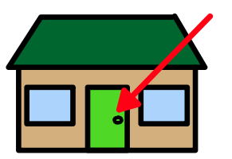
This is the entrance to The National Archives.

Slide 5
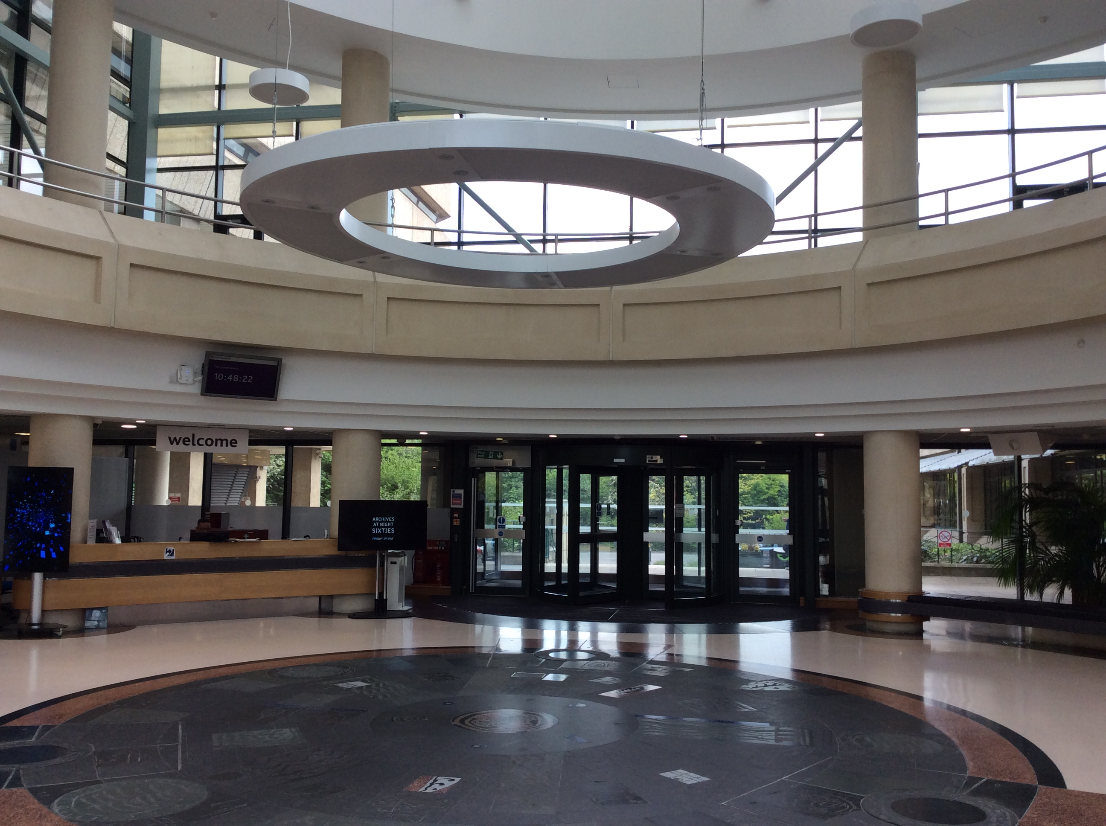
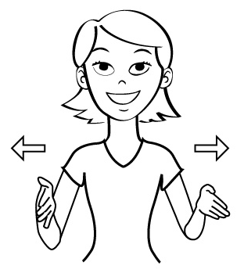
This is the welcome area. It is big and bright.

Slide 6
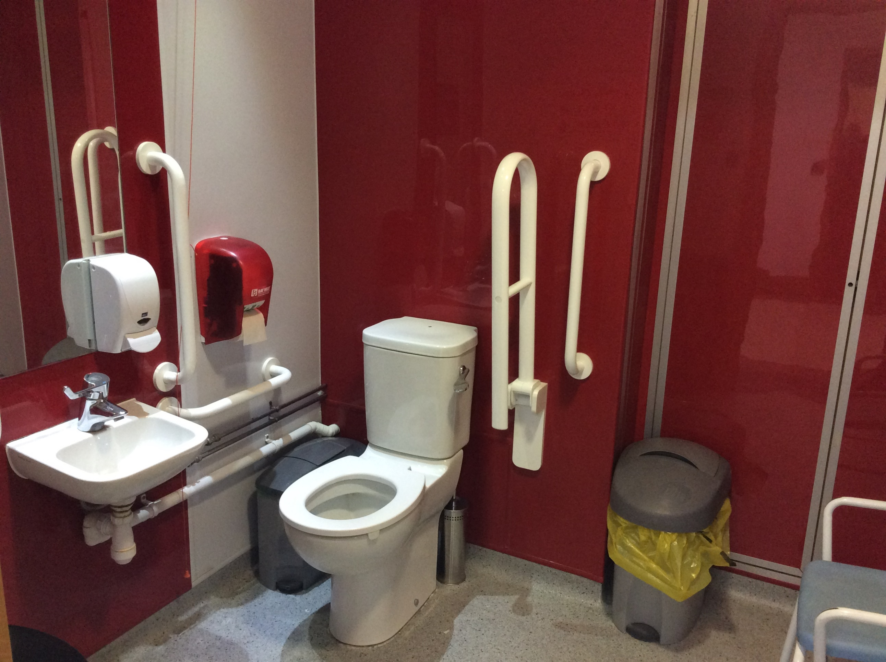
There are accessible toilets near the welcome area.

Slide 7
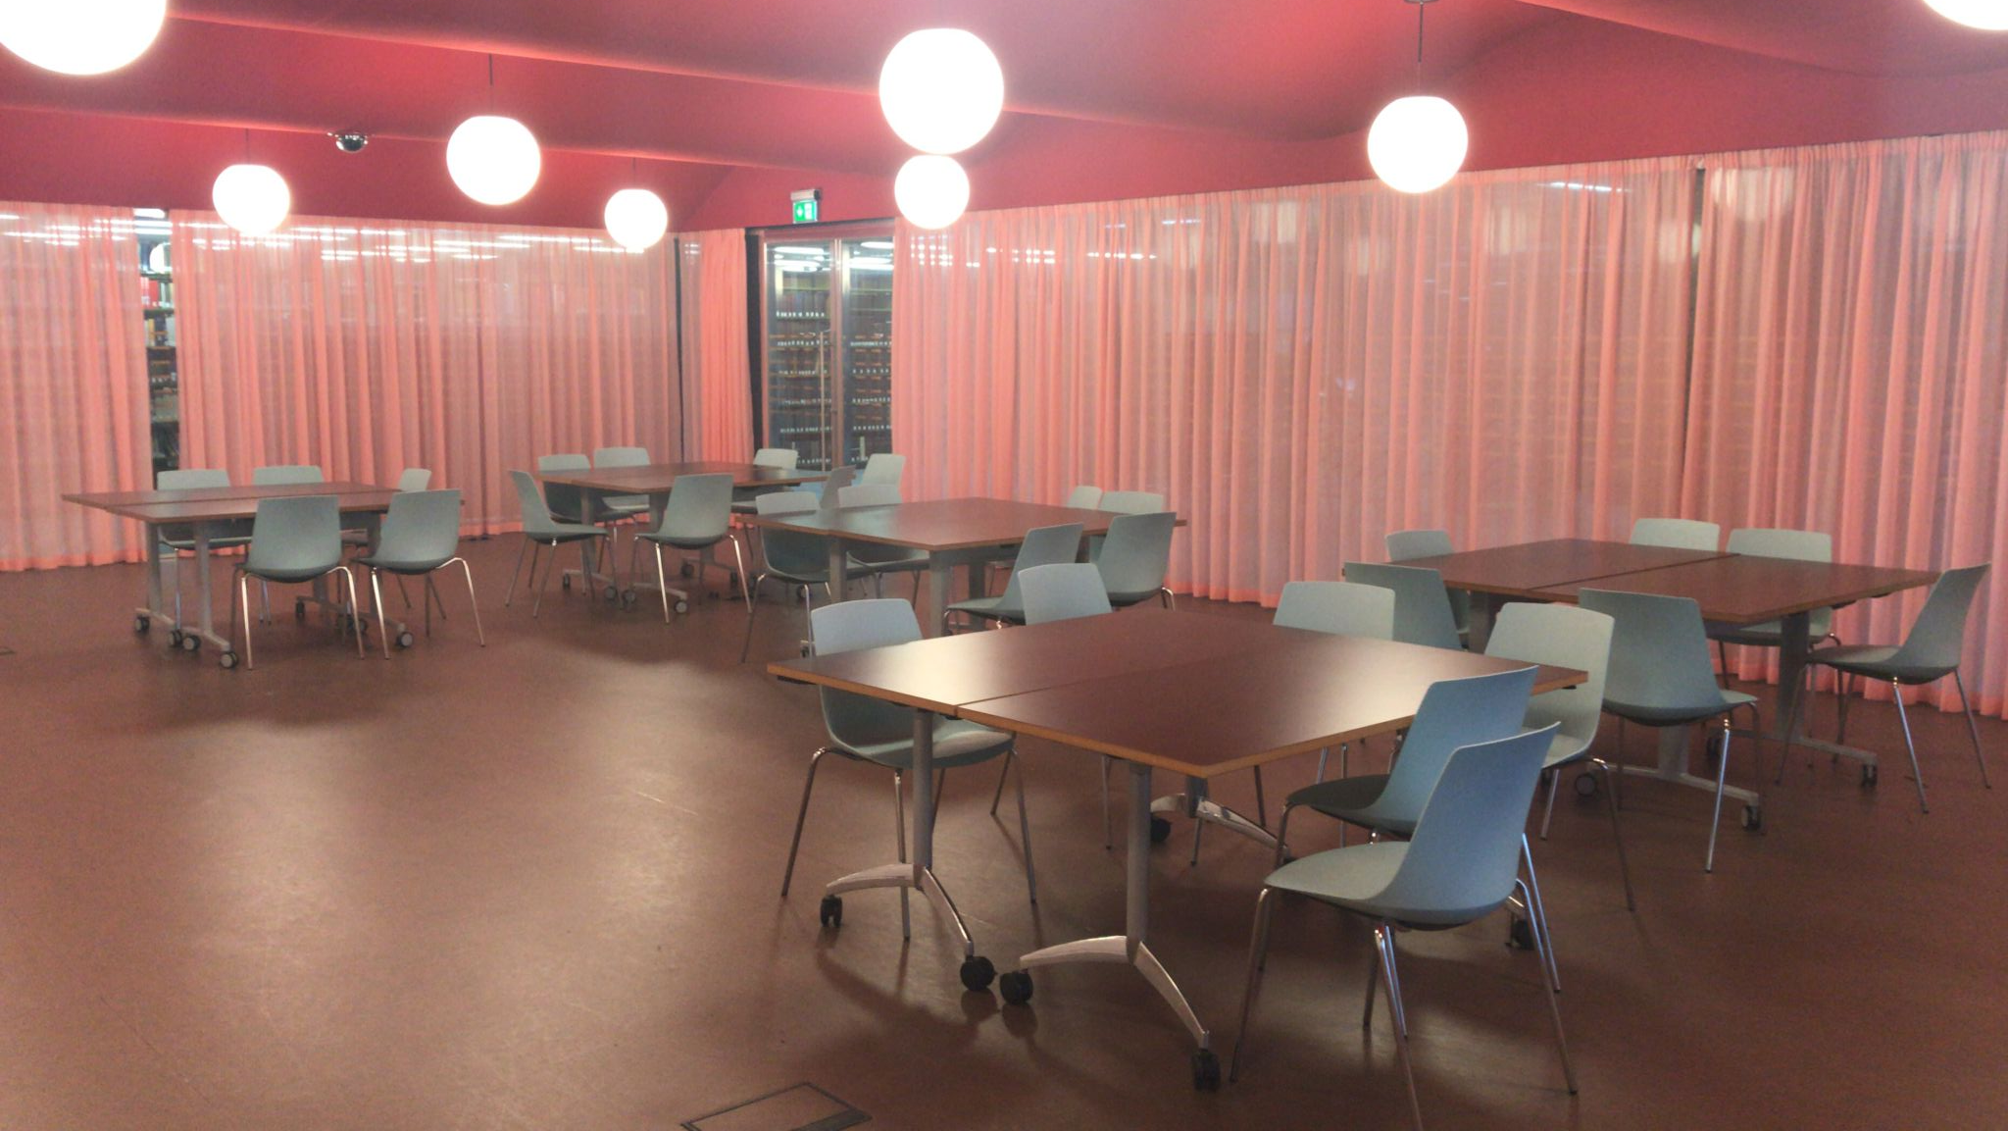
This is the Learning Space where you will have your workshop.

Slide 8

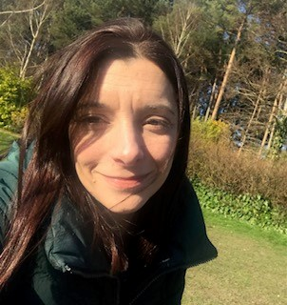

Noel
Rachel
Alice
Here are some of the people from The Archives you will work with during your visit.

Slide 9
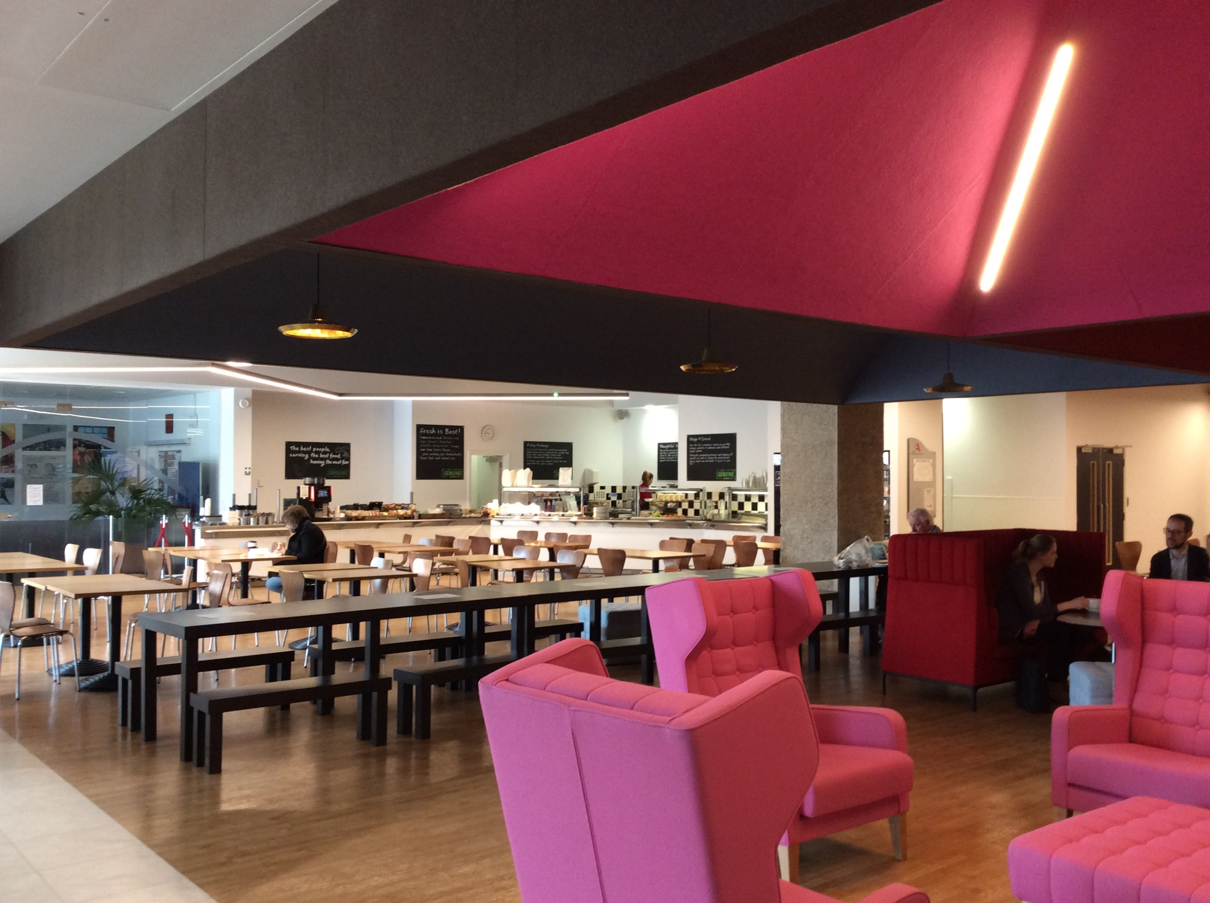


This is the public restaurant. Sometimes it is busy and noisy. You can eat your lunch here before your workshop.

Slide 10
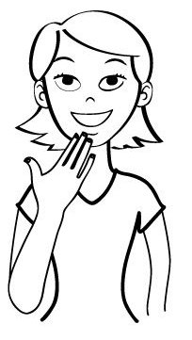
At the end of your visit, you will go back to school.
Thank you for coming to see us at The National Archives.
See you soon.

