Slide 1
What was the significance of the Belfast (Good Friday) Agreement?
Case Study: April to November 1998

Slide 2
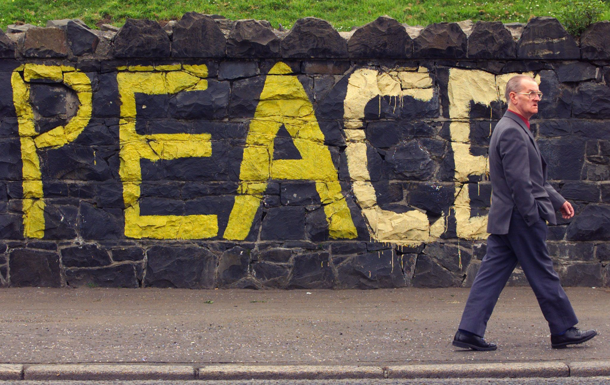
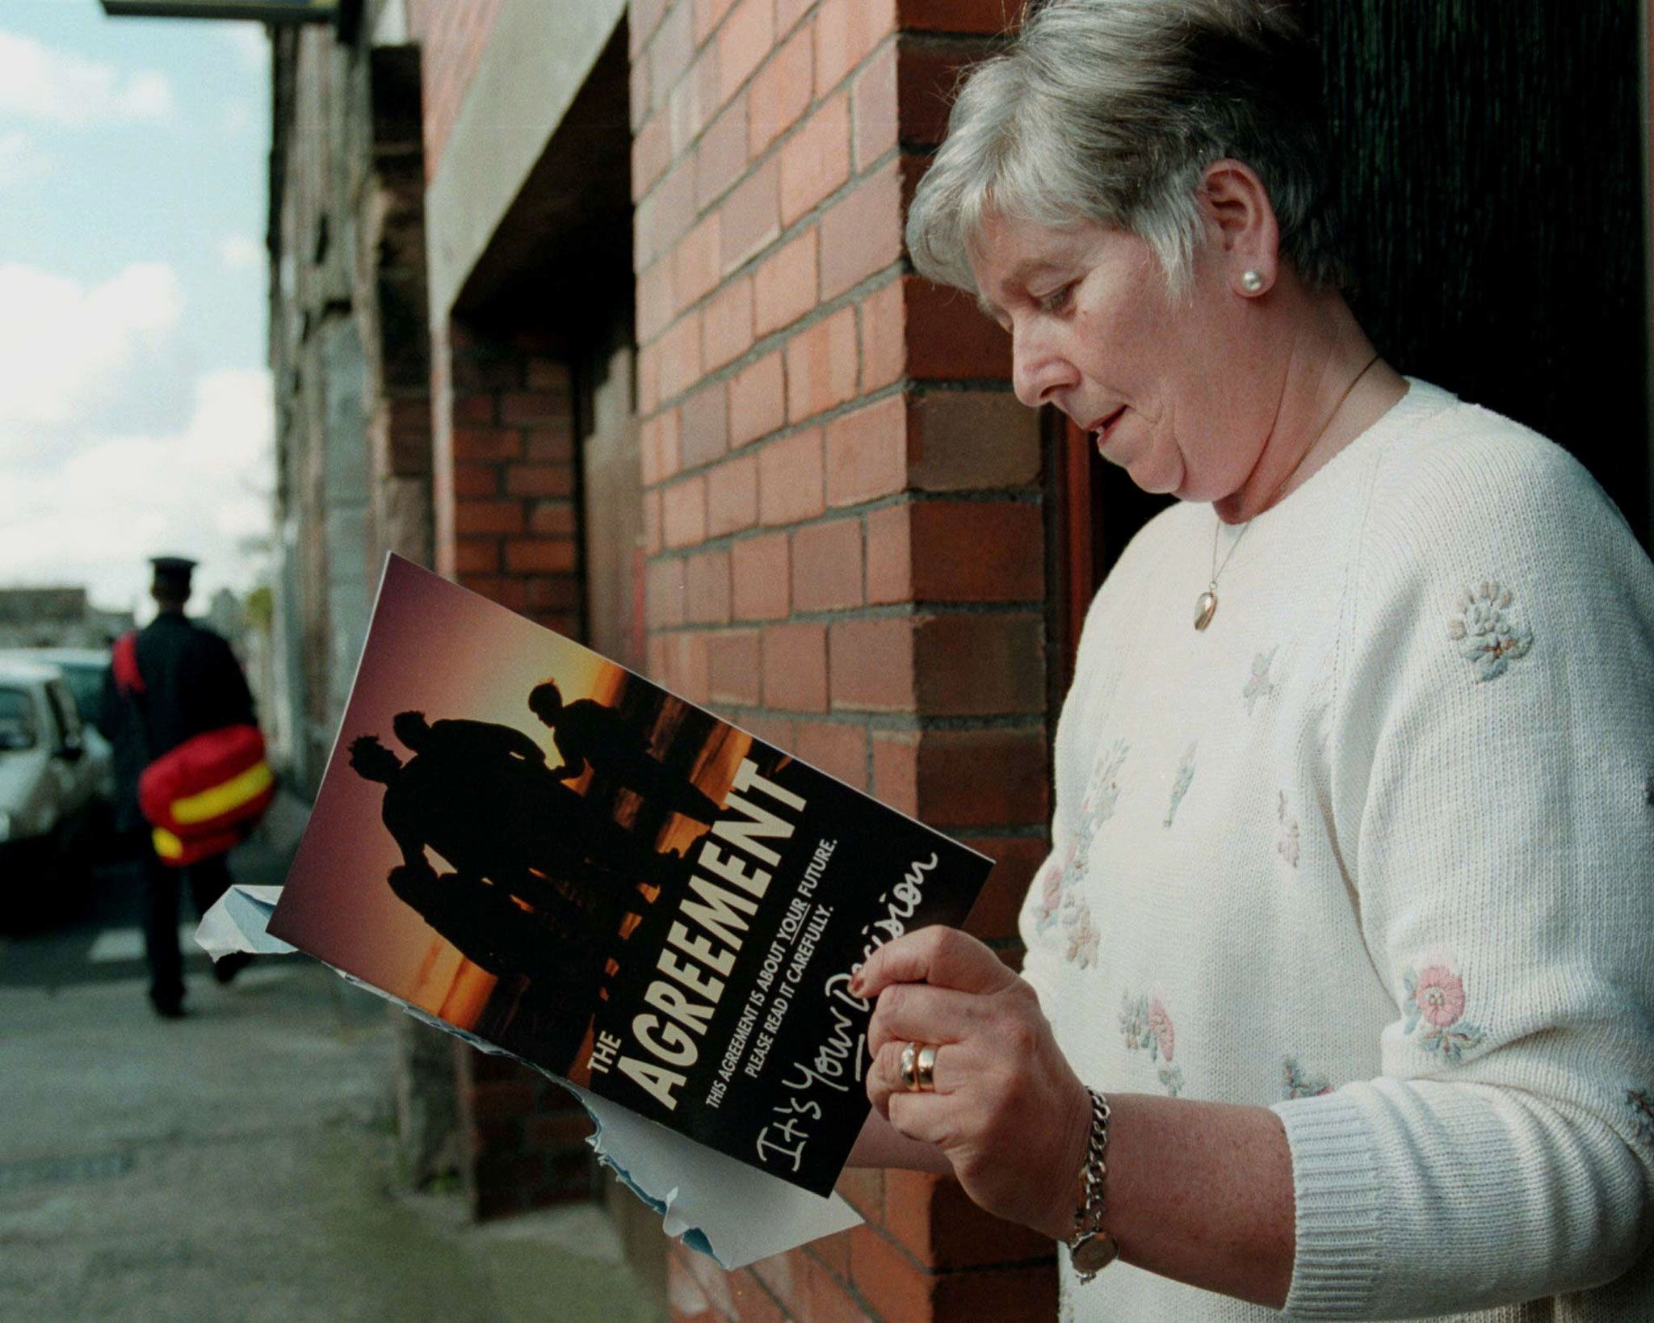
Great News!
In April 1998, after years of hard negotiations, there was a breakthrough in Northern Ireland.
The UK and Irish governments and the major political parties in Northern Ireland had all signed up to a historic agreement – the Belfast Agreement, often called the Good Friday Agreement.
Notes:
Reuters images – RTREAFE, RTXIEO7

Slide 3
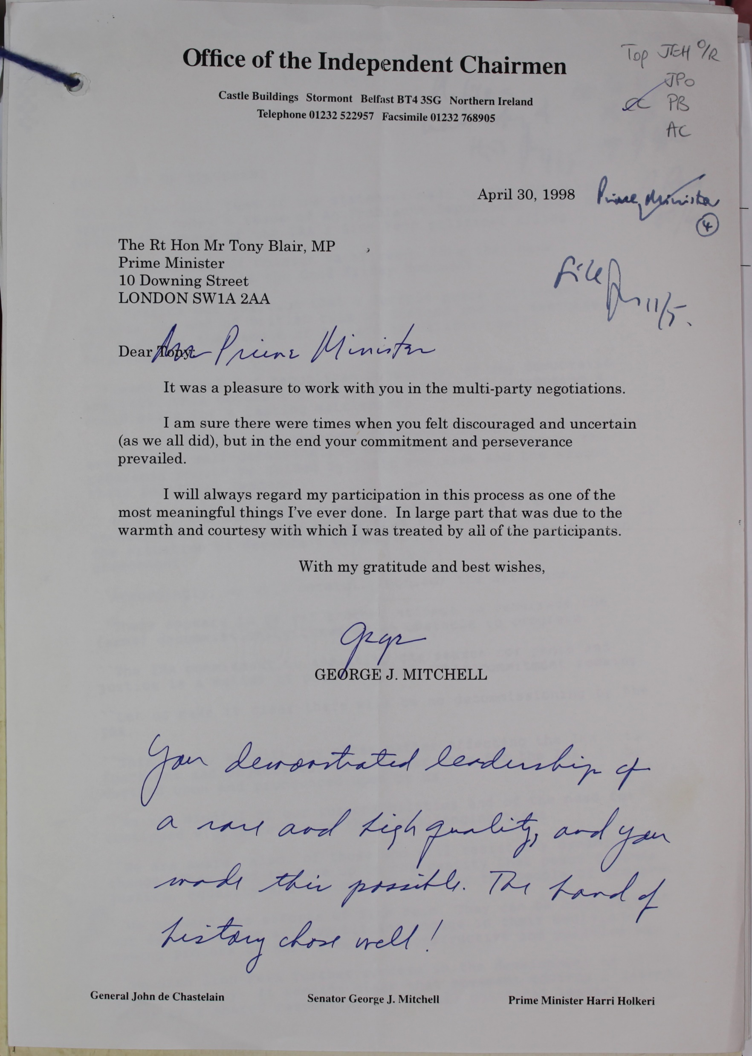
Does this document prove the Agreement was a success?
A letter from US Senator George Mitchell to UK Prime Minister Tony Blair in April 1998.
Mitchell was the Chairman of the Northern Ireland Peace Talks, an important figure in the talks which eventually led to the Agreement. His job was to be an independent and impartial individual who could help to resolve disputes.
Notes:
TNA Catalogue Ref: PREM 49/412

Slide 4
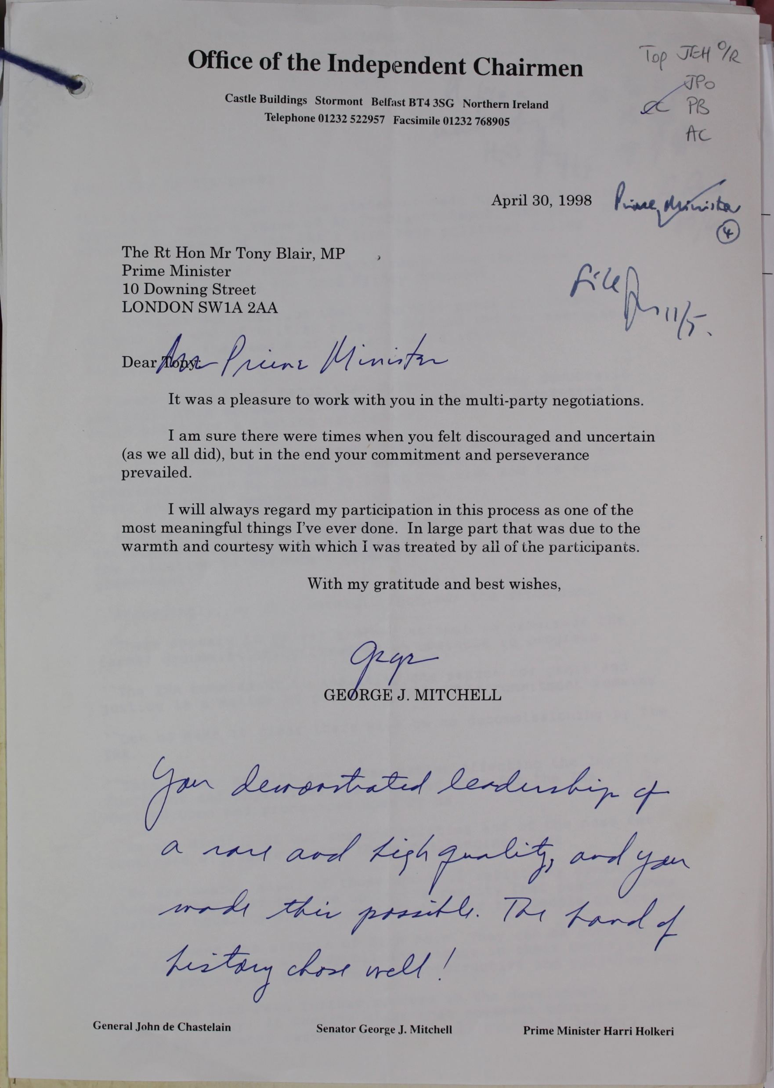
Worked example
Content of source
Senator Mitchell was congratulating Prime Minister Blair on the Agreement.
Context of source
Mitchell was effectively stepping down from his role and Chairman and this was a farewell letter to Blair.
How things work
It is clear that the Peace Process was extremely challenging and difficult.
Attitudes
Mitchell calls the Agreement one of the most meaningful things he has ever done. It seems clear that he is proud of the Agreement and thought it was a success.
Attitudes
Mitchell seems to have had a constructive relationship with Blair. His slightly teasing comment referred to a statement by Blair in 1998 when he said ‘A day like today is not a day for soundbites, we can leave those at home, but I feel the hand of history upon our shoulder with respect to this, I really do’. Many people thought this was amusing as they thought his comment actually was a soundbite!
Notes:
TNA Catalogue Ref: PREM 49/412

Slide 5
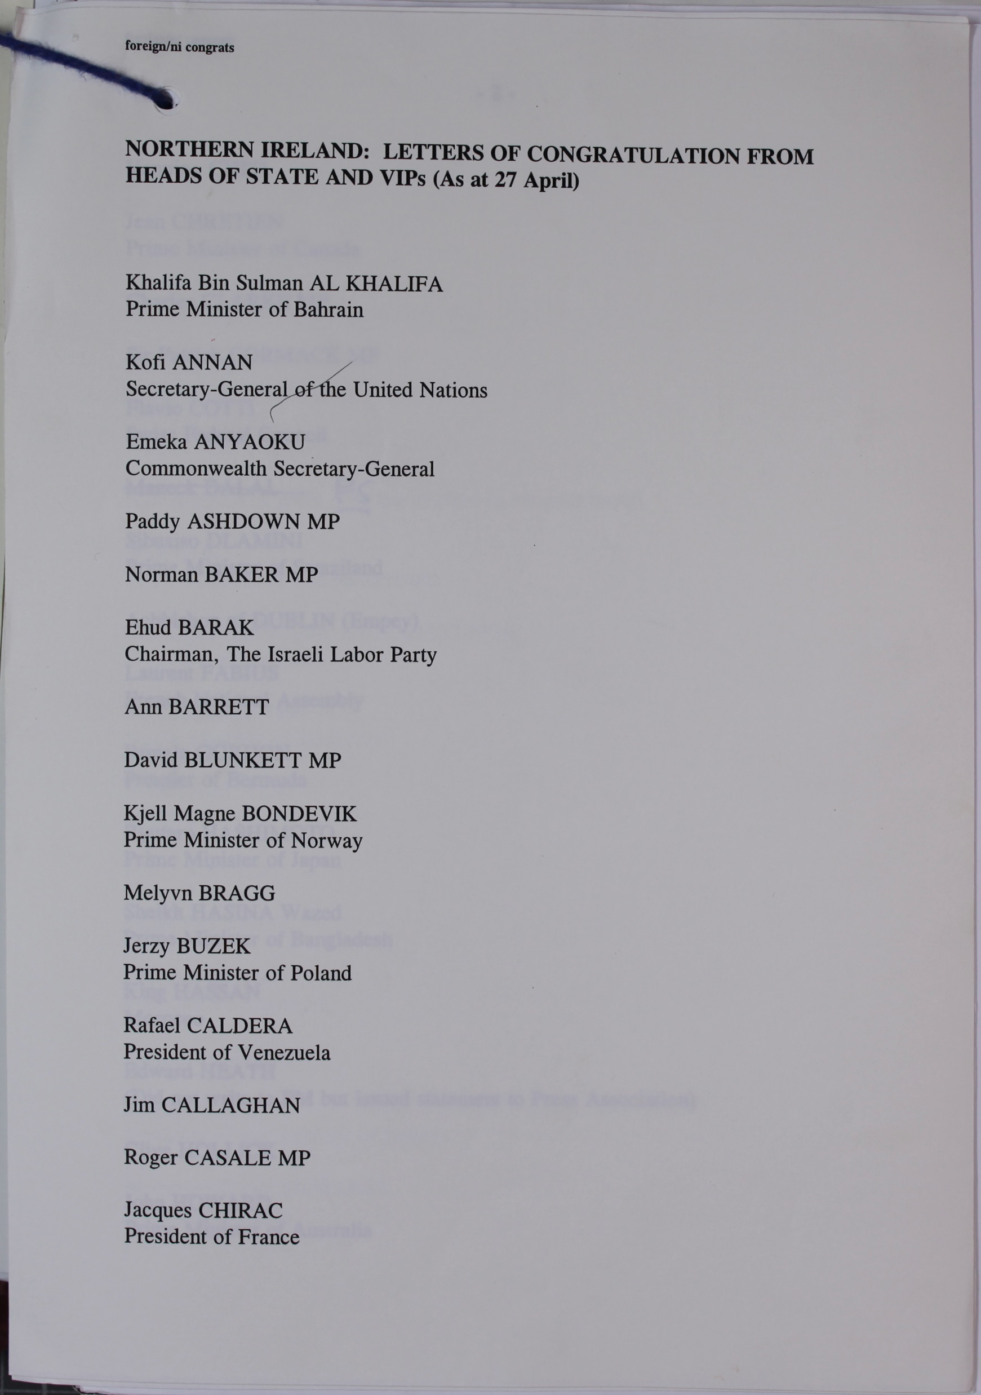
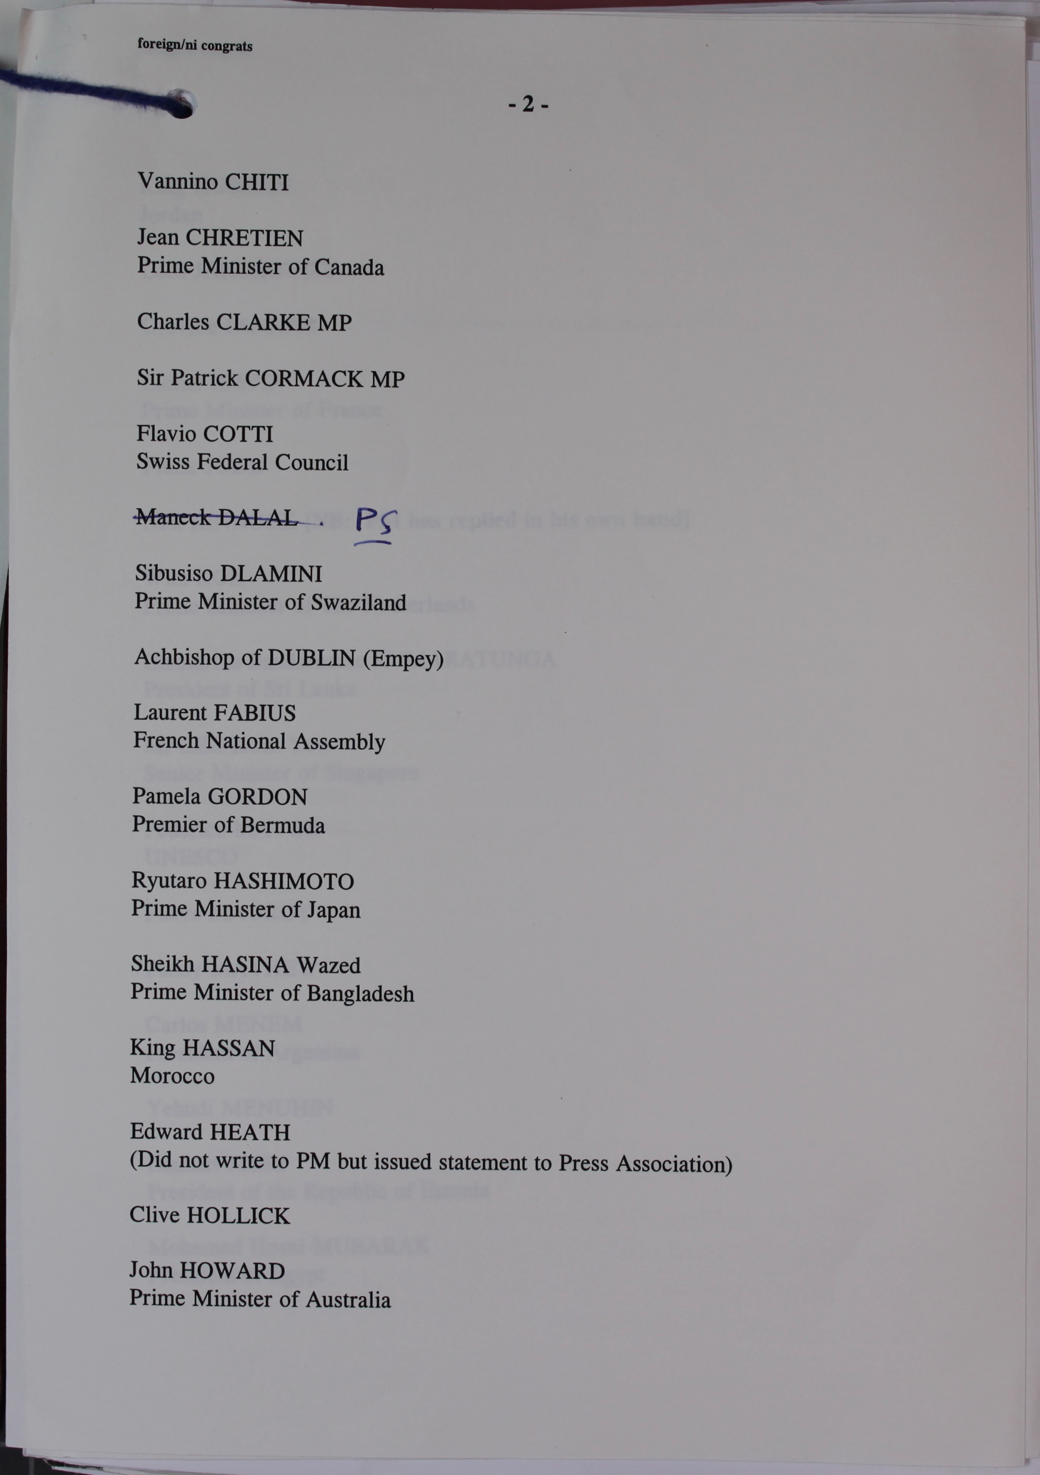
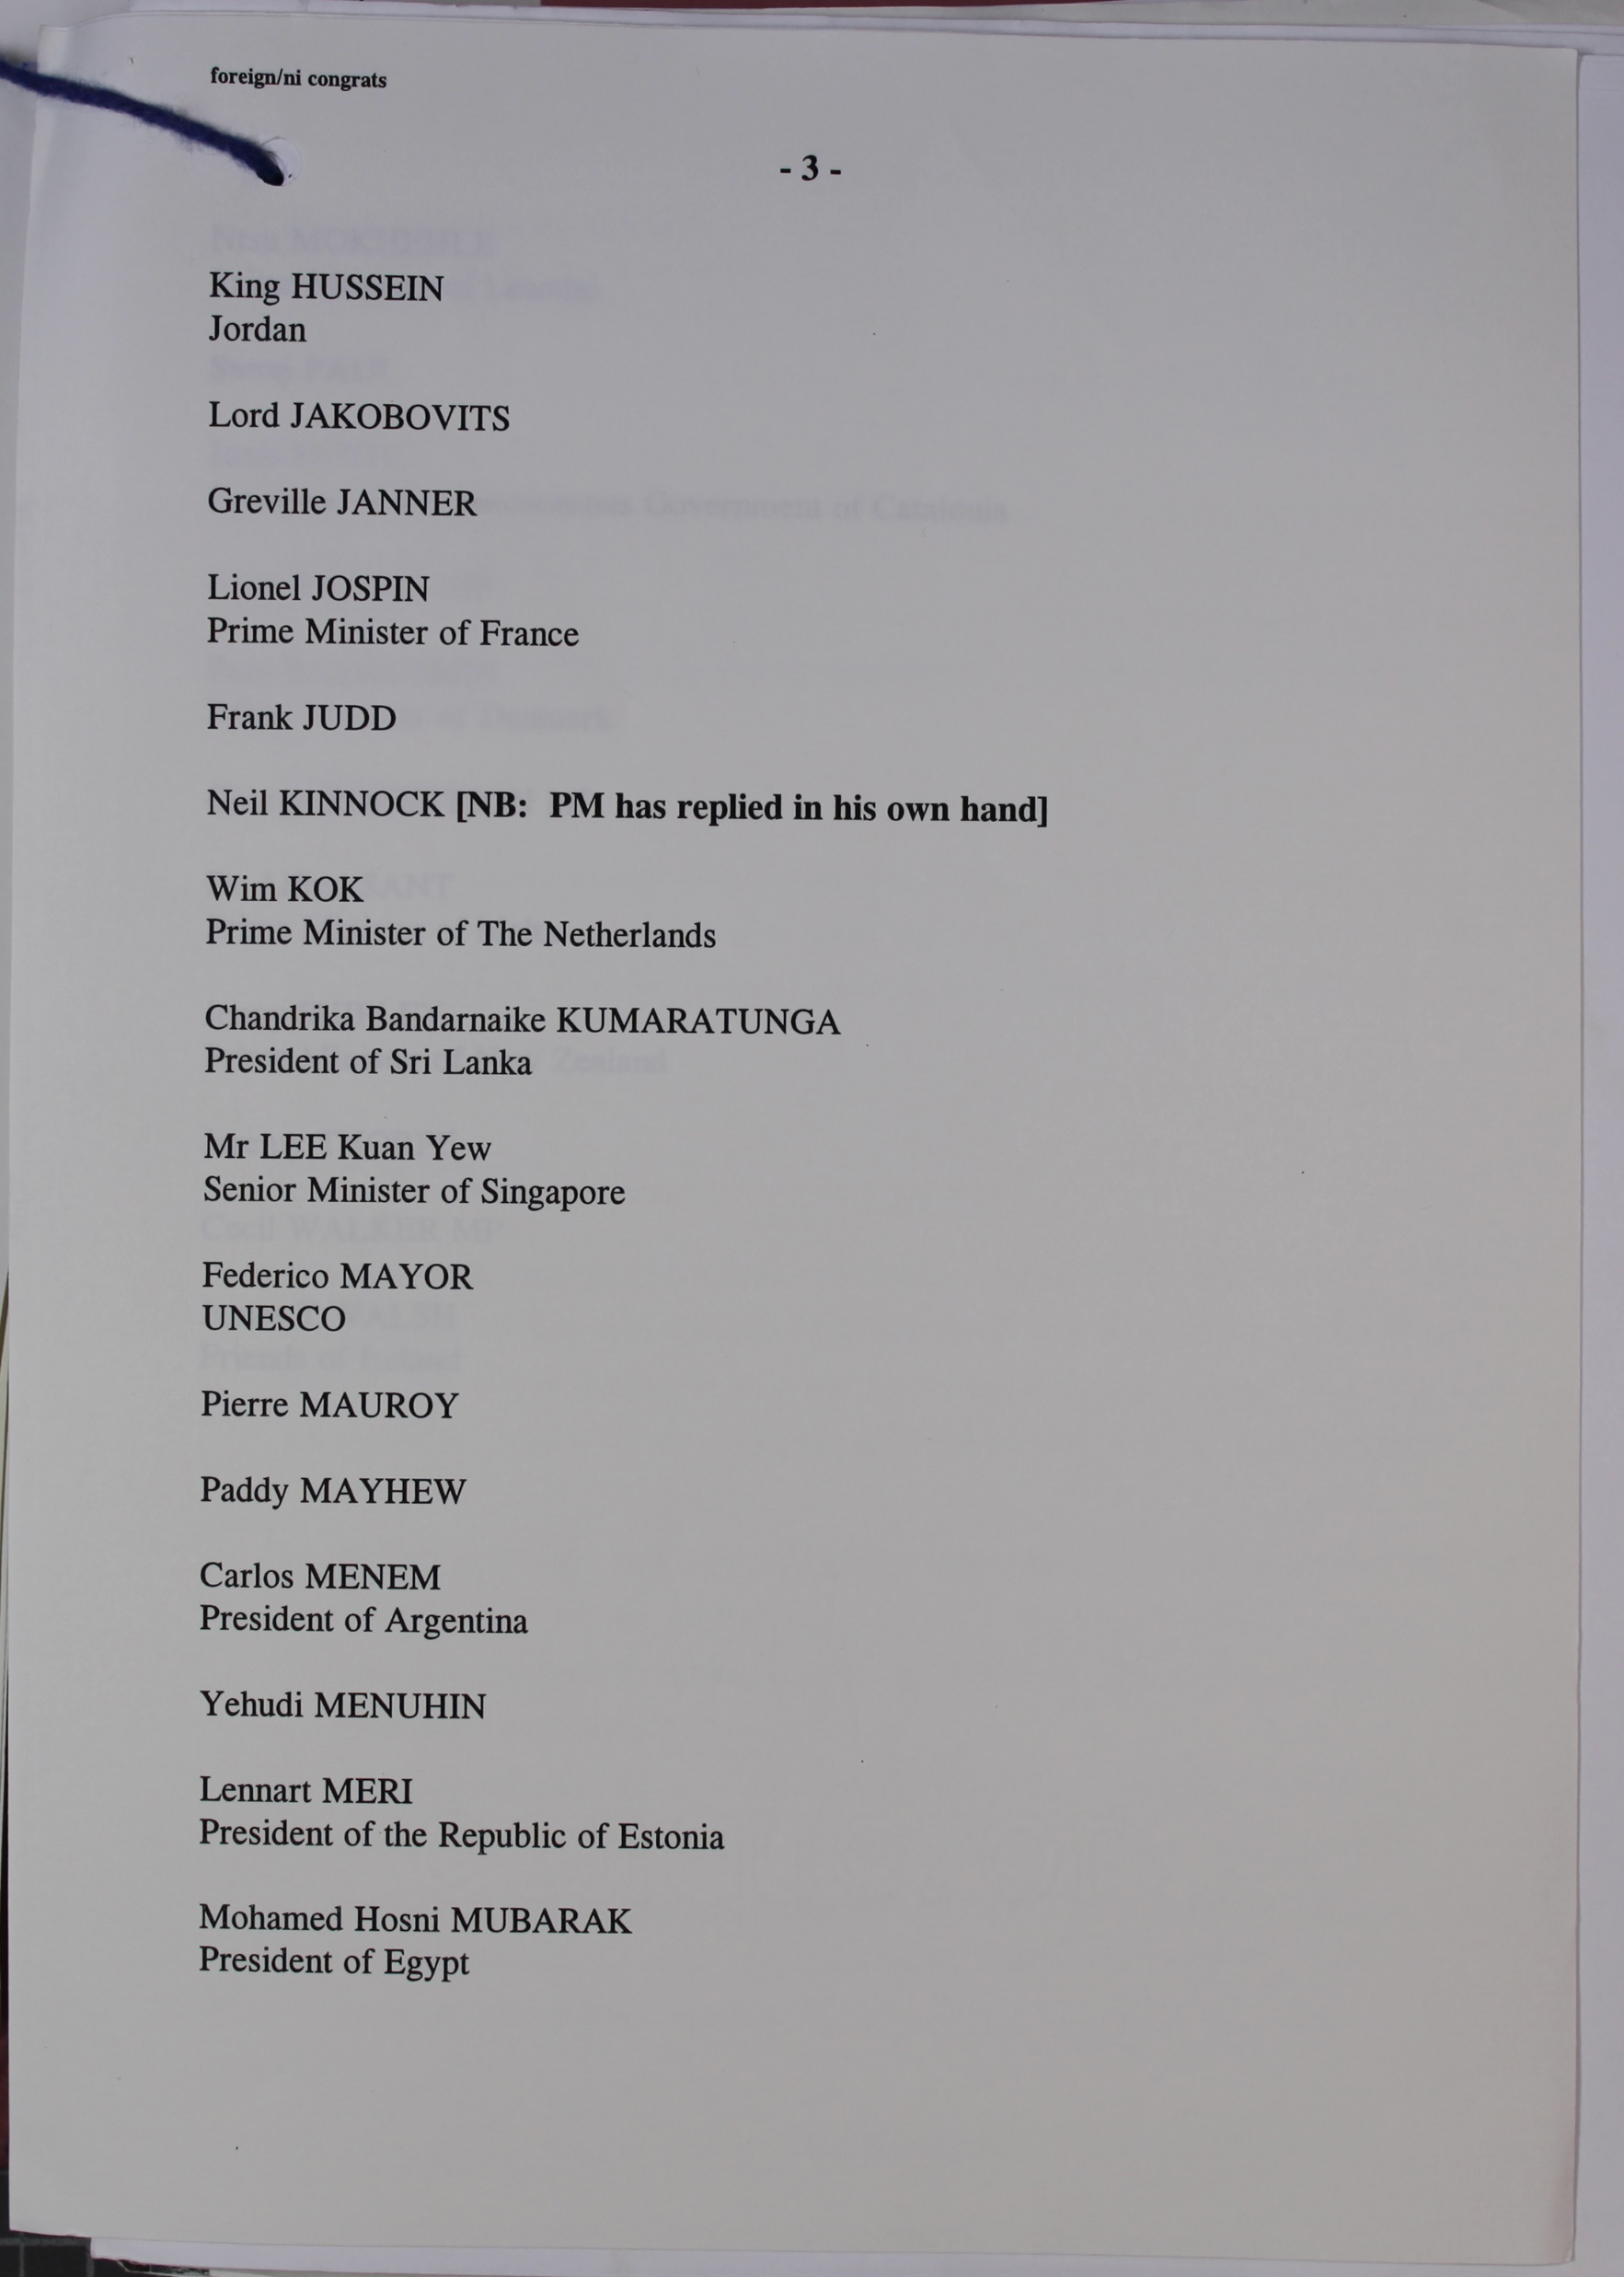
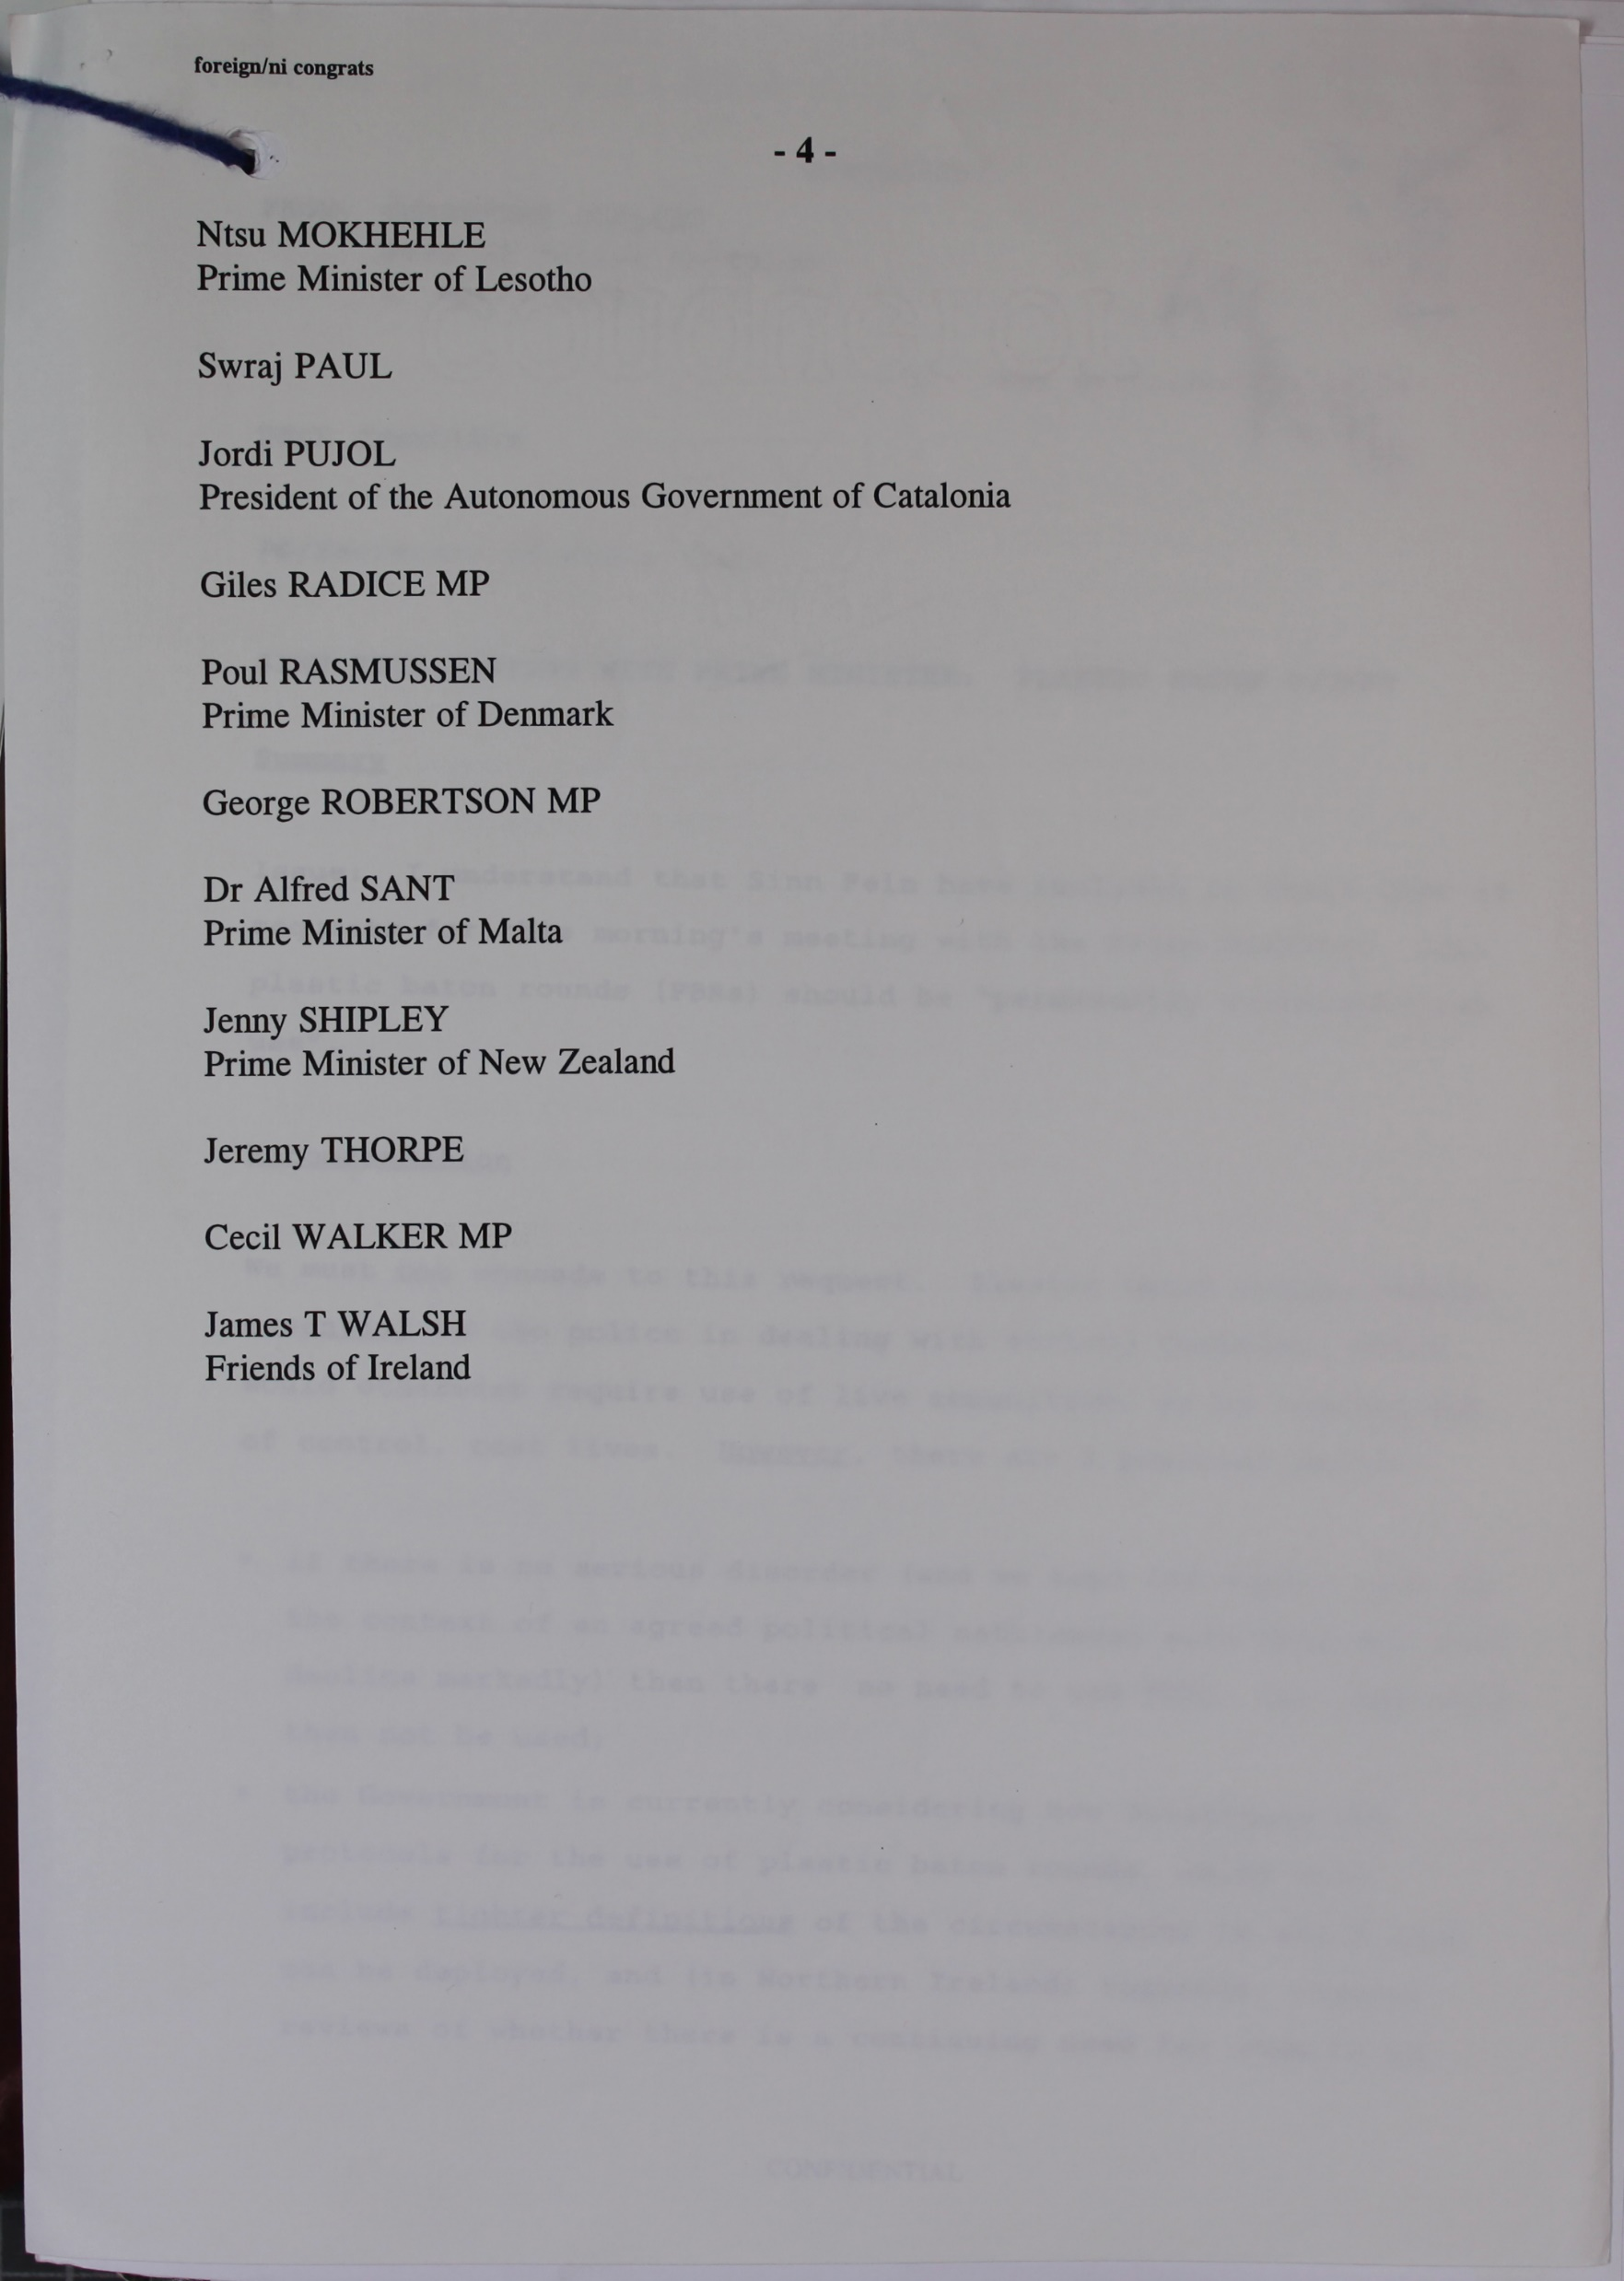
Does this document prove the Agreement was a success?
A list of Heads of State and VIPs who sent letters to the UK government congratulating them on the Agreement by 27 April 1998.
Notes:
TNA Catalogue Ref: PREM 49/412

Slide 6
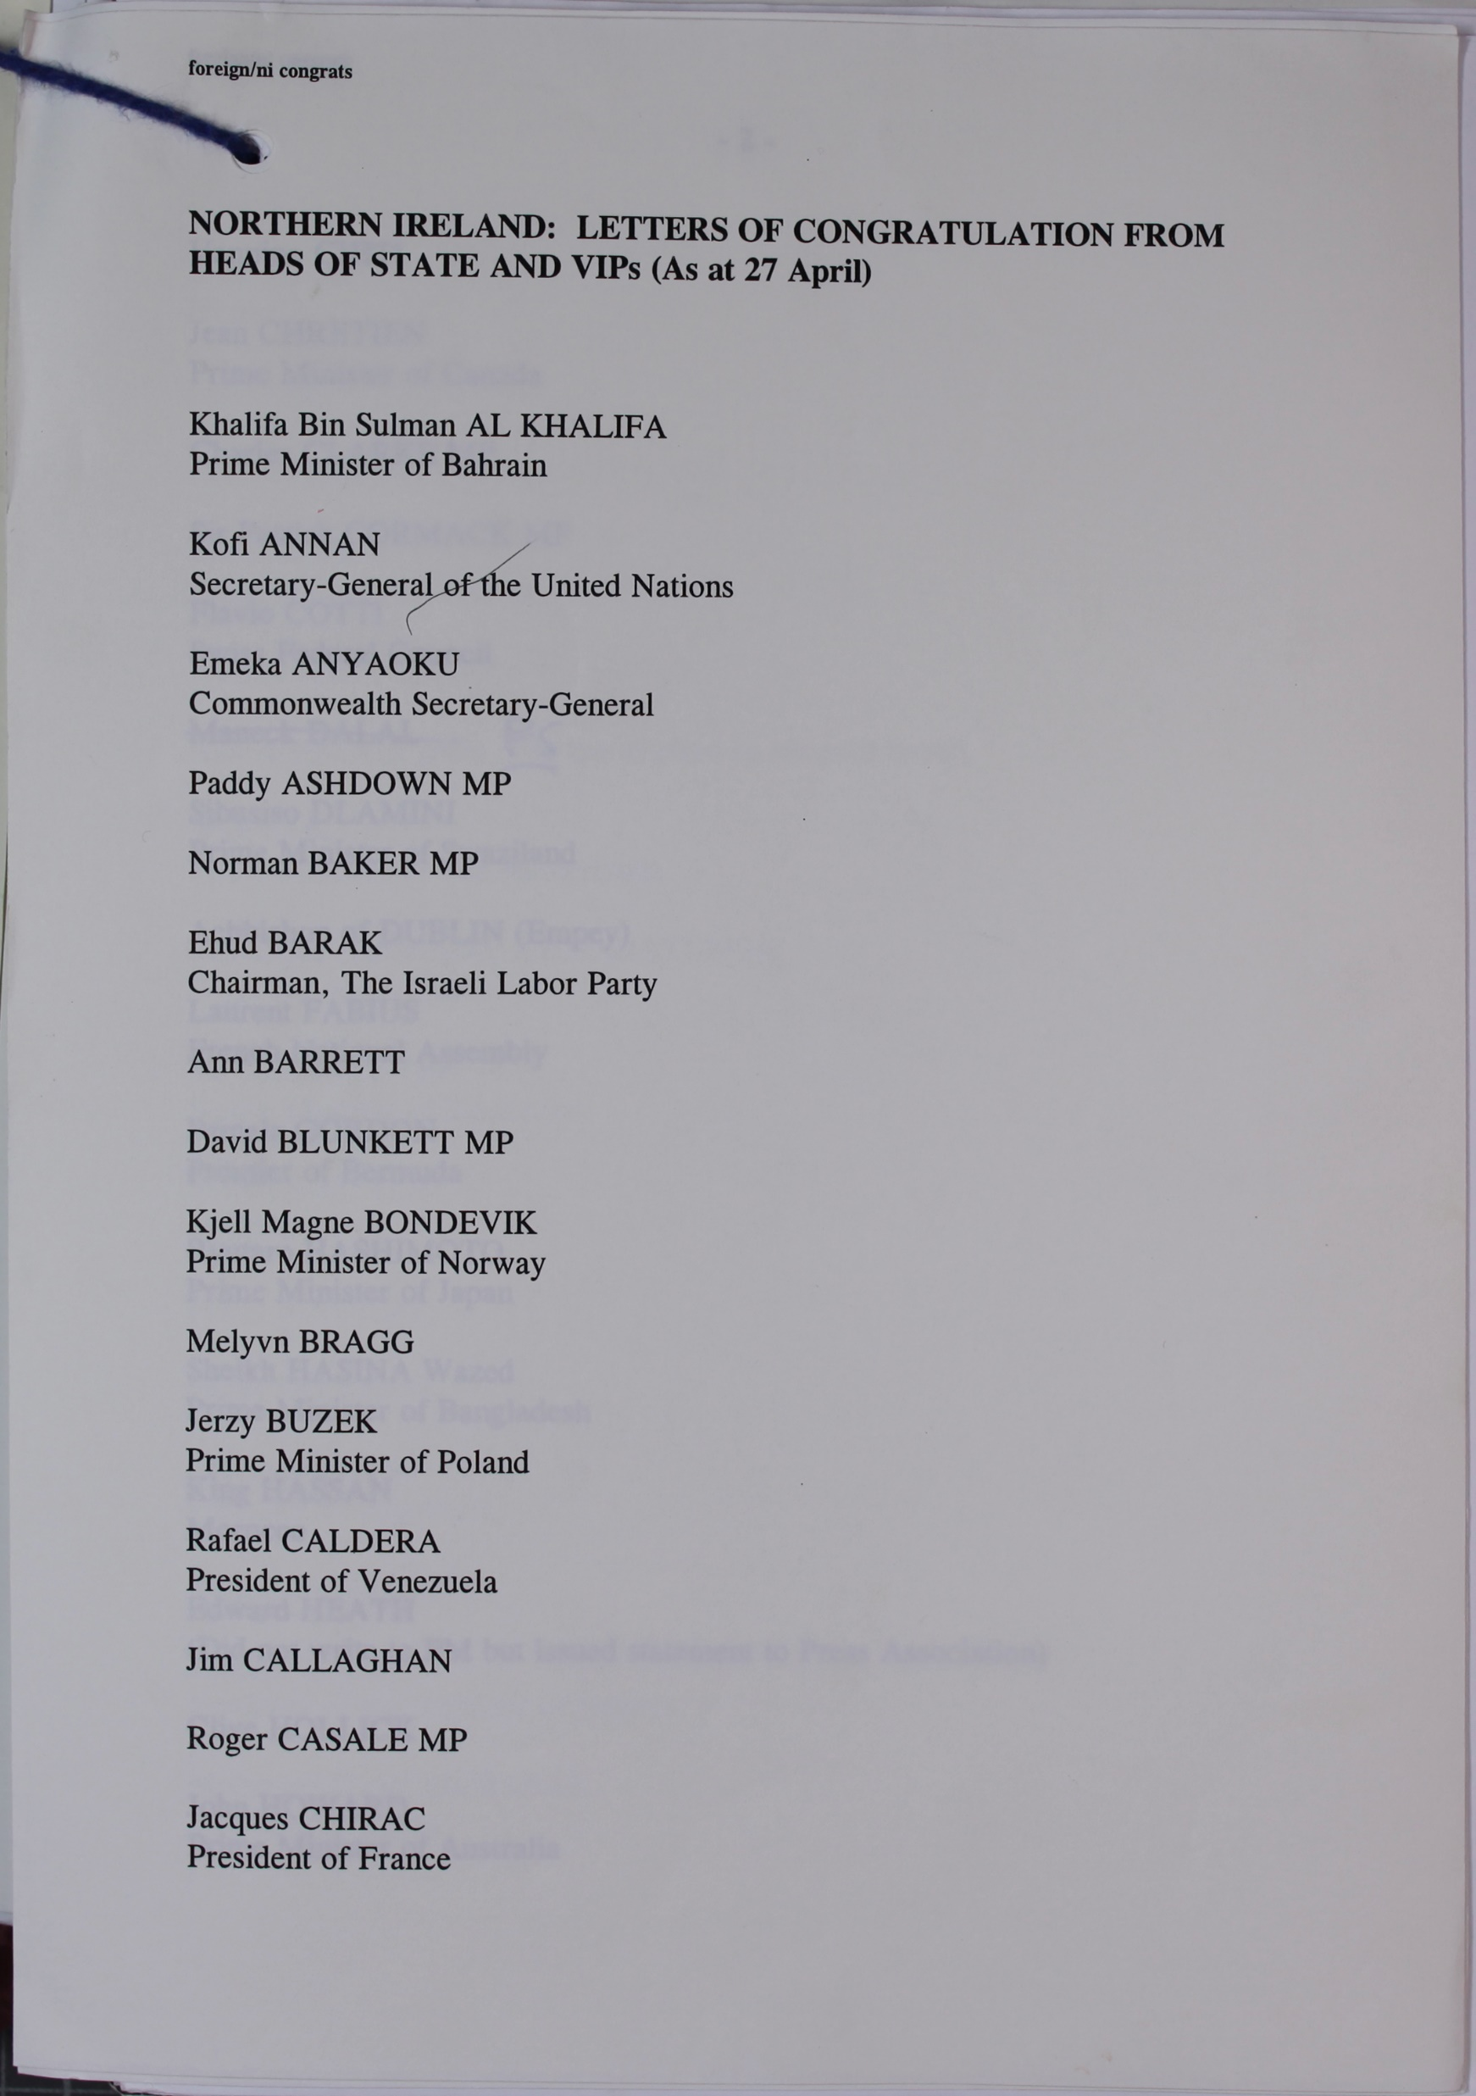
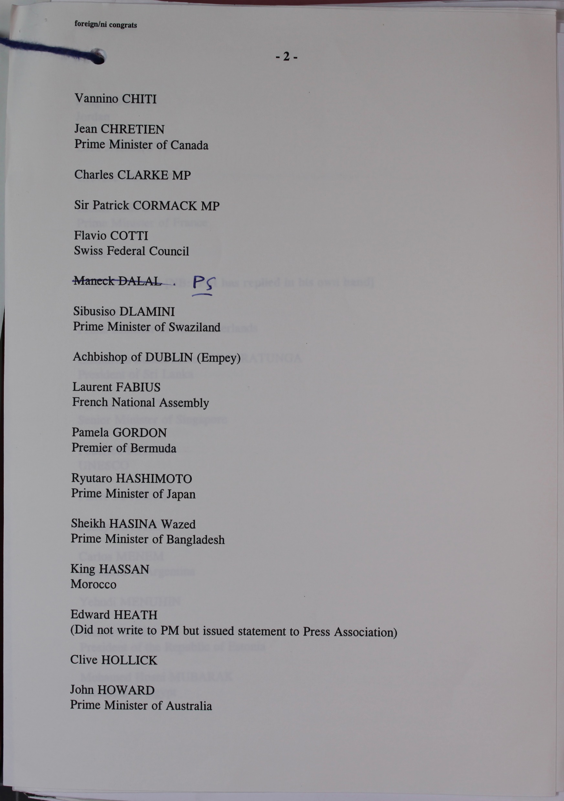
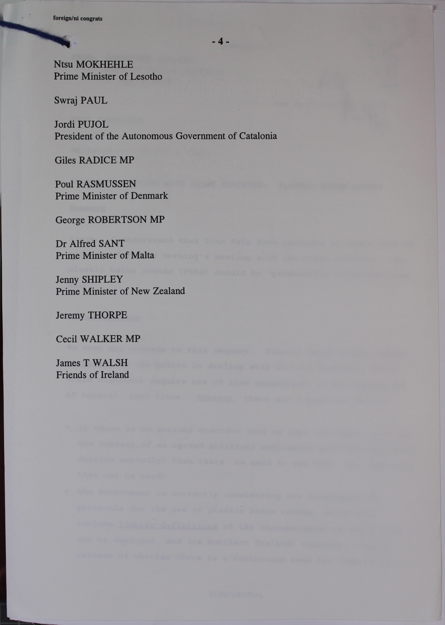
Worked example 2
Content of source
A very large and widespread list of politician and leaders had sent congratulations to the UK government.
Context of source
The Agreement was signed on April 10th, so these letters of congratulations had arrived since then.
Attitudes
It seems reasonable for historians to assume that these political leaders would not have sent letters of congrtaulations if they did not think the Agreement was an important achievement.
Notes:
TNA Catalogue Ref: PREM 49/412

Slide 7
Do you think the two documents prove the Agreement was a success?
Strongly agree | Agree | Neutral | Disagree | Strongly disagree
Study the following statements and then decide how far you agree with them and explain why.
The documents have proved to me that the Agreement was a success.
They prove that many important politicians believed that the Agreement was a success.
The documents actually prove that the Agreement was a failure.
The documents don’t prove anything at all.
The documents suggest the Agreement was a success but they do not prove it.
It is a reasonable theory that the Agreement was a success but I would need more supporting evidence to convince me.

Slide 8
How historians work
In History, it is usually very difficult to prove something.
However, historians can make a case based on the documents. This is often called a ‘line of argument’.
When they have a line of argument historians use documents and other sources they have studied as evidence to support their line of argument.

Slide 9
What can we learn from the documents about the first few months after the Agreement?
You are going to use this collection of documents to test out some lines of argument:
The Agreement ended all of the tensions over Northern Ireland between the UK and Ireland.
The Agreement failed to ease tensions over Northern Ireland between the UK and Ireland.
Some groups actively opposed the Agreement even after it was signed.
All sides gave up on the Agreement after it was signed.
Despite the problems, all sides worked hard to make the Agreement work and this helped to ease tensions over Northern Ireland between the UK and Ireland.

Slide 10
Study the documents and complete the table to help you decide which line of argument is supported best by the evidence.
Source | Date | What is the source? | Brief summary of content | Could be used to support line(s) of argument A-E because ……
1
2
3
4
5
6

Slide 11
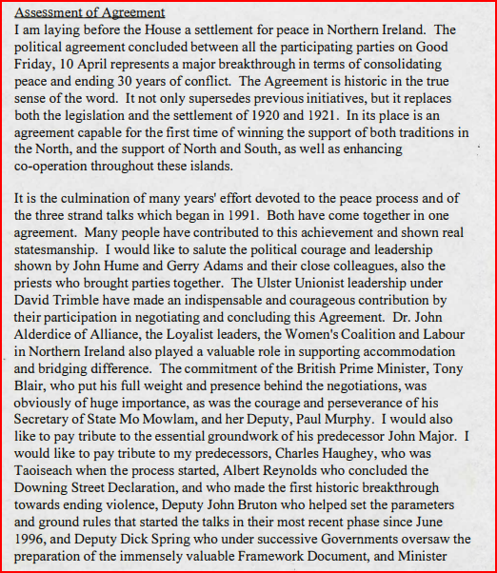
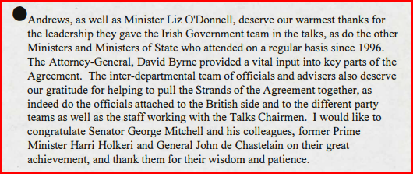
Source 1
The text of a speech by the Taoiseach (Irish Prime Minister) Mr. Bertie Ahern, TD on the Approval of the Multi-Party Agreement in Belfast on Good Friday, 10 April 1998. The speech was delivered on 22 April 1998.
Notes:
NAI Catalogue Ref: NAI/TAOIS/2021/100/08 1998-04-22
Context notes
Bertie Ahern was the Irish Taoiseach, the Prime Minister of Ireland. In this speech he was setting out the Agreement to the Irish Seanad, the upper house of the Irish Dáil. The Agreement was the culmination of years of political initiatives, negotiations and many setbacks. It involved politicians from Northern Ireland, Britain, Ireland, the USA and the European Union.
Questions
Content
Make a list of the individuals and groups who, according to Ahern, contributed to the Agreement.
Inferences from the Content
Is it reasonable for a historian to infer that Bertie Ahern was proud of the Agreement? Explain your answer.
Is it reasonable to infer that the Agreement was the result of close co-operation between politicians in Britain, Northern Ireland and Ireland? Explain your answer
Inferences from the Context
Why does Ahern believe that the Agreement is historic?
Lines of Argument
Which line(s) of argument A-E could use this document as supporting evidence?

Slide 12
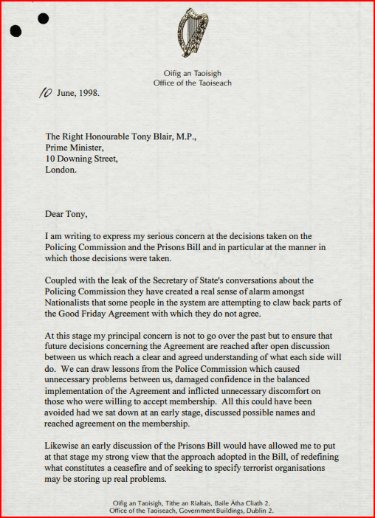
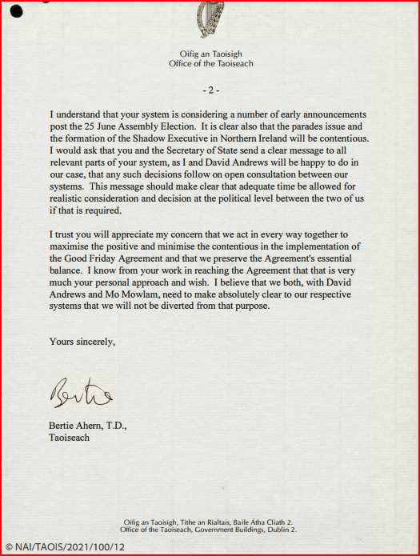
Source 2
A letter from the Taoiseach Bertie Ahern to the UK Prime Minister Tony Blair, 10 June 1998
Notes:
NAI Catalogue Ref: NAI/TAOIS/2021/100/12 1998-06-10
Context notes
One of many controversial issues in the history of Northern Ireland was the system of policing. Many in the Nationalist community felt that the existing police force, the Royal Ulster Constabulary (RUC) did not represent them properly. As part of the Agreement, the RUC was to be replaced by a new force called the Police Service of Northern Ireland (PSNI). An Independent Commission on Policing for Northern Ireland was set up to study policing and make recommendations about how Northern Ireland was to be policed in the future. There was a great deal of heated debate about who should be appointed to be part of this Commission. The situation was not helped when a confidential document about the Commission was leaked to the press on 4 June 1998 and revealed how tense and angry the debate was over the Commission.
Questions
Content
What is Ahern concerned about?
According to Ahern, why are Nationalists alarmed?
Inferences from the Content
Would historians be able to infer that Ahern is more concerned about not being consulted than about the actual decisions which have been made? Explain your answer.
Inferences from the Context
Is this source evidence that relations between the UK, Ireland and groups and politicians in Northern Ireland have broken down? Explain your answer.
Lines of Argument
Which line(s) of argument A-E could use this document as supporting evidence?

Slide 13
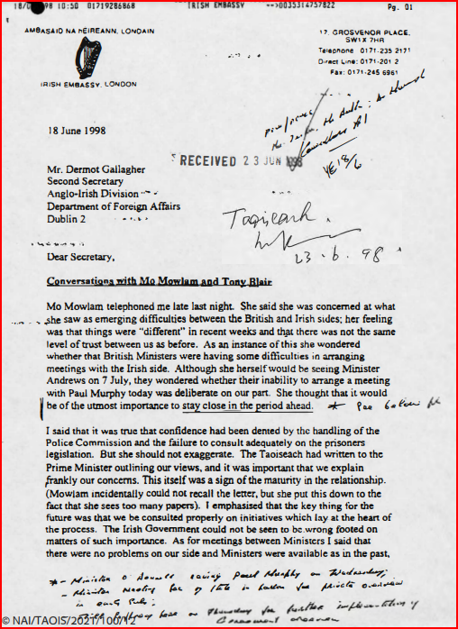
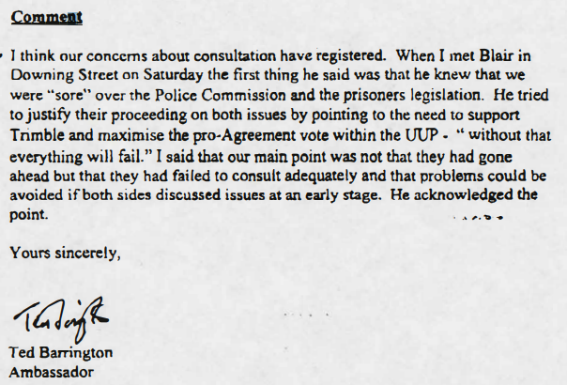
Source 3
Extracts from a letter from the Irish Ambassador in London to Dermot Gallagher, a senior official in the Department of Foreign Affairs in Ireland, June 1998
Notes:
NAI Catalogue Ref: NAI/TAOIS/2021/100/12 1998-06-17
Context notes
The author of this letter was Ted Barrington, Ireland’s Ambassador to the UK. He was reporting back to his superiors in the Foreign Affairs Department of the Irish Government about a phone conversation with Mo Mowlam. Mowlam was the UK Government’s Secretary of State for Northern Ireland. Paul Murphy was a UK Government Official who worked in Mo Mowlam’s department as Minister of State for Northern Ireland. A major part of Murphy’s job was liaising with officials from Ireland.
Questions
Content
According to Barrington what concerns does Mo Mowlam have?
What issues had “dented” relations between the UK and Ireland?
What was the underlying concern that Barrington said that the Irish Government had about how the UK had acted?
Inferences from the Content
Would historians be able to infer that on the whole Barrington was optimistic about relations between the UK and Irish governments?
Inferences from the Context
Can a historian make any inferences from this document about how well the British and Irish governments were communicating or co-operating?
Lines of Argument
Which line(s) of argument A-E could use this document as supporting evidence?

Slide 14
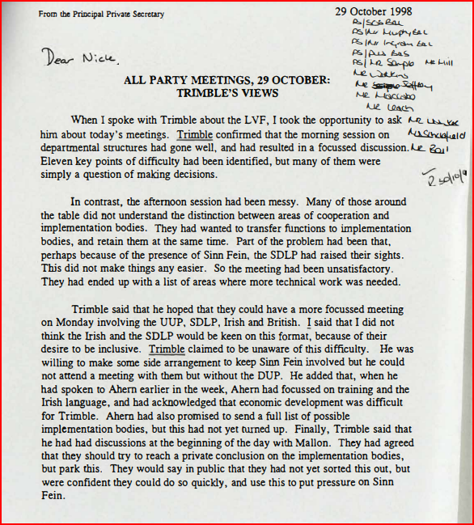
Source 4
Extracts from a letter between the UK Prime Minister’s Office and the Northern Ireland Office, October 1998.
Notes:
PRONI Catalogue Ref: PRONI CENT/3/268A 1998-10-29
Context notes
This letter was written in October 1998, by the Principal Private Secretary to the Prime Minister, a very senior figure in the UK civil service. He had been talking to David Trimble, leader of the Ulster Unionist Party, the largest Unionist Party in Northern Ireland at that time, about the Loyalist Volunteer Force (LVF), a Loyalist paramilitary organisation whose activities were causing concern. In the course of the conversation, they had talked about several other issues as well. The letter is reporting Trimble’s views to a colleague in the Northern Ireland Office.
Questions
Content
According to this account, did Trimble seem happy with the morning session of the meeting he had? Explain your answer.
Why was the afternoon session less successful?
What did Trimble want to happen?
Why would this be a problem for the Irish government?
Inferences from the Content
Would historians infer from this document that the meetings were going well, badly or somewhere in between? Explain your answer.
Inferences from the Context
What inferences could a historian make from the fact that the meetings were happening at all?
Lines of Argument
Which line(s) of argument A-E could use this document as supporting evidence?

Slide 15
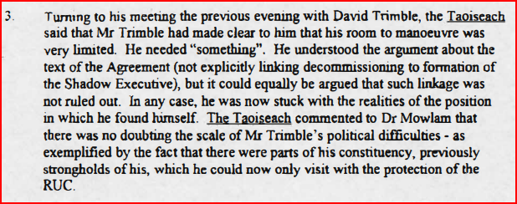
Source 5
Extract from a report of a meeting between the Taoiseach and the UK Secretary of State for Northern Ireland in September 1998
Notes:
NAI Catalogue Ref: NAI-TAOIS_2021_100_16 1998-09-23
Context notes
This extract comes from the notes taken at a meeting between Taoiseach Bertie Ahern and Northern Ireland Secretary Mo Mowlam. They discuss a wide range of issues, but these extracts focus on two issues. In section 3 they are discussing the challenges being faced by David Trimble, leader of the Ulster Unionist Party. Decommissioning meant the process of paramilitary groups giving up their weapons. The Shadow Executive was the term used for the new Northern Ireland devolved government before it officially took up its full powers. In section 13 the British-Irish Interparliamentary Body was an organisation formed in 1990. It was made up of 25 UK MPs and 25 Deputies of the Irish Parliament. They met to discuss issues of common interest and to promote understanding.
Questions
Content
What does Trimble mean when he says he ‘needs something’?
Inferences from the Content
What can a historian infer from the comment that Trimble needed RUC protection in parts of his own constituency.
What would you say was the attitude of Mo Mowlam and David Trimble towards the British-Irish Interparliamentary body?
Inferences from the Context
What inferences could a historian make from the fact that this meeting between the Taoiseach and Mo Mowlam was happening?
Lines of Argument
Which line(s) of argument A-E could use this document as supporting evidence?

Slide 16
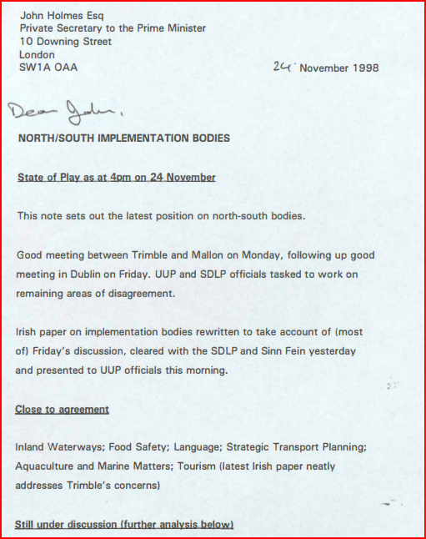
Source 6
Extract from a note by a UK government official on a meeting about cross-border bodies November 1998. These bodies were particiularly important as they allowed for deeper cooperation with the Irish government on matters affecting Northern Ireland and Ireland.
Notes:
PRONI Catalogue Ref: PRONI CENT/3/236A 1998-11-24
Context notes
Part of the Belfast Agreement of 1998 was the setting up of cross-border bodies – organisations which took responsibility for a range of issues across the whole island of Ireland. For example, the North/South Ministerial Council was established. The Council takes the form of meetings between ministers from both Ireland and Northern Ireland and is responsible for twelve policy areas. Six of these areas are the responsibility of corresponding North/South Implementation Bodies. For Unionists in particular, agreeing to these bodies was a massive step as it allowed for deeper cooperation with the Irish government on matters affecting Northern Ireland and Ireland. Trimble was the leader of the Ulster Unionist Party. Mallon was Seamus Mallon, Deputy Leader of the Social and Democratic Labour Party (SDLP), the main Nationalist party at this time.
Questions
Content
Who was meeting and where did they meet?
What areas of agreement were close?
Inferences from the Content
What can a historian infer from the activities described in this document?
Inferences from the Context
What inferences could a historian make from the fact that this meeting was happening?
Lines of Argument
Which line(s) of argument A-E could use this document as supporting evidence?

Slide 17
What was the significance of the Belfast (Good Friday) Agreement?
Complete the table before discussing which of the lines of argument are supported by the sources. It is possible that several are supported so you will then need to make a judgement about which has the most evidence and is the most convincing.
The Agreement ended all of the tensions over Northern Ireland within the UK and Ireland.
The Agreement failed to ease tensions over Northern Ireland within the UK and Ireland.
Some groups actively opposed the Agreement even after it was signed.
All sides gave up on the Agreement after it was signed.
Despite the problems, all sides worked hard to make the Agreement work and this helped to ease tensions over Northern Ireland within the UK and Ireland.

Slide 18
What was the significance of the Belfast (Good Friday) Agreement?
Once you have decided on a line of argument, you will write an extended paragraph in response to the question:
“What was the significance of the Belfast (Good Friday) Agreement?”
Your answer should explain why you have chosen the line of argument and what evidence from the sources supports it.
These sentence starters may help…
The Belfast (Good Friday) Agreement was / was not significant because (line of argument)…
This is supported by evidence in Source ___, which shows that …
This is further supported by Source ___, which shows that …
In conclusion the Belfast (Good Friday) Agreement should be seen as…

