Slide 1
The Road to the Belfast (Good Friday) Agreement

Slide 2
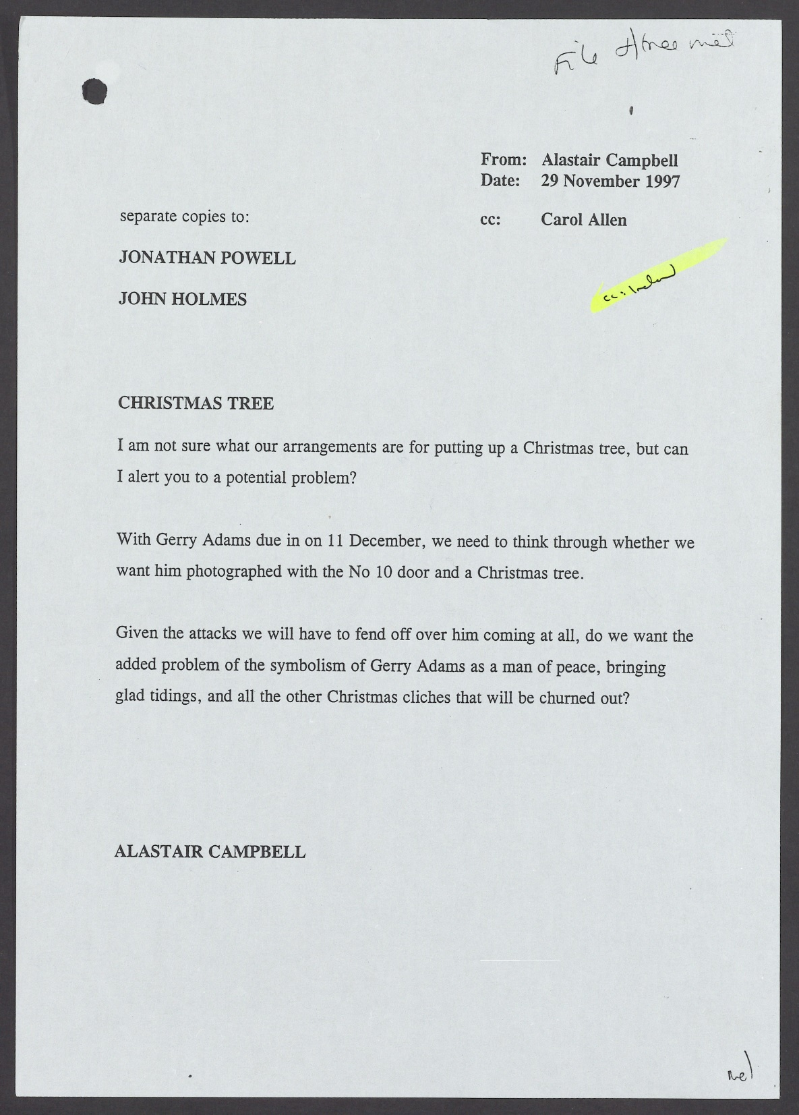
Why was Alastair Campbell worried about the Downing Street Christmas tree?
Notes:
TNA Catalogue Ref: PREM 49/121

Slide 3
Starter Activity
Read the document in front of you and answer the following questions:
What type of document is this?
What 3 things is Alastair Campbell concerned about?
Can you suggest any reasons for this?
What 3 questions to ask Alastair Campbell about his letter?
Notes:
TNA Catalogue Ref: PREM 49/121

Slide 4
Alastair Campbell was a Special Advisor to the Prime Minister, Tony Blair, in 1997.
In this communication, he is sharing concern with other people in the Prime Minister’s office about whether it would appear insensitive to put up a Christmas Tree outside 10 Downing Street.
This was because the Prime Minister was due to receive a visit from Gerry Adams on 11 December.
Notes:
TNA Catalogue Ref: PREM 49/121

Slide 5
This raises several questions …
Why was he coming to Downing Street?
Who was Gerry Adams?
Why was photographing him in front of a Christmas tree a problem?
Why was
Alastair Campbell expecting attacks?
Notes:
Teachers could fill in some of the blanks here, or just take questions and suggestions. They should be able to answer these questions at the end.

Slide 6
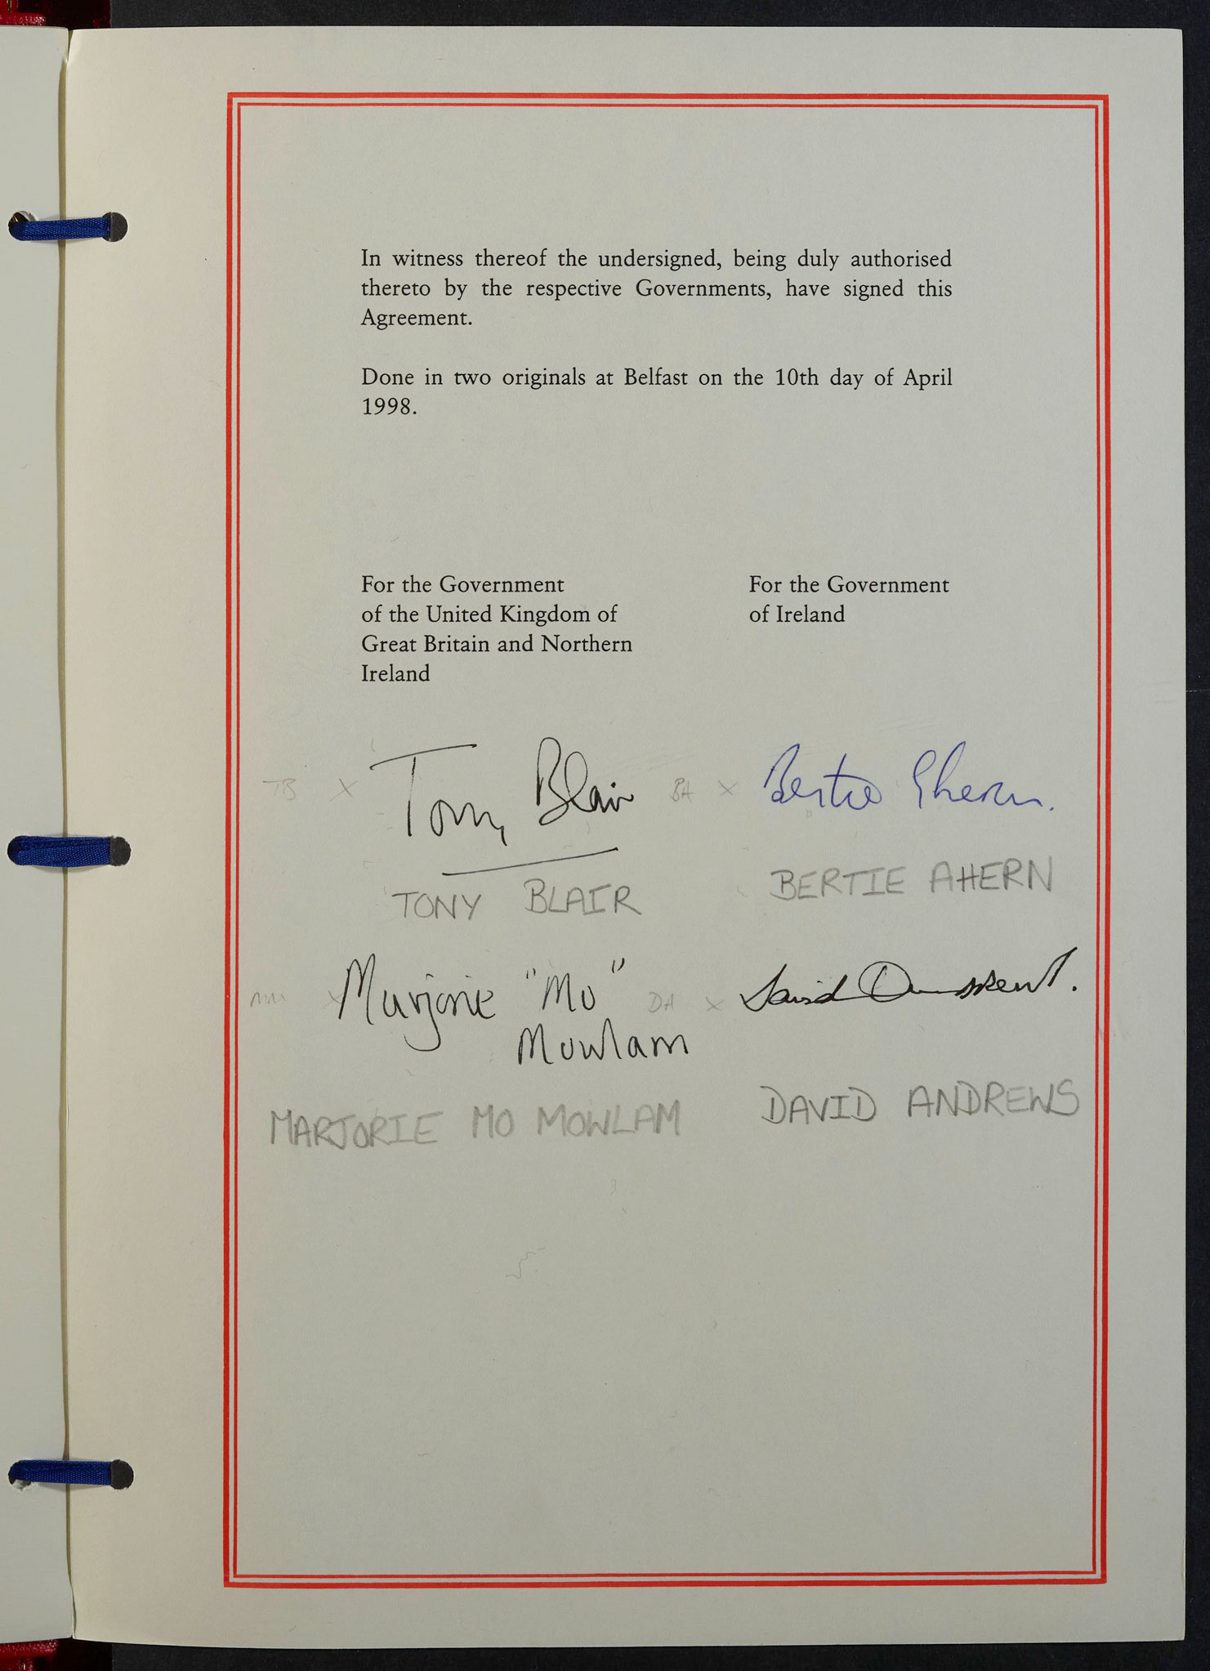
The Road to Peace
Why was it so difficult to make peace?
Notes:
TNA Catalogue Ref: FO 93/171/33

Slide 7
By the end of the session, you will:
know two of the key moments on the road towards the Belfast (Good Friday) Agreement
understand reasons why it was so difficult to make peace
be able to use contemporary documents to deepen your understanding of the peace process in Northern Ireland
Notes:
TNA Catalogue Ref: FO 93/171/33

Slide 8
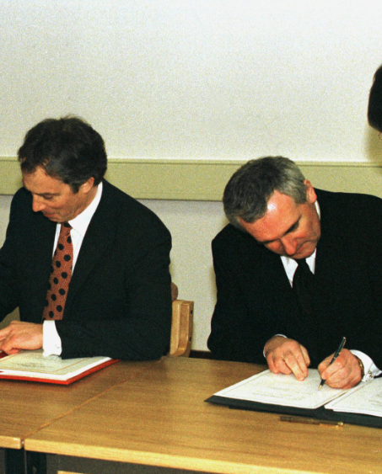
The signing of the Good Friday (or Belfast) Agreement was a historic achievement:
It established a Northern Ireland Assembly based on a power-sharing between different parties and communities
It set up a North-South Ministerial Council, made up of members of the Assembly as well as ministers from the Republic of Ireland.
The Irish government agreed to give up claims on Northern Ireland as part of its territory
There would be a review of policing in Northern Ireland
Early release for paramilitary prisoners was promised.
Notes:
Reuters images – RTRD2XQ
Refer to assembly video here if students have watched this.

Slide 9
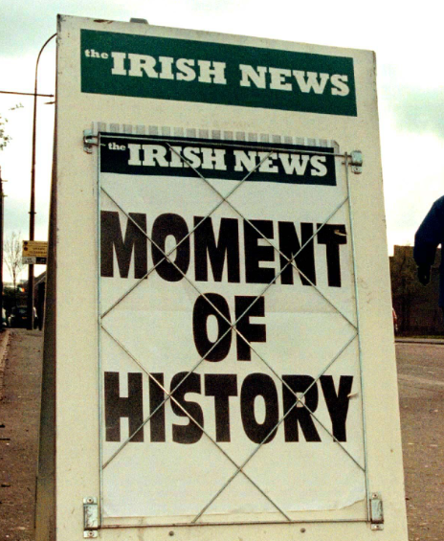
Why was the peace process so long and so hard?
However, this was not achieved easily.
As Alastair Campbell’s communication reveals, tensions were still running high months before the final agreement was signed.
In fact, there were still doubts about whether an agreement would be reached just days before it was finally signed by all parties.
Why was the peace process so long and so hard?
Notes:
Reuters Images – RTXIF8P

Slide 10
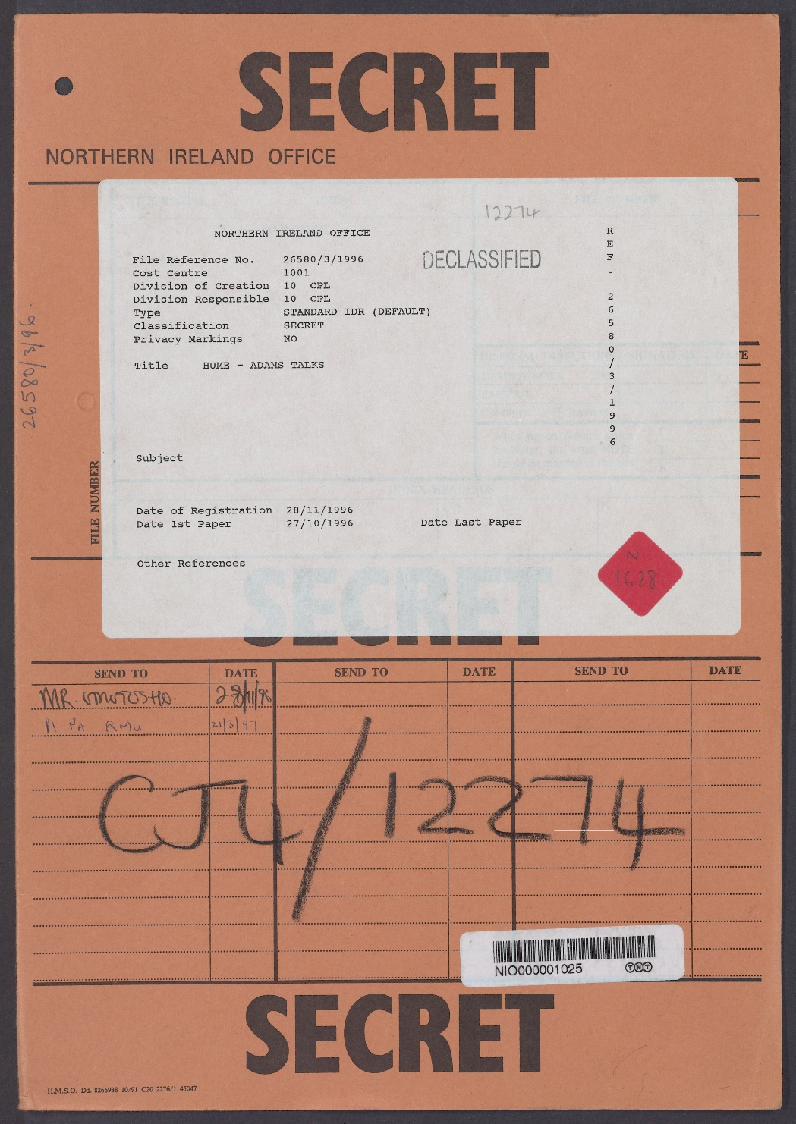
Main activity:
Why was it so difficult to make peace?
You are going to use a collection of six documents from The National Archives to investigate two key moments on the road to peace:
Peace talks in June 1996 (Documents A–D)
Peace talks in October 1997 (Documents E and F)
Notes:
TNA Catalogue Ref: CJ4/12274

Slide 11
Task instructions
For each document you examine, you need to:
Find any evidence that the talks are going well or that progress is being made
Find any evidence that there are still challenges or barriers to peace
Consider if it reveals any clues as to why making peace was so difficult
Use the questions at the bottom of each document to help you.
Notes:
TNA Catalogue Ref: CJ4/12274
Teachers should be clear that students may not be able to fill in every box for every document.

Slide 12
Review 1 – The Peace Process by June 1996
Look back over the last column in your table for Sources A-C.
List what you consider to be three important reasons why achieving peace was so difficult.
Choose one and write a paragraph to explain how it made achieving peace difficult. You need to use support from at least two documents you have examined.
These sentence starters may help…
One of the most important reasons it was so difficult to make peace was …
For example, in Source ___, we can see that …
This is further supported by Source ___, which shows us that …
Notes:
TNA Catalogue Ref: FO 93/171/33

Slide 13
Review 2 – The Peace Process by October 1997
Look back over the last column in your table for Sources D-F.
List what you consider to be three important reasons why achieving peace was so difficult.
Consider whether anything has changed between your previous review for June 1996 and this review in October 1997.
Choose one change and write a paragraph to explain what has changed and whether it made peace more or less likely. You need to use support from at least two documents you have examined.
These sentence starters may help…
One of the most important changes which helped / hindered the peace process was …
For example, in Source ___, we can see that …
This is further supported by Source ___, which shows us that …
Notes:
TNA Catalogue Ref: FO 93/171/33

