Slide 1
What was the most important factor which led to the achievement of the Belfast (Good Friday) Agreement?
Substantiating Historical Interpretations using Primary Sources

Slide 2
Substantiating Historical Interpretations
Historians substantiate their interpretations of the past by supporting their claims with evidence from primary sources. This is why two of the key assessment objectives at A level are:
Understanding and evaluating historical interpretations.
Using and assessing a range of historical sources
The following activity will require you to use and assess original documents from three archives in order to assess a number of different interpretations about the Belfast (Good Friday) Agreement.
All of the documents come from either:
The National Archives of the United Kingdom
The National Archives of Ireland
The Public Record Office of Northern Ireland

Slide 3
We asked five historians the following question…
What was the most important factor which led to the achievement of the Belfast (Good Friday) Agreement?
Naturally, they all said it was too simplistic to say that any single factor brought about the Belfast (Good Friday) Agreement.
However, each identified a factor, group or individual that they considered to be the most important.
They were only allowed a maximum of 250 words for their interpretations.
We have provided a brief biographical background to each historian before presenting their answer.

Slide 4
View 1 - Professor Henry Patterson - Biography
Henry Patterson – Ulster University
Emeritus Professor of Irish Politics at Ulster University
Published extensively on the history of Northern Ireland, Ireland and Anglo-Irish relations.
Publications include:
Ireland's Violent Frontier: the Border and Anglo-Irish Relations during the Troubles (2016)
Unionism and Orangeism since 1945 (2007), Ireland since 1939 (2006)
Northern Ireland 1921-2001 Political Forces and Social Classes (2002)
Class Conflict and Sectarianism The Protestant Working Class and the Belfast Labour Movement 1868-1920 (2020)
Member of the Centenary Historical Advisory Panel established by the Secretary of State for Northern Ireland in August 2020.

Slide 5
View 1 - Professor Henry Patterson
The most important factor that led to the achievement of the Good Friday Agreement was David Trimble’s leadership of the Ulster Unionist Party. Trimble led a naturally conservative force to embrace an accord which involved a share in government for Sinn Féin, a party which unionists regarded as spokespersons for a terrorist campaign that accounted for over sixty per cent of deaths during the Troubles.
His predecessor, James Molyneaux, had pronounced the IRA ceasefire of 1994 the most destabilising event in the history of Northern Ireland. He feared that any subsequent negotiations would see unionists pressed to make unacceptable political concessions to prevent a return to violence.
When Molyneaux resigned in 1995 David Trimble, was perceived as the most right wing of the contenders . However, once Leader, Trimble broke decisively with Molyneaux’s passive approach. Convinced that he had obtained acceptance of Northern Ireland’s constitutional position by nationalists and republicans he was prepared to go into government with Sinn Féin, agree to the early release of paramilitary prisoners and the radical reform of policing. Without this willingness to go over the heads of many of his party members and activists the Agreement would not have been possible.
Notes:
Questions
What does Henry argue is the most important factor, individual or group?
How did this contribute to the peace process and the Belfast (Good Friday) Agreement?
What challenges and obstacles had to be overcome?
What evidence is given to support this interpretation?
Does Henry’s biographical information help to explain this interpretation?
From your own knowledge how convincing do you find this interpretation?
What further evidence would you want to find in the documents to make the interpretation convincing?
If you were to provide a one-word summary of this individual’s contribution, which of these would you choose, or can you think of a better word? Obstructive / Unhelpful / Marginal / Constructive / Helpful / Pragmatic / Visionary / Essential

Slide 6
View 2 – Dr Eleanor Williams - Biography
Eleanor Williams – University of Cardiff and Researcher, The National Archives (UK)
International relations and politics tutor at Cardiff University.
First Class Honours Degree in International Relations and Politics at Cardiff University.
Masters Degree in International Relations.
PhD from Queen’s University Belfast investigating the ethics of state intelligence during the conflicts in Northern Ireland and Colombia
Researcher at The National Archives identifying documents about The Belfast (Good Friday) Agreement

Slide 7
View 2 – Dr Eleanor Williams
One of the most important factors which led to the achievement of the Good Friday Agreement was the inclusion of the people who were conducting the violence, which were the Republicans and the Loyalists. In the past, there had been other attempts at peace such as the Sunningdale Agreement of 1973. Whilst this agreement had many of the key ideas of the Good Friday Agreement of 1998, one of the main things missing were the groups who were conducting the violence. This meant that Republicans and Loyalists, who were not part of the agreement, had no incentive to stop their violent campaigns. Subsequently, making peace in the 1970s was very difficult and resulted in thousands of more people being killed.
In the Good Friday Agreement of 1998, the Republican and Loyalist groups were part of the negotiations and agreement. This was difficult for all groups involved. People had to negotiate with groups who were responsible for killing their loved ones, friends, and people within their own community. However, it meant that some of their key grievances could be resolved, as well as having to compromise too with key issues such as decommissioning. By involving the Loyalists and Republicans, those who were responsible for the violence now had a stake in peace and led them to signing the Good Friday Agreement.
Notes:
Questions
What does Eleanor argue is the most important factor, individual or group?
How did this contribute to the peace process and the Belfast (Good Friday) Agreement?
What challenges and obstacles had to be overcome?
What evidence is given to support this interpretation?
Does Eleanor’s biographical information help to explain this interpretation?
From your own knowledge how convincing do you find this interpretation?
What further evidence would you want to find in the documents to make the interpretation convincing?
If you were to provide a one-word summary of this individual’s contribution, which of these would you choose, or can you think of a better word? Obstructive / Unhelpful / Marginal / Constructive / Helpful / Pragmatic / Visionary / Essential

Slide 8
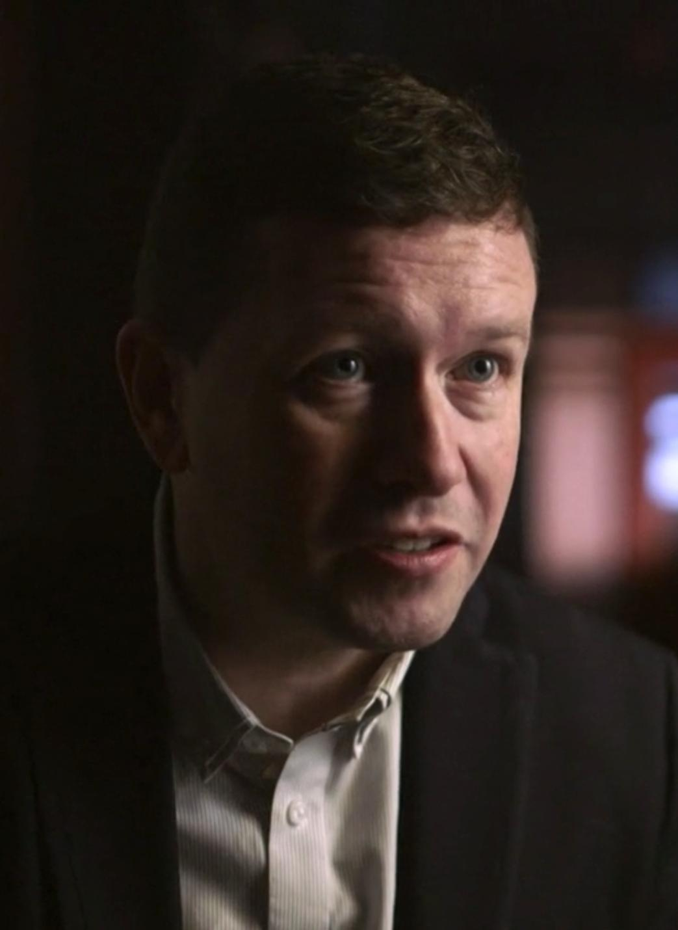
View 3 - Professor Tom Hennessey - Biography
Tom Hennessey – Canterbury Christ Church University
Professor of Modern British and Irish History at Canterbury Christ Church University.
Junior Research Fellow, at the Institute of Irish Studies, at Queen’s University, Belfast.
Research Officer at the Centre for the Study of Conflict, the University of Ulster.
Research Assistant at the think tank Democratic Dialogue
Research Fellow at the School of Politics, at Queen’s University, Belfast.
Member of the Ulster Unionist Party’s Talks Team during the negotiation of the Belfast (Good Friday) Agreement in 1998.

Slide 9
View 3 - Professor Tom Hennessey
A key turning point was the Republican movement’s dropping of the demand for a declaration by the British of intent to withdraw from Northern Ireland. This was a traditional Republican demand, and its ending can be traced back to a speech given by Jim Gibney of Sinn Féin, in 1992, at Bowdenstown, the burial place of the great Irish Republican, Wolfe Tone, where they make major announcements, when he said: “We know and accept that the British government's departure must be preceded by a sustained period of peace and will arise out of negotiations. We know and accept that such negotiations will involve the different shades of Irish nationalism, and Irish unionism engaging the British government either together or separately to secure an all-embracing and durable peace process.”
Jim Gibney was part of Gerry Adams’ think tank at Sinn Féin and he was setting the scene that there would be a longer process which would not require the British to agree to withdrawal up front. This marks a key change by the republican movement and a change in the thinking about the role of armed struggle against the British.
Notes:
Questions
What does Tom argue is the most important factor, individual or group?
How did this contribute to the peace process and the Belfast (Good Friday) Agreement?
What challenges and obstacles had to be overcome?
What evidence is given to support this interpretation?
Does Tom’s biographical information help to explain this interpretation?
From your own knowledge how convincing do you find this interpretation?
What further evidence would you want to find in the documents to make the interpretation convincing?
If you were to provide a one-word summary of this individual’s contribution, which of these would you choose, or can you think of a better word? Obstructive / Unhelpful / Marginal / Constructive / Helpful / Pragmatic / Visionary / Essential

Slide 10
View 4 - Dr Caoimhe Nic Dháibhéid - Biography
Caoimhe Nic Dháibhéid – University of Sheffield
Senior Lecturer in Modern History at the University of Sheffield.
Studied History and French at University College Cork, before undertaking an M.A. and Ph.D. at Queen’s University Belfast.
2009-10 Research Fellow at the Institute of Irish Studies, Queen’s University Belfast
2010-2012 Rutherford Research Fellow at Fitzwilliam College, Cambridge.
Researches in Irish history, in particular the Irish Revolution; political violence and terrorism since the nineteenth century; and the cultural history of the Irish Revolution, particularly the history of emotions.

Slide 11
View 4 - Dr Caoimhe Nic Dháibhéid
When thinking about the key contributors who shaped the peace process at various points Bertie Ahern is absolutely crucial because he is a deal maker. He comes from a background of undertaking very effective trade union negotiations and is instinctively oriented towards outcomes and getting deals done. He understands the importance of making key concessions. In particular, the amending of articles two and three of the Irish Constitution, which removed the claim to Northern Ireland as part of its national territory is absolutely crucial. Making that concession at an early stage of the negotiations and getting the people of Ireland to agree to it was key to building unionist confidence because they saw there was a new relationship between North and South. A long-standing Unionist fear was that they were bordered by an aggressive state waiting to swamp them. So the changing of articles two and three seems to me to be an important turning point because it handed Trimble the commitment necessary for him to convince the unionists that Ireland was serious about change.
Notes:
Questions
What does Caoimhe argue is the most important factor, individual or group?
How did this contribute to the peace process and the Belfast (Good Friday) Agreement?
What challenges and obstacles had to be overcome?
What evidence is given to support this interpretation?
Does Caoimhe’s biographical information help to explain this interpretation?
From your own knowledge how convincing do you find this interpretation?
What further evidence would you want to find in the documents to make the interpretation convincing?
If you were to provide a one-word summary of this individual’s contribution, which of these would you choose, or can you think of a better word? Obstructive / Unhelpful / Marginal / Constructive / Helpful / Pragmatic / Visionary / Essential

Slide 12
View 5 – Frank Sheridan - Biography
Frank Sheridan – Irish Government Diplomat and Researcher, The National Archives (Ireland)
Irish Foreign Service 1973 – serving in USA, Britain, the European Union, South America and Africa.
Private Secretary to Irish Foreign Minister.
Irish Ambassador to Mozambique.
Irish Ambassador to Brazil.
2014 Masters in contemporary Irish History, Trinity College Dublin.
Researcher film documentary - John Hume building Irish lobby in US.
Researcher for Seamus Mallon, former Deputy First Minister in Northern Ireland, politics memoir.
Edited memoir by British diplomat, Sir David Goodall, on negotiation of the Anglo-Irish Agreement 1985.
Researcher on Anglo-Irish affairs identifying documents for release to the Irish National Archives.

Slide 13
View 5 – Frank Sheridan
Unlike all the previous attempts at finding a solution to the conflict in Northern Ireland, the negotiations of the Belfast Good Friday Agreement were overseen by an external chairperson acting as a sort of referee on who could participate, the agenda for talks, and how to conduct them. That person was neutral, with no prior affiliation to any group in Northern Ireland or the two governments. He was former U.S. Senator, George Mitchell, a lawyer and politician with a strong record of achievement, and in 1995 he was proposed for the role by U.S. President, Bill Clinton.
The idea of such an appointment came from Irish-American pressure during the US presidential election in 1992 and on election, President Clinton appointed Mitchell, recently retired, first as advisor on Northern Ireland and then proposed to the British and Irish government leaders that Mitchell oversee all-party talks on the conflict.
It took almost a year to secure the agreement of all involved to Mitchell’s appointment. On the thorny issue of admission to talks of representatives of paramilitary groups, Mitchell drew up the Mitchell Principles, requiring a solemn pledge to non-violence and the use of only democratic means. For two years, with endless patience, Mitchell oversaw talks with the parties, slowly nudging them towards agreement and securing the involvement, usually by telephone calls from the White House to party leaders, of President Clinton, in support of his efforts which culminated in the Belfast Good Friday Agreement on 10th April, 1998.
Notes:
Questions
What does Frank argue is the most important factor, individual or group?
How did this contribute to the peace process and the Belfast (Good Friday) Agreement?
What challenges and obstacles had to be overcome?
What evidence is given to support this interpretation?
Does Frank’s biographical information help to explain this interpretation?
From your own knowledge how convincing do you find this interpretation?
What further evidence would you want to find in the documents to make the interpretation convincing?
If you were to provide a one-word summary of this individual’s contribution, which of these would you choose, or can you think of a better word? Obstructive / Unhelpful / Marginal / Constructive / Helpful / Pragmatic / Visionary / Essential

Slide 14
Part 1: Assess the Interpretations
Study each interpretation and summarise the key points made by the historian.
What do they argue is the most important factor, individual or group?
How did this contribute to the peace process and Belfast (Good Friday) Agreement?
What challenges and obstacles had to be overcome?
What evidence is given to support this interpretation?
Does the historian’s biographical information help to explain their interpretation?
From your own knowledge how convincing do you find this interpretation?
What further evidence would you want to find in the documents to make the interpretation convincing?
If you were to provide a one-word summary of this individual’s contribution, which of these would you choose, or can you think of a better word? Obstructive / Unhelpful / Marginal / Constructive / Helpful / Pragmatic / Visionary / Essential

Slide 15
Part 2: Assess the Sources
Carefully study the pack of 10 documents about the peace process.
Decide whether each document could be used as evidence to support views 1, 2, 3, 4 or 5.
Remember that documents may support more than one view
Decide whether they constitute strong, convincing evidence or whether more evidence is required to substantiate the interpretation and support the historian’s line of argument.
Here is an example of a source which could be used as evidence to support Henry’s view, but would you say it was decisive?

Slide 16
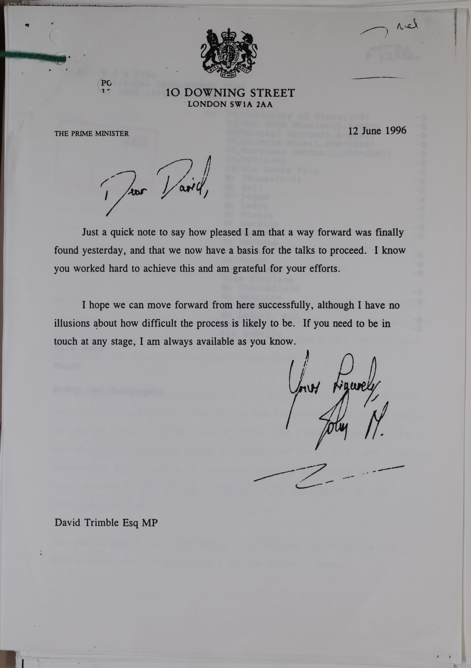
Worked example
Content of source
The Prime Minister was thanking Trimble for his contributions in the meeting.
Context of source
The meeting the PM refers to was one of many meetings which had taken place since the mid 1980s. Many of these meetings had been in secret. By 1996 there was a Peace Process, but there were still many obstacles.
How things work
We can infer that Trimble helped during the meeting. It might be reasonable to suggest that Trimble might have spoken to others behind the scenes at the meeting to help reassure or persuade them.
Attitudes
We can reasonably infer that some groups were hostile to the plans for a new government in Northern Ireland.
Attitudes
The Prime Minister seems genuinely grateful to Trimble. He also says he will always be available to talk. We can reasonably infer from this that Trimble is seen as an important and helpful figure by the UK Government.
This is a letter from UK PM John Major to Ulster Unionist Party (UUP) leader David Trimble on June 12th 1996. The Prime Minister is writing after he, Trimble and many other politicians and officials had met to work out plans for a new way to run Northern Ireland.
Notes:
TNA Catalogue Ref: CJ 4/12228

Slide 17
Before studying the documents remember…
Historians find sources useful in a number of ways …
Factual information (eg contents of agreements)
Making inferences from the content of the sources (eg inferring that X was concerned about Y because of the language they were using about Y; inferring that taking a particular action was difficult for X).
Making inferences from the context of the creation of the sources (eg why it is useful to know that X said Z about Y at a particular time, in a particular way, to a particular audience, using a particular medium – official letter, TV interview, particular newspaper etc)
KEY POINT – All sources are useful
Historians can always use sources as evidence about something
When X says something critical of Y it might be unreliable about Y but it is probably a very reliable source about the attitudes of X

Slide 18
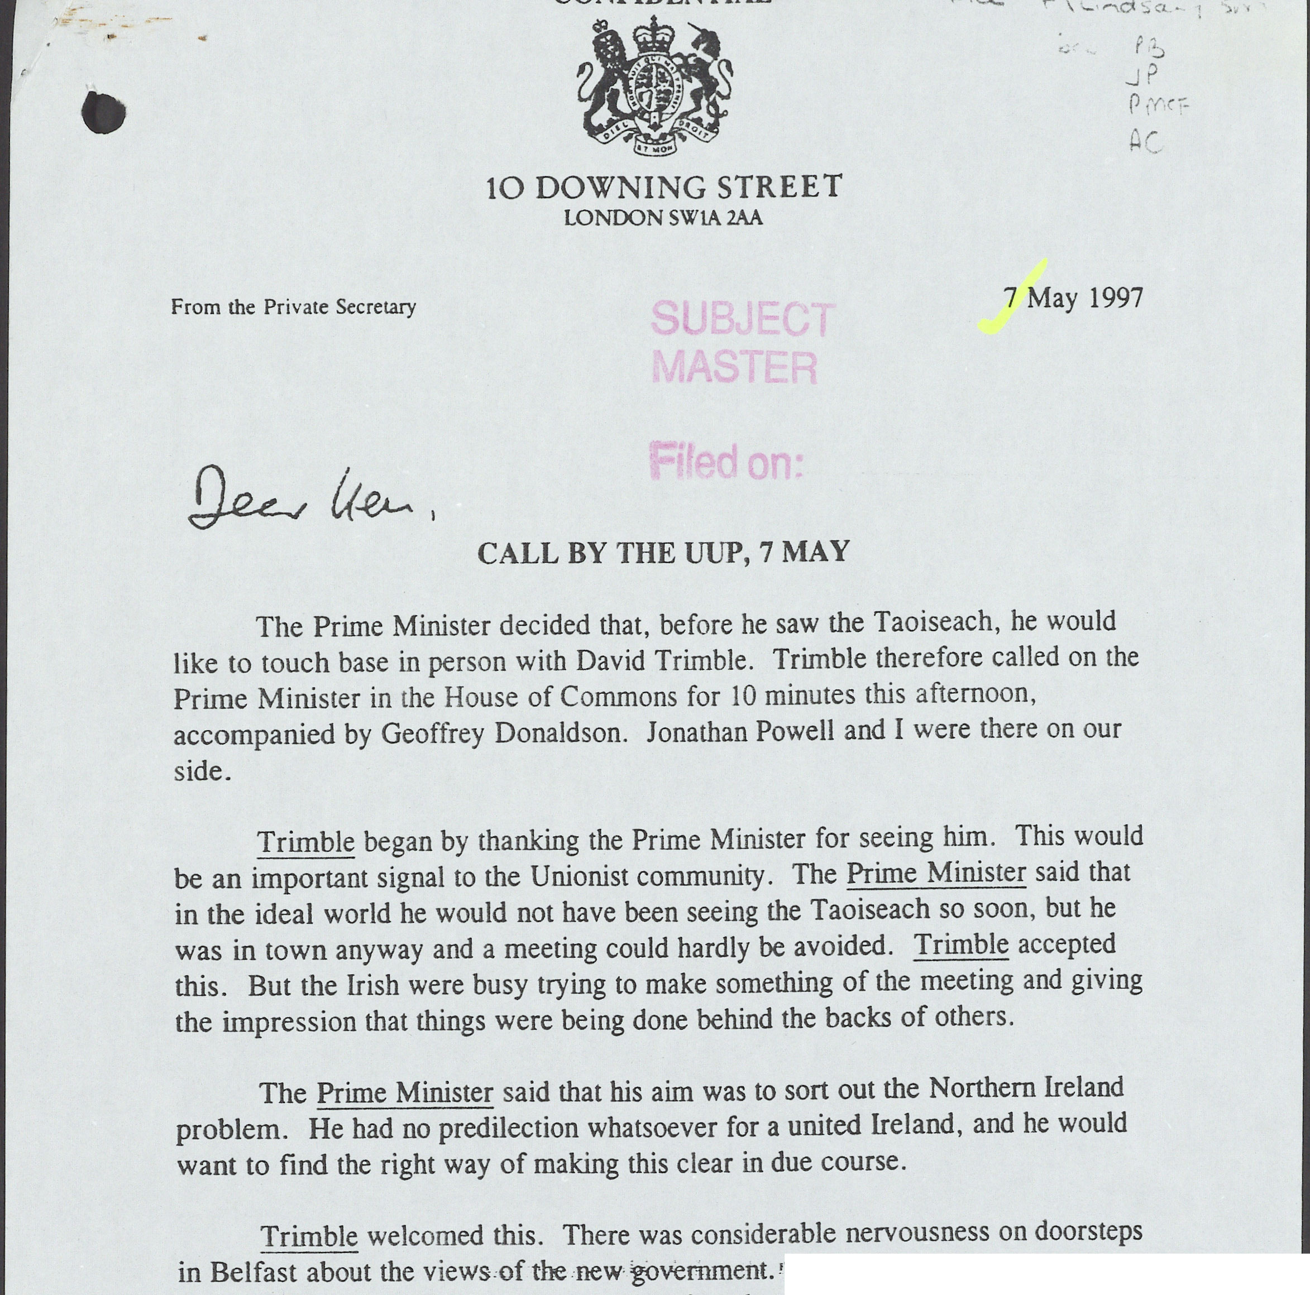
Source 1
Part of a record of a meeting on 7 May 1997 between the UK Prime Minister Tony Blair and David Trimble, leader of the Ulster Unionist Party (UUP) and Jeffrey Donaldson, of the Ulster Unionist Party (UUP).
Notes:
TNA Catalogue Ref: PREM 49/108
Context notes
This document was a record of a meeting between the UK Prime Minister Tony Blair and David Trimble, leader of the Ulster Unionist Party (UUP) and Jeffrey Donaldson, of the Ulster Unionist Party (UUP). Blair had only just won the UK election on May 1st. All sides were anxious to see whether the new government would maintain the same position as the previous Conservative government or whether Blair would take a different approach.
Questions
Content
Why was Trimble thanking Blair?
What were Blair’s views on the Northern Ireland situation?
Inferences from the content
What can be inferred about Trimble’s concerns at this point?
Inferences from the context
Can anything be inferred about the actions of the Irish government at this time?
Can anything be inferred from the fact that the meeting took place at all?
Lines of Argument
Which historian could use this document as supporting evidence?

Slide 19
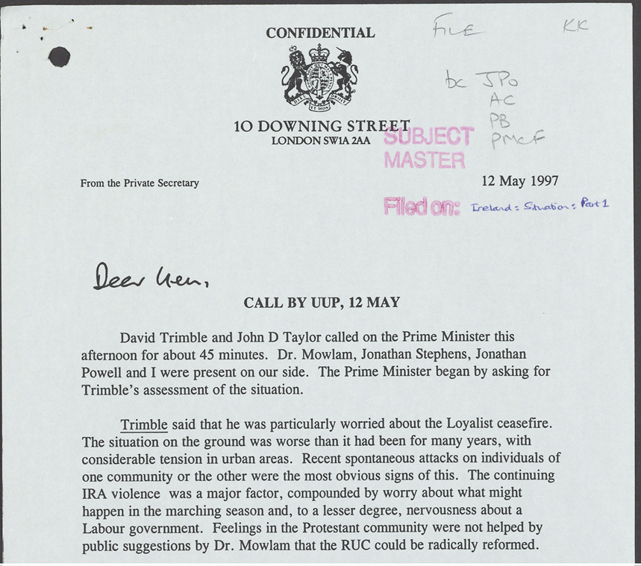
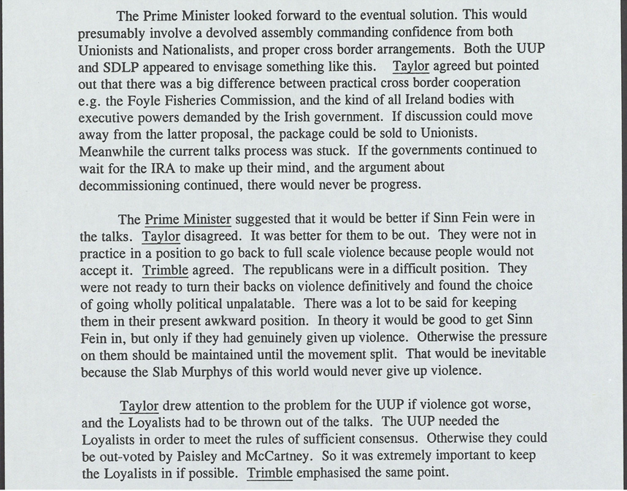
Source 2
Part of a record of a meeting on 12 May 1997 between the UK Prime Minister Tony Blair and David Trimble, leader of the Ulster Unionist Party (UUP) and John Taylor, the Deputy Leader of the UUP.
Notes:
TNA Catalogue Ref: PREM 49/108
Context notes
This document was a record of a meeting between the UK Prime Minister Tony Blair and David Trimble, leader of the Ulster Unionist Party (UUP) and John Taylor, the Deputy Leader of the UUP. Blair had only just won the UK election on May 1st. All sides were anxious to see whether the new government would maintain the same position as the previous Conservative government or whether Blair would take a different approach. At the time all groups were making plans for talks to set up a new government in Northern Ireland which would be based in Northern Ireland and run by representatives elected in elections in Northern Ireland. One of the biggest issues was the inclusion in elections of parties which had not signed up to the principles of The Downing Street Declaration of 1993, which had made clear that a party which did not renounce violence could not be part of any talks. Another point of disagreement was on the issue of cross-border cooperation, which related to the role and degree of influence of the Irish Government in matters affecting Northern Ireland. Ahern refers to Bertie Ahern, leader of the Fianna Fáil party in Ireland. As this meeting was taking place an election was due in Ireland in June and Ahern was expected to win, which he did.
Questions
Content
What were the main concerns of Trimble in his opening summary?
According to Blair, what would the ‘eventual solution’ look like?
What was the attitude of Trimble and Taylor to Sinn Féin?
What else was worrying the UUP?
Inferences from the content
What can be inferred from Blair asking Trimble to summarise the situation?
What can be inferred about Blair’s attitude towards Taylor and Trimble?
Inferences from the context
Can anythg be inferred about the differences between this meeting and the meeting on 7 May (Source1).
Lines of Argument
Which historian could use this document as supporting evidence?

Slide 20
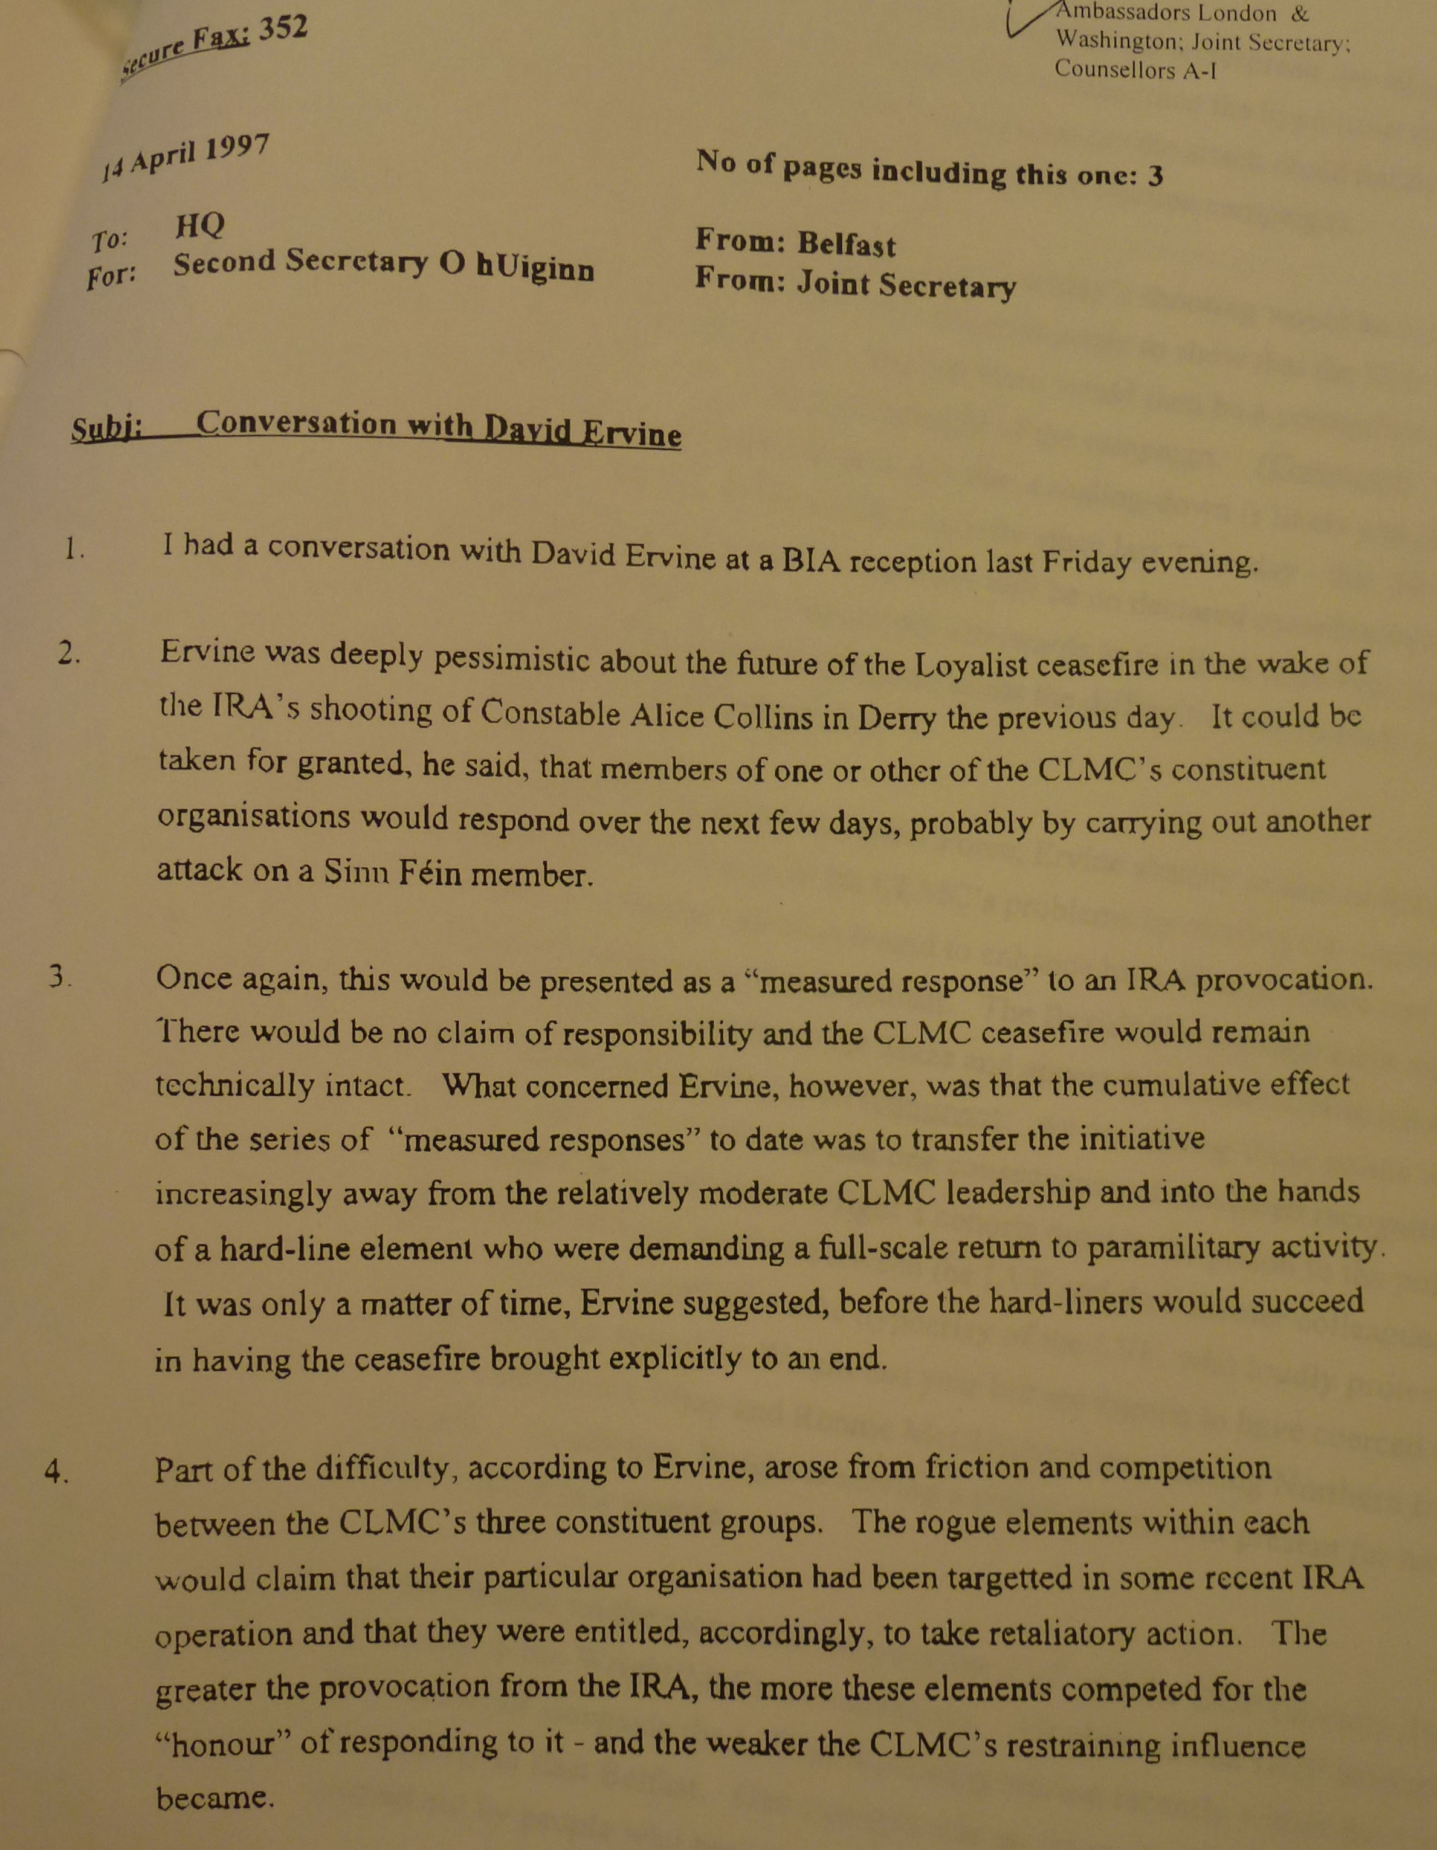
Source 3
Extract from a report written 14 April 1997 by an official to Seán Ó hUiginn, the Joint Secretary of the Anglo-Irish Secretariat in Belfast. It describes a conversation with David Ervine, a former Loyalist paramilitary and member of the Progressive Unionist Party.
Notes:
NAI Catalogue Ref – DFA_2021_53_15 p1 and p2
Context notes
For most of the 1970s, 1980s and early 1990s Loyalist paramilitary organisations had been active in Northern Ireland. They attacked IRA activists, Sinn Féin politicians, other Republican activists but also many who were simply members of the Catholic or Nationalist communities. By the 1990s Loyalist paramilitaries were becoming more active than the Provisional IRA in terms of the number of attacks carried out. However, an important group within the Loyalist paramilitaries favoured an end to conflict by the early 1990s. One of the most important was Gusty Spence of the Ulster Volunteer Force (UVF). Another was David Ervine, also a former paramilitary. Ervine met Spence in prison and was greatly influenced by him. He rejected violence and both Ervine and Spence became key figures in bringing about a Loyalist ceasefire in 1994. Leaders of the paramilitary groups the UVF, the Ulster Defence Association (UDA) and the Red Hand Commando formed an umbrella organisation called the Combined Loyalist Military Command (CLMC). This organisation co-ordinated the actions and statements of Loyalist organisations, although it was always a difficult job to control all of the factions within their respective organisations. Ervine himself went on to be a representative in the Northern Ireland government after the Agreement and was generally very well regarded by other politicians involved in the Peace Process.
Questions
Content
Why was Ervine pessimistic in May 1997?
What were Ervine’s concerns about successive ‘measured responses’?
What difficulty did Ervine identify for the CLMC?
Inferences from the content
What can be inferred about the CLMC’s views and attitudes to the Peace Process?
What can be inferred about the challenges facing the CLMC?
Inferences from the context
Can anything be inferred from the fact that this conversation took place at all?
Lines of Argument
Which historian could use this document as supporting evidence?

Slide 21
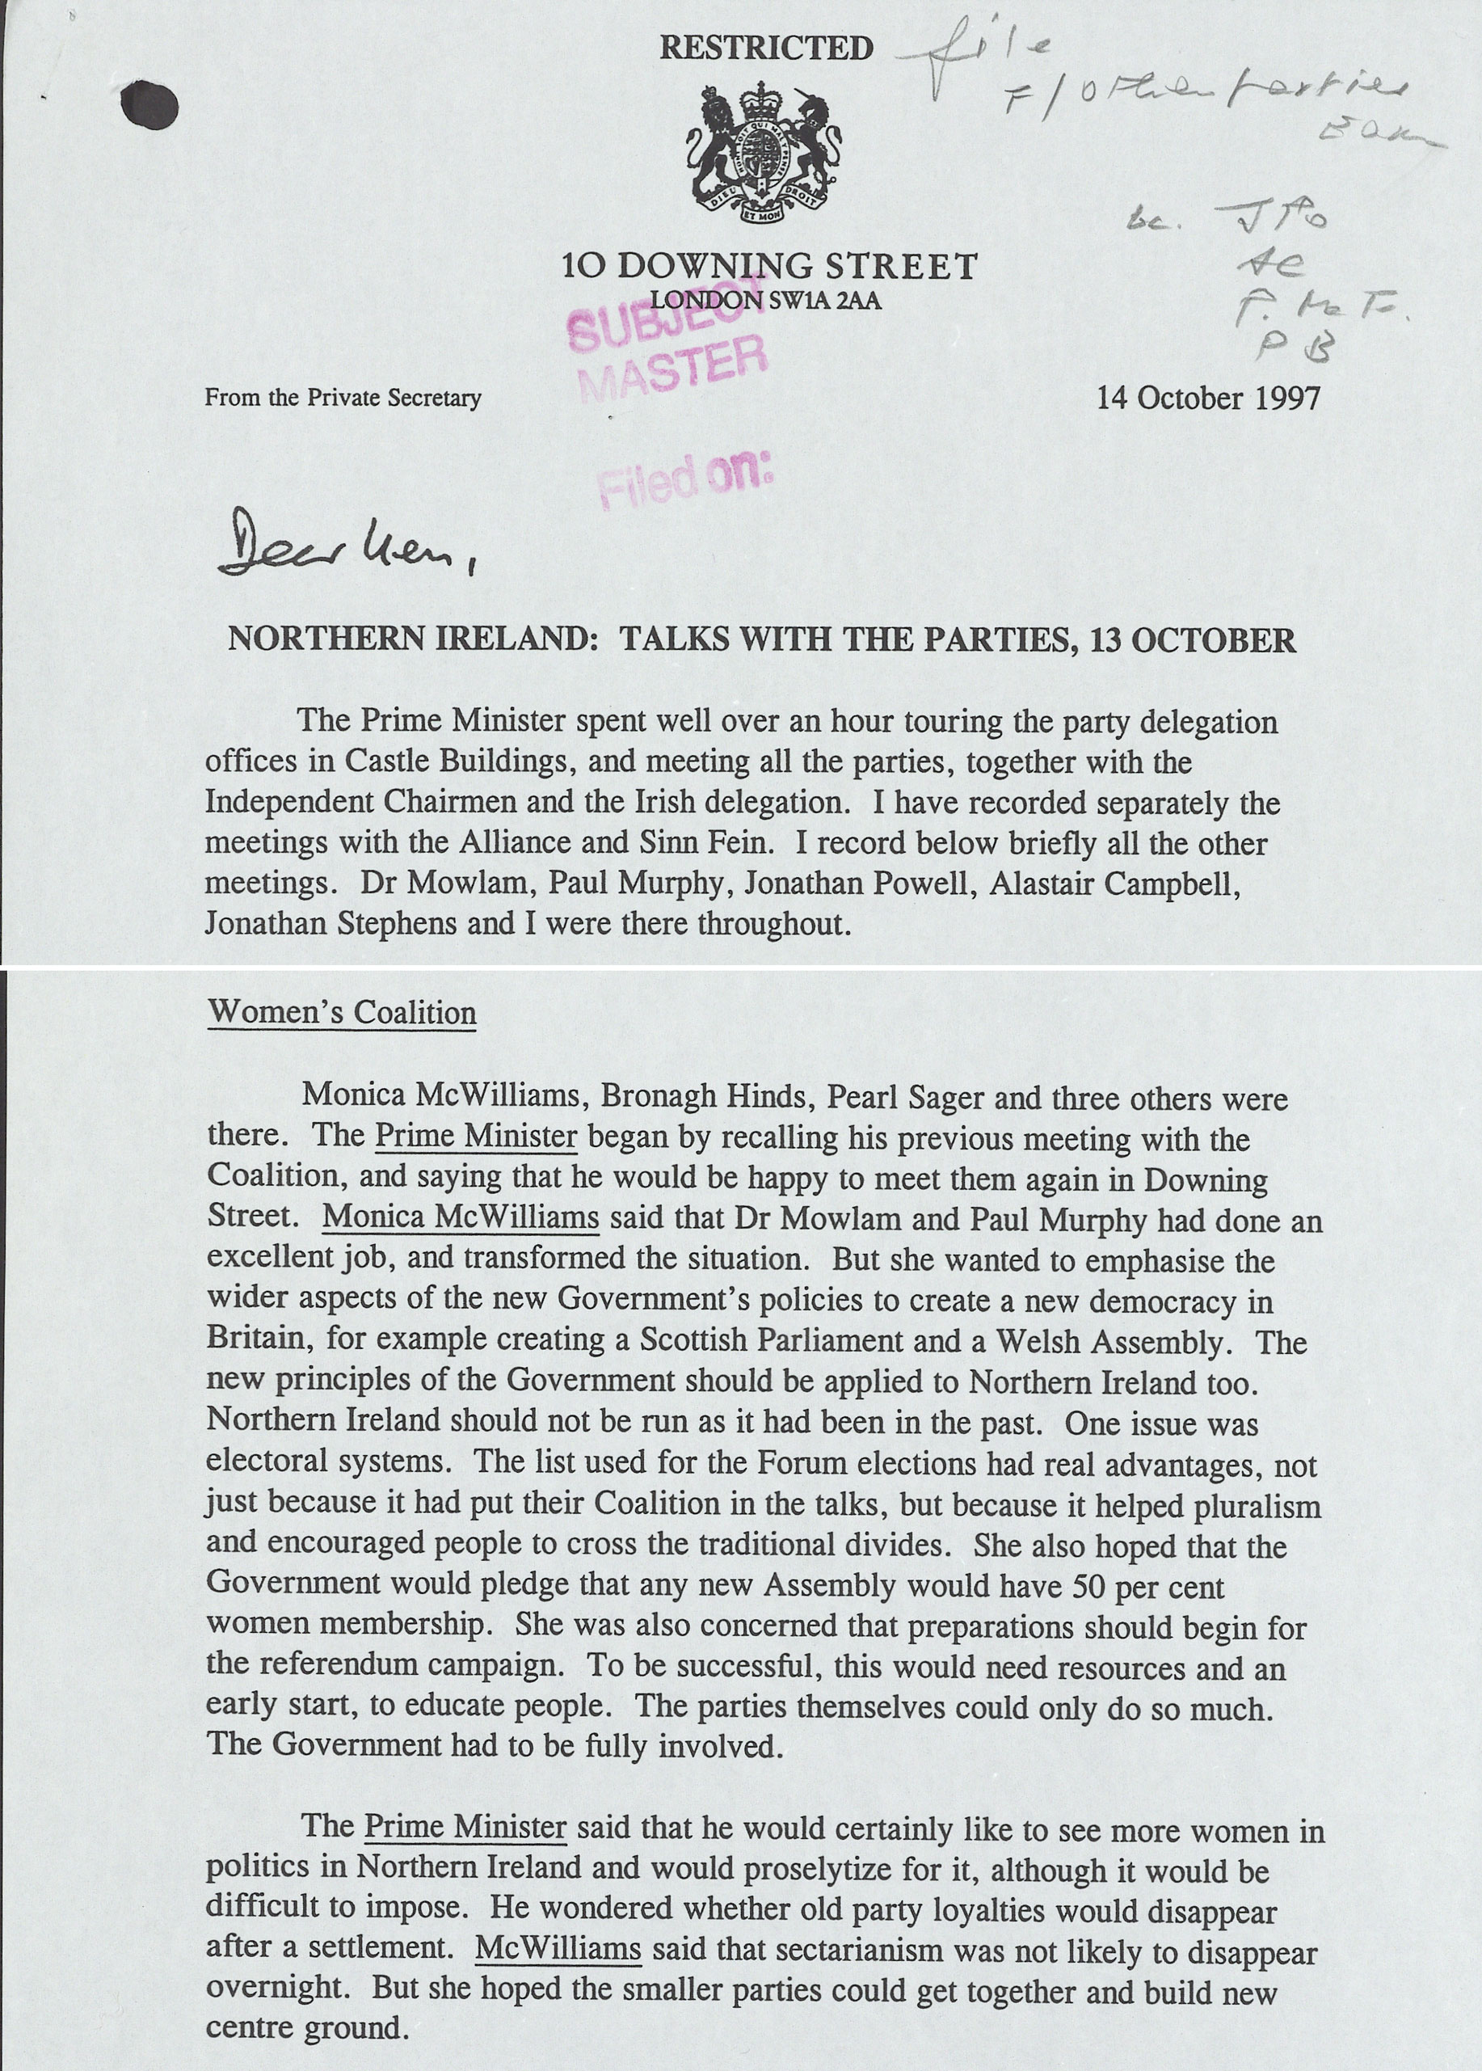
Source 4
Extract from a report summarising talks between the UK government and various political parties and community groups in Northern Ireland, 14 October 1997.
Notes:
TNA Catalogue Ref: PREM 49/119
Context notes
This meeting took place about six months before the final Belfast (Good Friday) Agreement. The Prime Minister and Taoiseach met with all of the Northern Ireland parties. This extract records their discussions with the Northern Ireland Women’s Coalition (NIWC). This was a cross-community party founded in 1996 by a Catholic academic, Monica McWilliams and a Protestant social worker, Pearl Sagar. They did not campaign specifically as a feminist organisation, and they were not Nationalist or Unionist in their aims. The movement principally aimed to try to represent the views of the wider community and not the main political parties or the paramilitary groups.
Questions
Content
Who is talking to whom at this meeting?
What points were made about developments in the rest of the UK outside Northern Ireland?
What were the leaders of the NIWC hoping for?
How did Blair respond to the views of the NIWC leaders?
Inferences from the content
Do you get the impression that the NIWC leaders are optimistic or pessimistic about the peace process?
How would you describe Blair’s attitude towards the NIWC?
Inferences from the context
What inferences can be made from the fact that these talks were taking place?
Is it possible to make any inferences from the fact that this particular group (the NIWC) was involved in the talks?
Lines of Argument
Which historian could use this document as supporting evidence?

Slide 22
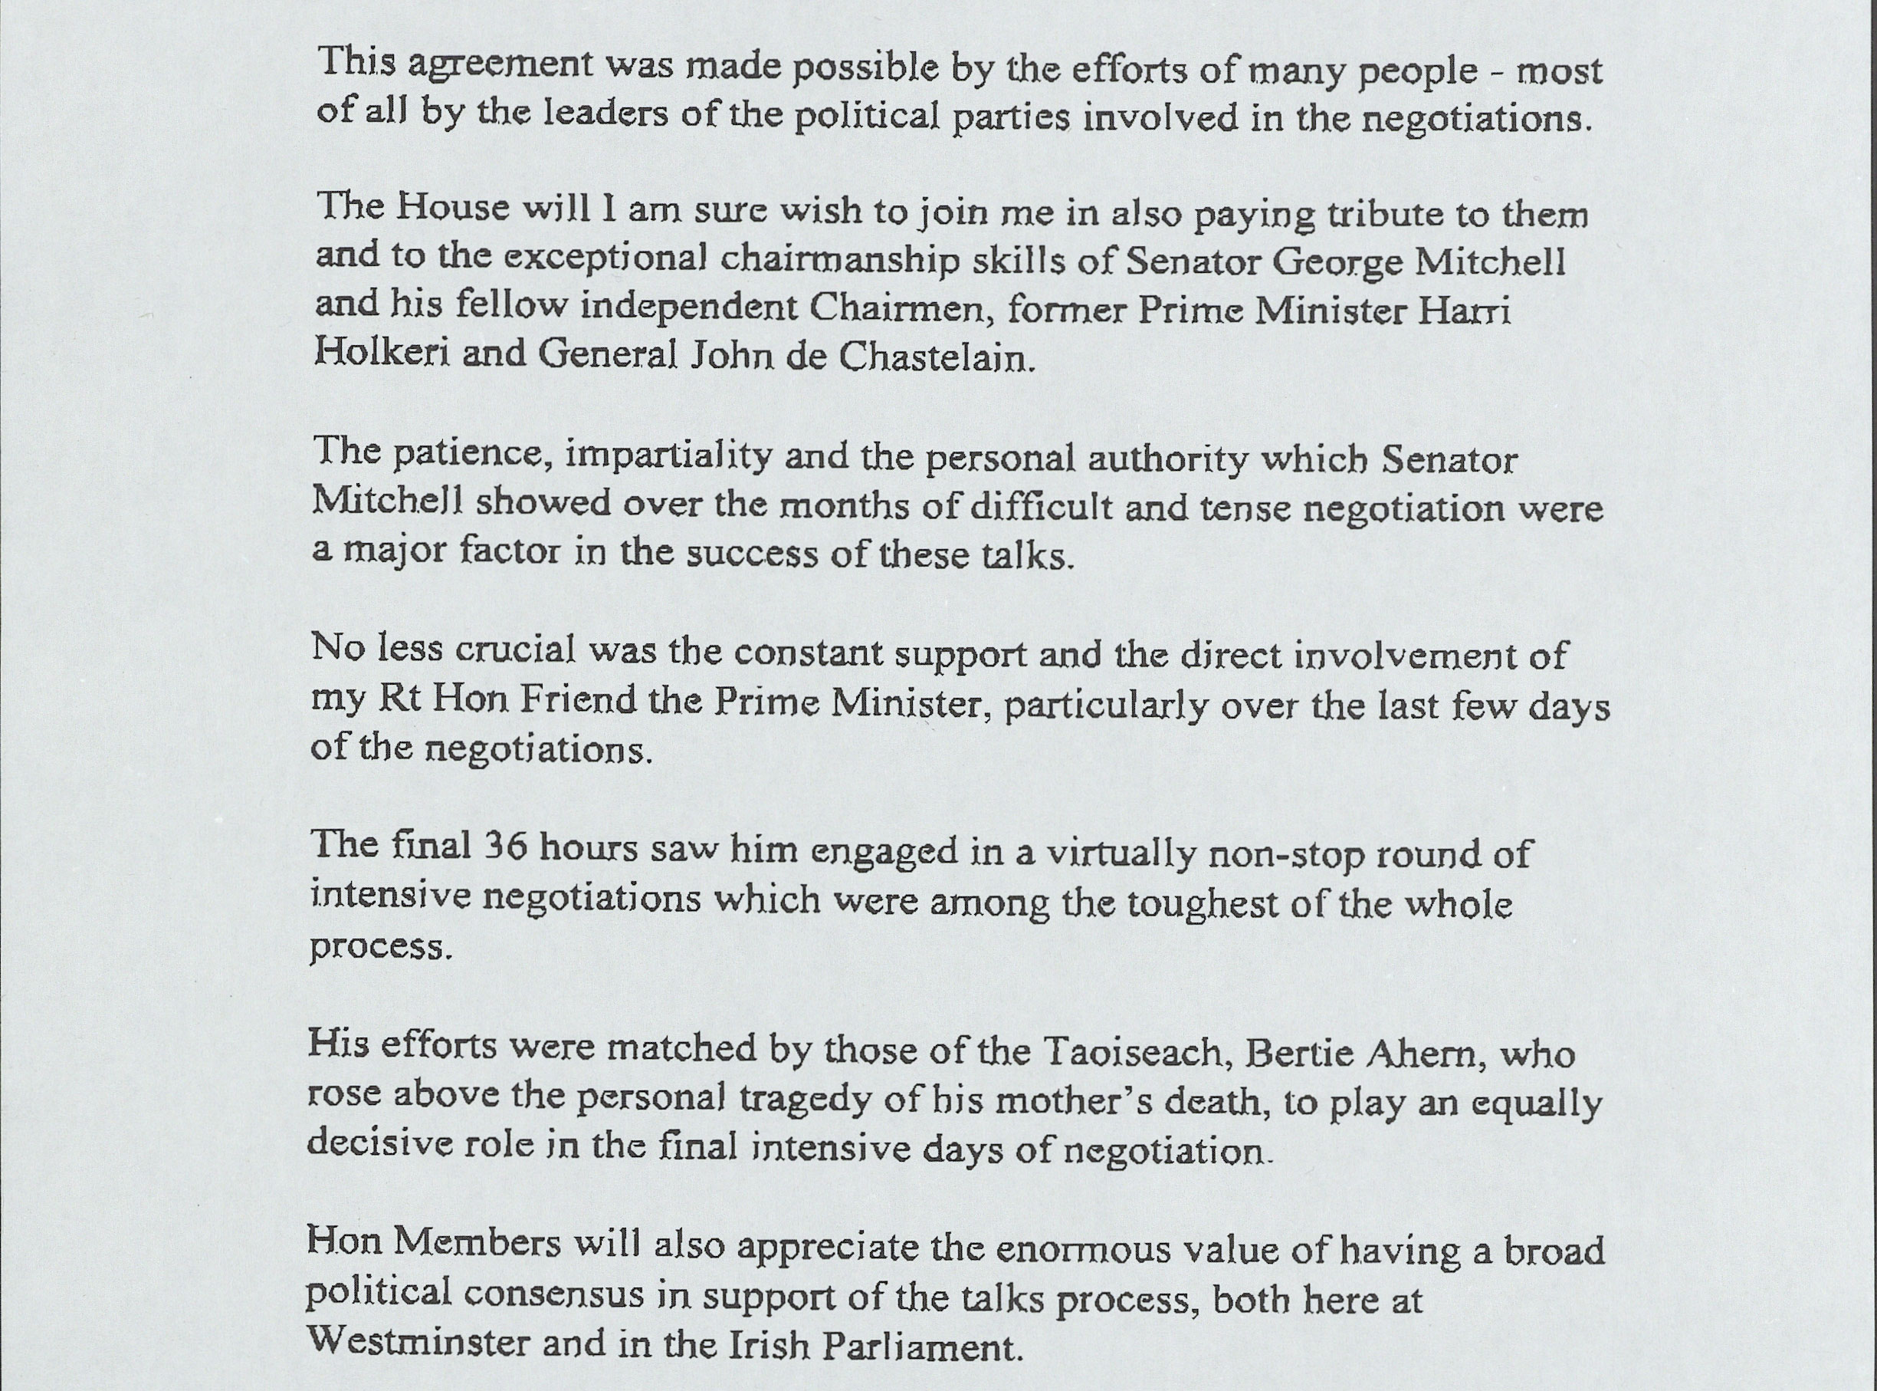
Source 5
Extract from a statement by the UK Secretary of State for Northern Ireland, Dr Mo Mowlam in April 1998.
Notes:
TNA Catalogue Ref: 49/412
Context notes
In 1972 the Northern Ireland Parliament (based at Stormont on the edge of Belfast) was suspended due to the political upheavals in the province. What followed was known as Direct Rule – Northern Ireland was governed directly by the UK Government, and the main responsibility for Northern Ireland lay with the Secretary of State for Northern Ireland. When Labour won the 1997 UK General Election, Dr Marjorie ‘Mo’ Mowlam became the Northern Ireland Secretary. In this document she set out the main terms of the Belfast (Good Friday) Agreement and in this extract gives credit to some of those who made it possible. Senator George Mitchell is an American politician. John de Chastelain is a Canadian diplomat and former army general. Harri Holkeri is a former prime minister of Finland. Tony Blair is the UK Prime Minister. Bertie Ahern is the Taoiseach (Prime Minister) of Ireland.
Questions
Content
Who is given credit by Dr Mowlam in this extract?
Inferences from the content
Would you agree that whether an individual or group is named implies that they played an important role?
Is it possible to infer whether Dr Mowlam thinks any individual or group played a particularly important role?
Inferences from the context
Is it possible to make any inferences from the fact that Dr Mowlam did not name any of the Northern Ireland political parties or their leaders?
Lines of Argument
Which historian could use this document as supporting evidence?

Slide 23
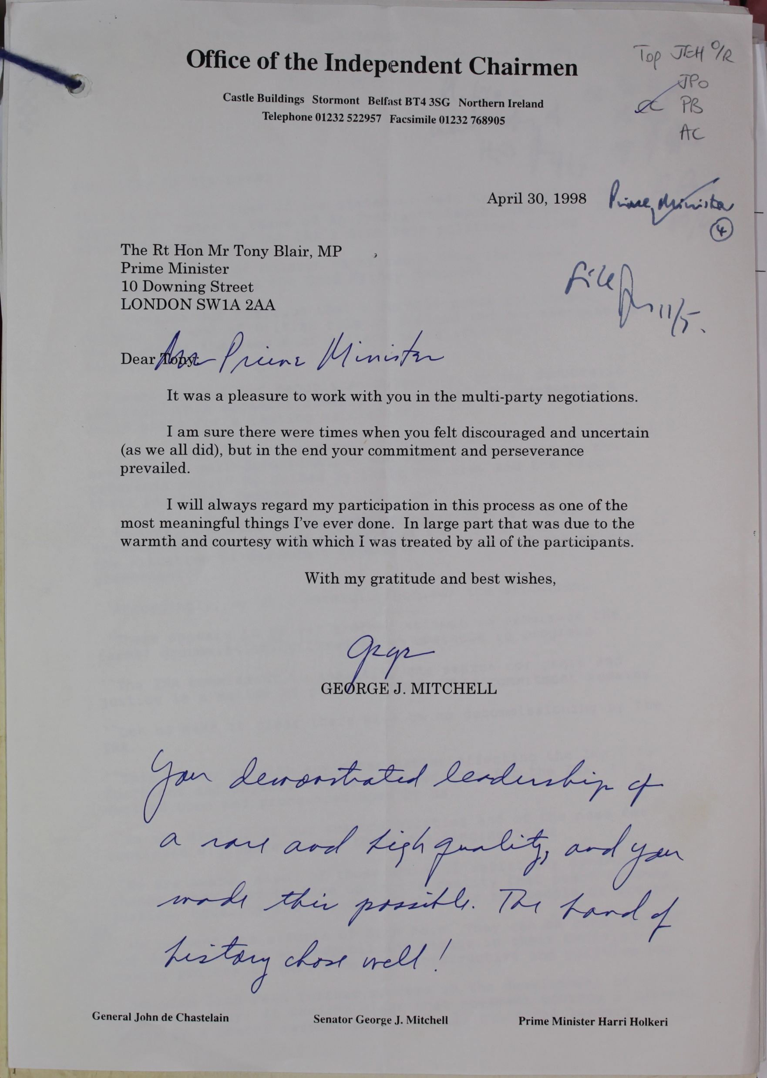
Source 6
A letter from US Senator George Mitchell to UK Prime Minister Tony Blair on 30 April 1998, soon after the signing of the Agreement.
Notes:
TNA Catalogue Ref: PREM 49/412
Context notes
Mitchell was a US Senator who had a deep interest in Northern Ireland. President Clinton appointed him as US Special Envoy in 1995 to to be an independent figure in the Northern Ireland peace process. He became the Co-Chairman of the Northern Ireland Peace Talks, an important figure in the talks which eventually led to the Agreement. His job was to be an independent and impartial individual who could help to resolve disputes. He was best known for his work in negotiating the decommissioning of paramilitary forces. However, he also worked with the political parties, persuading them to accept the Mitchell Principles. These were a set of limits on political parties, the most important of which was that unless they renounced violence they would not have any role in any of the talks or negotiations. The letter was written a few days after the BGFA was agreed.
Questions
Content
What was the main reason for Mitchell writing this letter?
Inferences from the content
What inferences can be made about Mitchell’s views on the negotiations?
What can be inferred about Mitchell’s views of Tony Blair?
Inferences from the context
Can anything be inferred from the timing of this letter?
Lines of Argument
Which historian could use this document as supporting evidence?

Slide 24
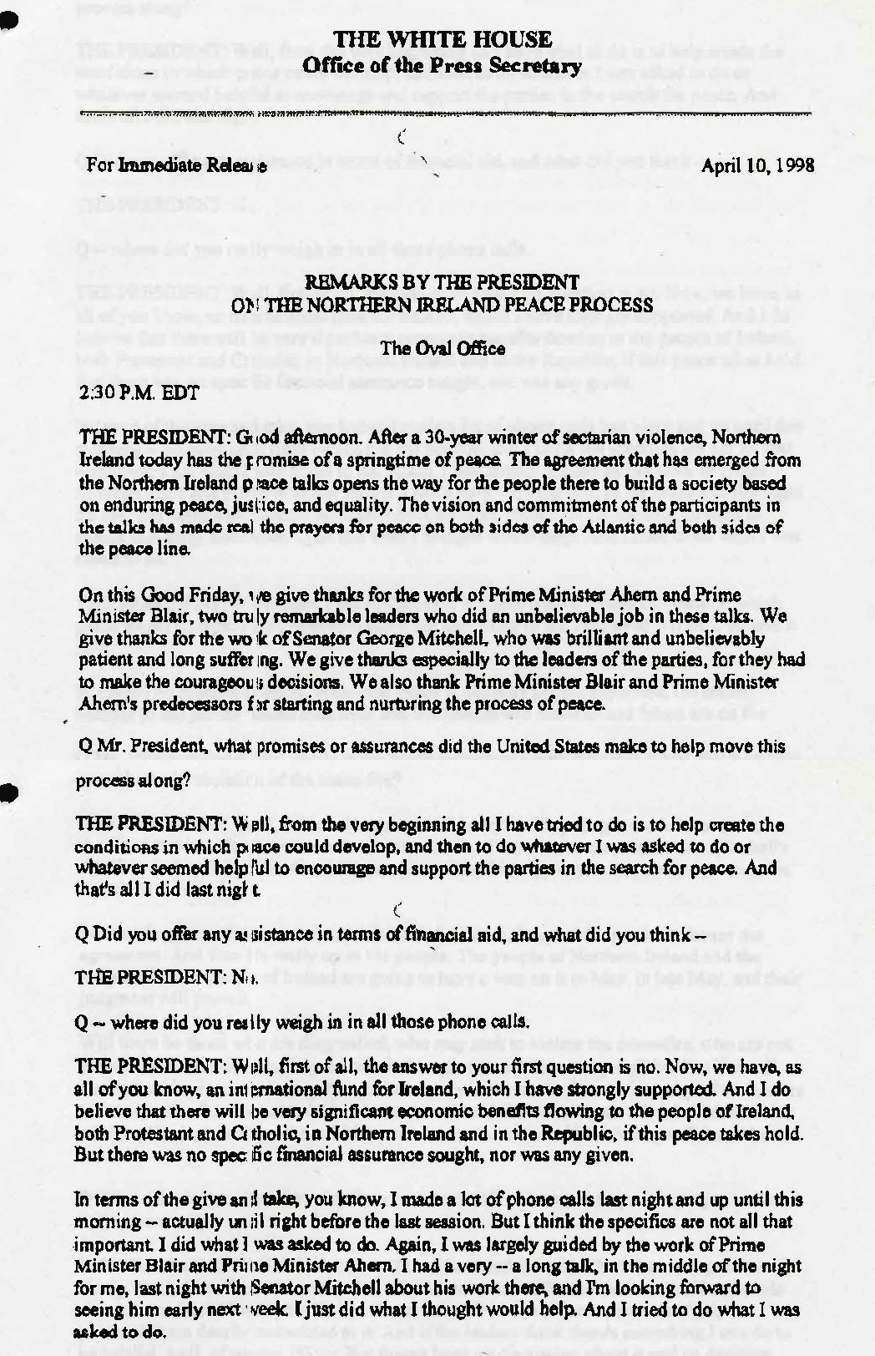
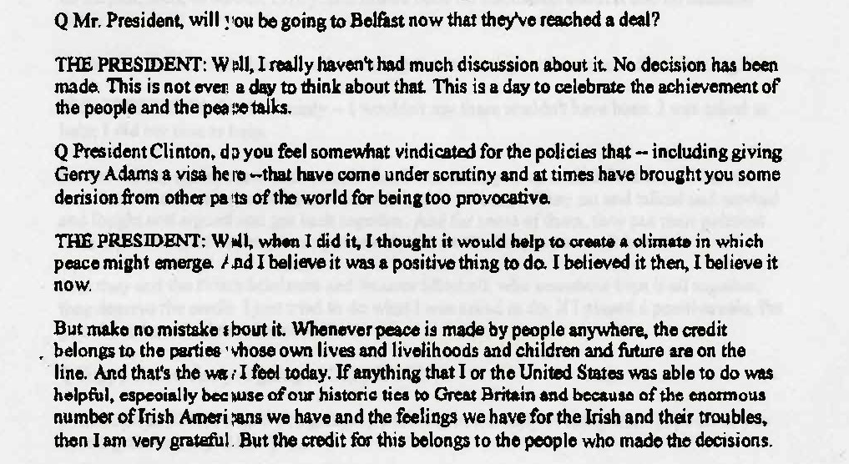
Source 7
Extracts from a Question and Answer session between US President Bill Clinton and US journalists on 13 April 1998.
Notes:
NAI Catalogue Ref: NAI-TAOIS-2021-100-7 1998-04-10
Context notes
The USA had a large population of Irish-Americans, descended from people who had emigrated to the USA since the 1600s. As a result, US Presidents tended to be very interested in the situation in Ireland, particularly Democratic Presidents as the Democratic Party had a large support among Irish-Americans. When he was first elected in 1995, President Clinton was relatively critical of the UK government in Northern Ireland. However, over time his position changed and he worked to support the Peace Process alongside the UK and Irish governments and the political parties in Northern Ireland.
Questions
Content
According to Clinton, who deserves most credit for the Agreement?
What actions did Clinton take to support the Peace Process?
Inferences from the content
Is it reasonable to infer that Clinton's contribution was more one of influence than specific actions?
Inferences from the context
Can anything be inferred from the timing of this statement?
Lines of Argument
Which historian could use this document as supporting evidence?

Slide 25
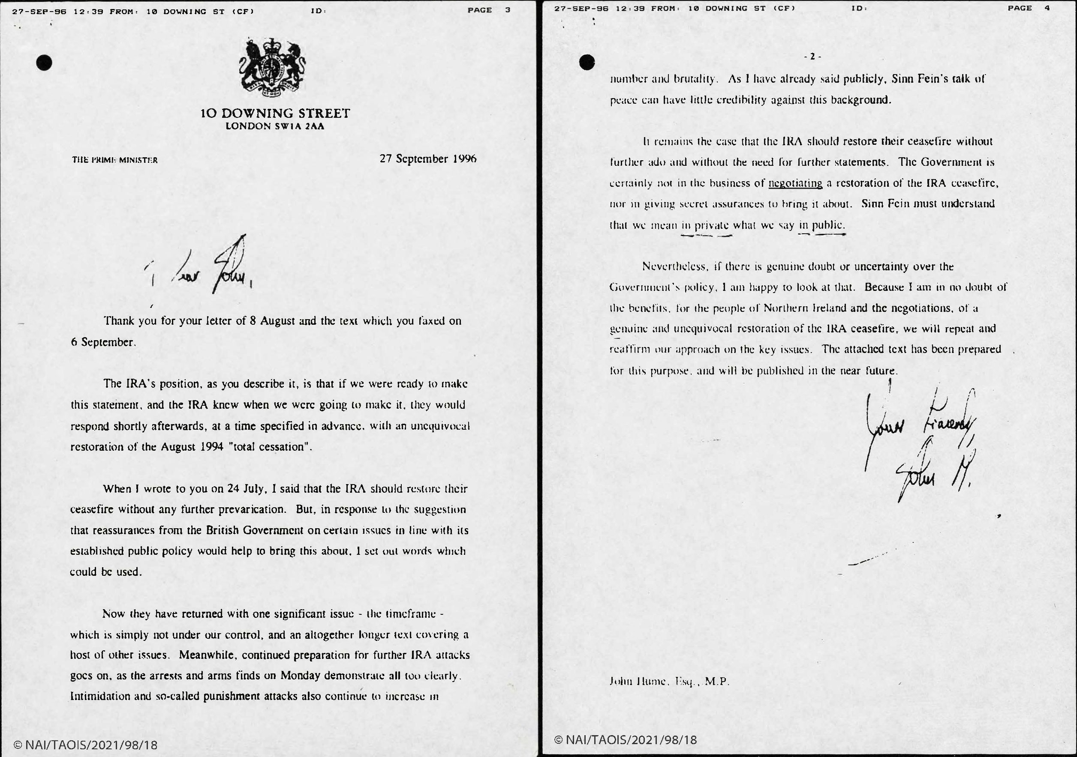
Source 8
A letter from the UK Prime Minister John Major to the SDLP leader John Hume, September 1996.
Notes:
NAI Catalogue Ref: NAI-TAOIS-2021-98-18 1996-09-27
Context notes
One of the key dates in the peace process was the Downing Street Declaration of 1993. In this agreement, the UK and Irish governments enshrined the principle of consent – that Northern Ireland would remain in the United Kingdom unless the majority of the people of Northern Ireland decided otherwise. Another key principle was that only political parties which rejected violence would be included in talks about the future of Northern Ireland. In 1994 the Provisional IRA (PIRA) announced a ceasefire. This helped Sinn Féin to be accepted into discussions. However, the PIRA broke its ceasefire in February 1996. The Social Democratic and Labour Party (SDLP) leader, John Hume, had been in discussions with Sinn Féin leader Gerry Adams through the early 1990s and as this letter suggests, continued to try to encourage communication between Republicans and the UK government.
Questions
Content
According to the letter, what was the IRA’s position?
How did Major respond to the IRA’s position?
What other IRA actions does Major refer to?
Inferences from the content
How would you describe the attitude of Major towards the IRA and Sinn Fein?
Inferences from the context
What can be inferred about the importance of SDLP leader John Hume from this letter?
Lines of Argument
Which historian could use this document as supporting evidence?

Slide 26
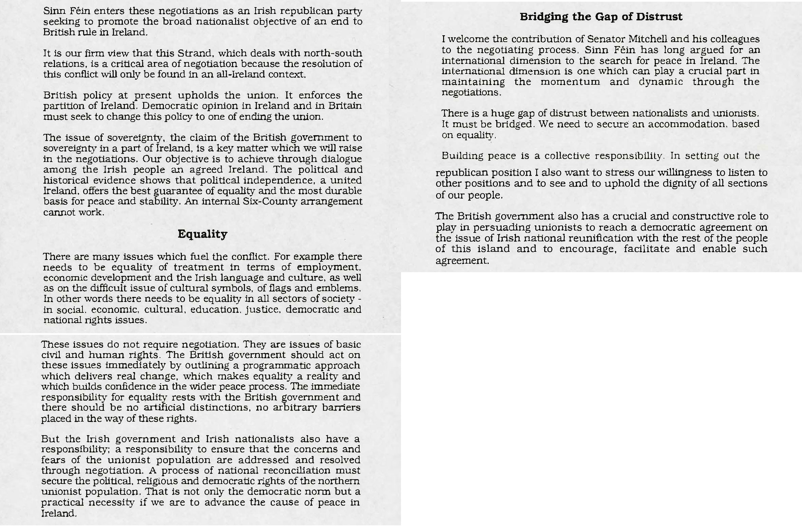
Source 9
Extracts from the opening remarks of Sinn Féin leader Gerry Adams to the first meeting of Northern Ireland parties and the UK and Irish governments in October 1997.
Notes:
NAI Catalogue Ref: NAI-TAOIS-2021-99-23 1997-10-07b
Context notes
When the peace process began there were three main strands of the discussions. Strand One concerned the Northern Ireland Assembly. Strand Two concerned issues within the island of Ireland and relations between the Irish government and Northern Ireland. Strand Three concerned relations between the British and Irish governments. This document sets out the opening comments made by the Sinn Féin leader Gerry Adams at the opening talks on Strand Two. Sinn Féin was a Republican party in Northern Ireland. Unionists and the British government regarded Sinn Féin as the political wing of the Provisional IRA. However, Sinn Féin always denied that there was an official connection.
Questions
Content
What was Sinn Féin’s political position?
How did Adams describe his main objective?
According to Adams, which issues fuel the conflict?
According to Adams, what should the British government do?
What responsibility, according to Adams, do the Nationalists and the Irish government have?
Inferences from the content
How would you describe the general tone of this statement?
How do you think other parties and the two governments might have viewed the statement?
Inferences from the context
Can we infer anything from the fact that the statement is being made at all?
Lines of Argument
Which historian could use this document as supporting evidence?

Slide 27
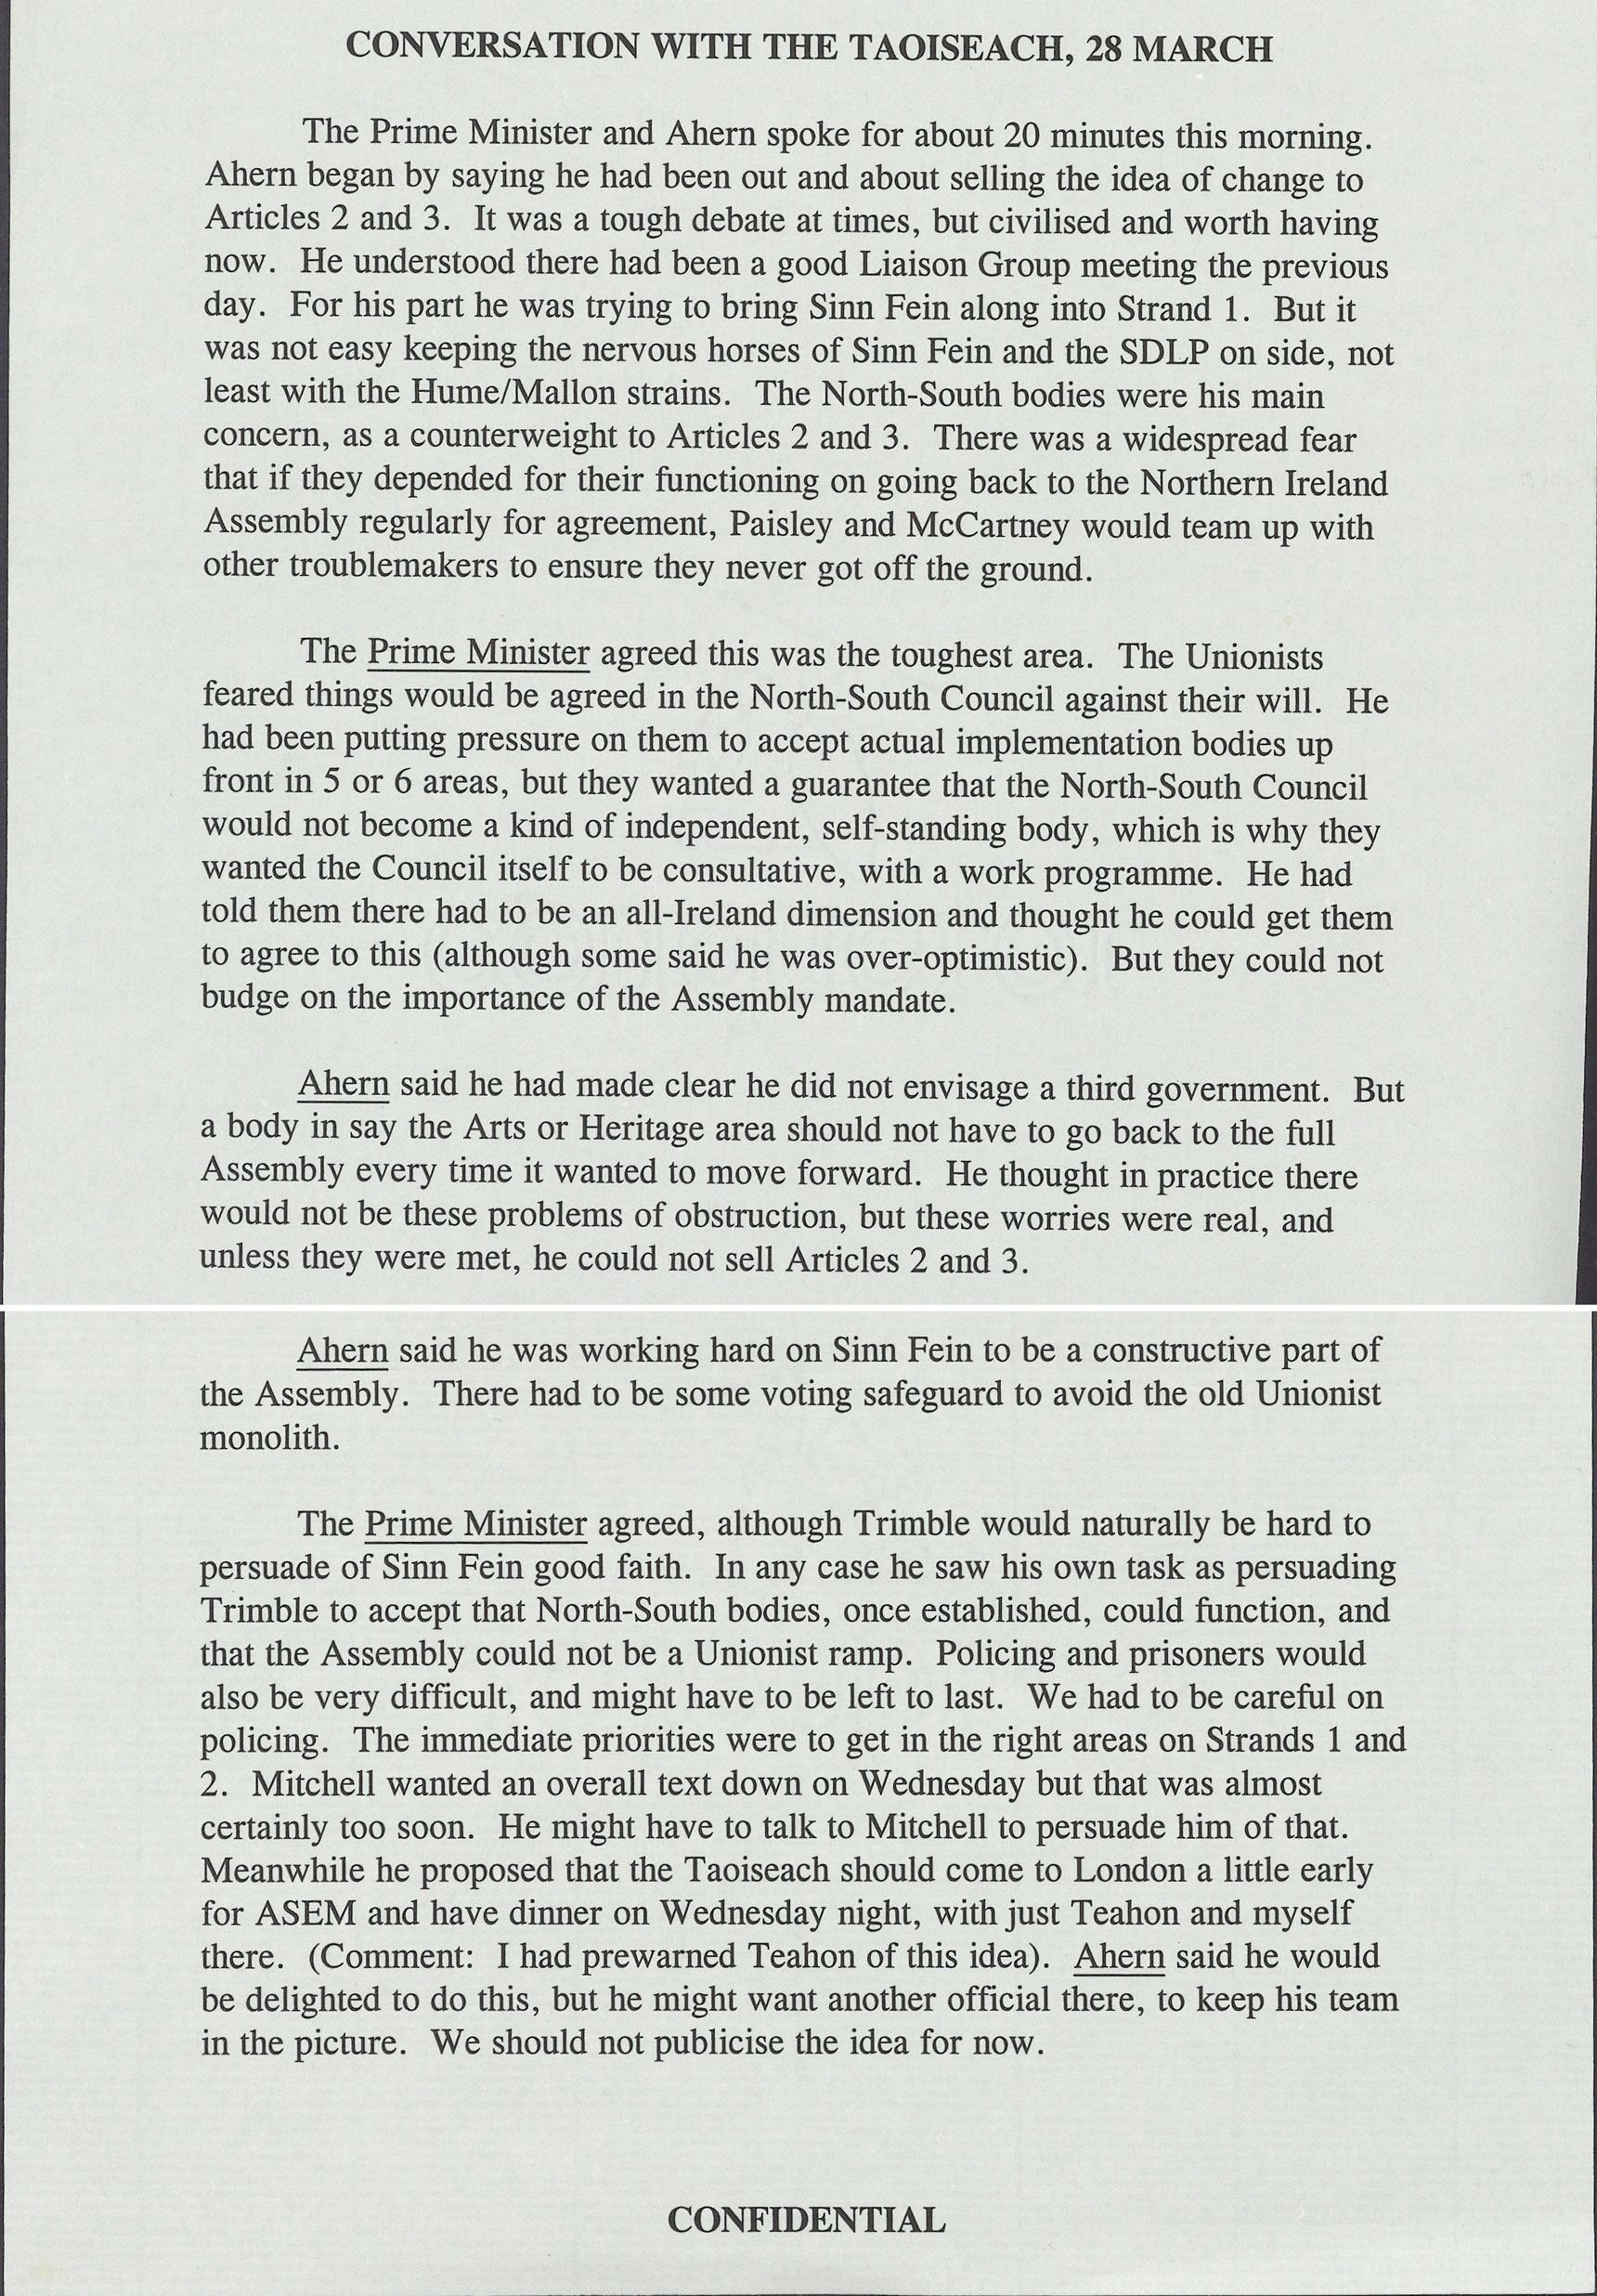
Source 10
Notes from a meeting between the UK Prime Minister Tony Blair and the Taoiseach Bertie Ahern, 28 March 1998.
Notes:
TNA Catalogue Ref: PREM 49/410
Context notes
Blair became Prime Minister in May 1997 and Ahern became Taoiseach in June 1997. The two leaders had a good working relationship which helped the peace process. In this conversation they refer to a number of developments. Strand One was the creation of a new Assembly to govern Northern Ireland. Strand Two concerned relations between the Irish government and Northern Ireland, and the creation of organisations which would have a role in issues which ran across the border between Northern Ireland and Ireland, such as heritage or cultural bodies.
Questions
Content
What was the main concern about the North-South bodies?
Did Ahern and Trimble agree on this issue?
What other activities of Ahern are described in the notes?
Inferences from the content
What can be inferred about Ahern’s influence on Nationalist groups in Northern Ireland?
Inferences from the context
What can be inferred about the relationship between Blair and Ahern from this document?
Lines of Argument
Which historian could use this document as supporting evidence?

